Slide 1
What does the Bible say about the End Times

Slide 2
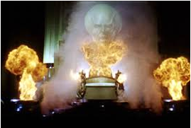

Slide 3
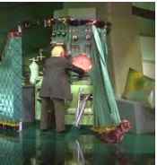

Slide 4
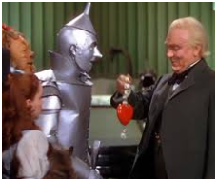

Slide 5
Eschatology
Eschatos = “last”
Logy = “the study of”
Eschatology = the study of last things

Slide 6




Persevere

Slide 7
Table of Contents
Overview
Four General Views to Interpret End Times Prophecy
Three Millennial Views
Five Rapture Views
The Rapture vs. the Second Coming
False Predictions of the Second Coming
Israel vs. the Church
Resurrections
Nebuchadnezzar’s Statue
Daniel’s 70 Weeks
Revelation – A Timeline of Events

Slide 8
Why is studying End Times prophecy important?
1 John 3:2-3
2 Beloved, now we are children of God, and it has not appeared as yet what we will be. We know that when He appears, we will be like Him, because we will see Him just as He is. 3 And everyone who has this hope fixed on Him purifies himself, just as He is pure.

Slide 9
Colossians 3:1-5
Therefore if you have been raised up with Christ, keep seeking the things above, where Christ is, seated at the right hand of God. 2 Set your mind on the things above, not on the things that are on Earth.
3 For you have died and your life is hidden with Christ in God. 4 When Christ, who is our life, is revealed, then you also will be revealed with Him in glory.
5 Therefore consider the members of your earthly body as dead to immorality, impurity, passion, evil desire, and greed, which amounts to idolatry.

Slide 10
Prophecy Facts
There are 66 books in the Bible; 62 contain prophecy.
Ruth
Song of Solomon
Philemon
3 John
27% of all verses are prophetic
Jesus’ Second Coming is mentioned 1,845 (OT) + 318 (NT) = 2,163

Slide 11
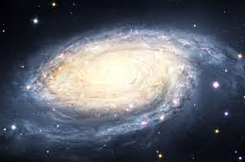
Start our View from High Up

Slide 12
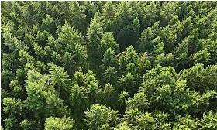
Maybe more from this high

Slide 13
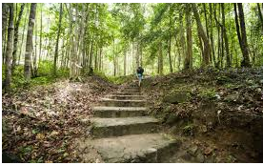
Then get a little more detailed

Slide 14
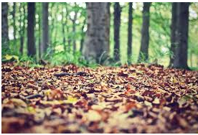
Then into the down and leafy

Slide 15
Quick Terminology
Tribulation: This is a time of disaster and judgment.
Antichrist: This is a human ruler who severely persecutes Christians during the Tribulation.
Second Coming: This is when Jesus Himself or His judgment comes to the Earth. This usually follows the Tribulation.
Millennium: This is a long time of peace. It generally follows the Second Coming.

Slide 16
Quick Terminology (continued)
New heavens and new earth: A recreation of the existing universe. The last event before eternity starts.
Seven Seals, seven Trumpets, seven Bowls or Vials: A series of catastrophic events that occur during the Tribulation.

Slide 17
Four Views to Interpret End Times Prophecy
Preterist
The word “preterism” means “past.” These proponents believe that all or most of End Times prophecies have already taken place.
Full
Partial

Slide 18
Full Preterist
Matthew 16:28
“Truly I say to you, there are some of those who are standing here who will not taste death until they see the Son of Man coming in His kingdom”
Matthew 24:24 which is immediately after Jesus talking about His Second Coming
“Truly I say to you, this generation will not pass away until all these things take place.”

Slide 19
Partial Preterist
Partial preterists believe that most End Times prophecies have already occurred but that the final three chapters of Revelation (20-22) are future events and that Jesus will come to the Earth at the Second Coming.

Slide 20
Historicism
This is somewhat similar to preterism in that the events are already fulfilled—historical—but stretches out over thousands of years rather than being done by 70 AD.
Revelation chapters 4-7 will fulfilled in the fall of the Roman Empire.
Chapters 8-10 is when the Roman Empire was invaded by the Vandals, Huns, Saracens, and Turks.
Chapters 11-13 is the true church’s conflict with Roman Catholicism.
Chapters 14-19 are God’s judgment on and overthrow of the Catholic Church.

Slide 21
Futurism
Revelation 1:19
“Therefore write the things which you have seen, and the things which are, and the things which will take place after these things.”
Revelation chapter 1 is “things which you have seen”
Chapters 2-3 as “things which are”
Chapters 4 - 22 as “things which will take place after these things.”

Slide 22
Idealism
Everything is symbolic or an allegory.
There is no historical fulfillment.

Slide 23
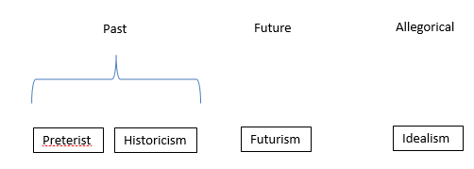
Summary

Slide 24
Three Millennial Views
Revelation 20:5-7
⁵ The rest of the dead did not come to life until the thousand years were completed. This is the first resurrection.
⁶ Blessed and holy is the one who has a part in the first resurrection; over these the second death has no power, but they will be priests of God and of Christ and will reign with Him for a thousand years.
⁷ When the thousand years are completed, Satan will be released from his prison,

Slide 25
Three Millennial Views (continued)
Amillennialism
Postmillennialism
Premillennialism

Slide 26

Amillennialism
Literally means “no millennium.” There is no literal 1,000-year millennium. “Millennium” in this case simply means “a long time.” The millennium is the time period between Jesus’ first and second Comings.

Slide 27
Amillennialism Summary
We are currently in the Millennium
The Millennium is an indefinite time period of, at least, nearly 2,000 years
The church inherited all of Israel’s promises because of Israel’s disobedience and rejection of the true Messiah and so is known as spiritual Israel
The world will get worse and worse
There is no literal seven-year Tribulation
The Second Coming will happen just as the world’s condition becomes intolerable which is analogous with Noah and the Flood
All of the final remaining major events will occur together at the Second Coming: the Rapture, Resurrections, and God’s final judgment

Slide 28
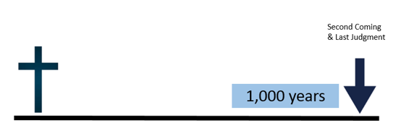
Postmillennialism
As a result of the Gospel and the efforts of the church, the world will become better and better eventually ushering in a literal 1,000 year Golden Age of peace and prosperity. At the end of these 1,000 years Jesus will return.

Slide 29
Postmillennialism Summary
The Tribulation occurred around the time of Jerusalem’s destruction in 70 AD and involved only the Jews
The church will become increasingly successful throughout the world
There will be or already has started a 1,000 year Golden Age at which the world would be Christianized
During this Golden Age there will be peace and prosperity
Some post-millennialists believe that at the end of the 1,000 years there will be a small apostasy and then will be the Second Coming, however, the majority do not believe this
The church inherited all of Israel’s promises because of Israel’s disobedience and rejection of the true Messiah and so is known as spiritual Israel
All of the final remaining major events will occur together at the Second Coming: the Rapture, Resurrections, and God’s final judgment

Slide 30
Postmillennialism Problem
Matthew 24:6-12
6 You will be hearing of wars and rumors of wars. See that you are not frightened, for those things must take place, but that is not yet the end. 7 For nation will rise against nation, and kingdom against kingdom, and in various places there will be famines and earthquakes. 8 But all these things are merely the beginning of birth pangs. 9 Then they will deliver you to tribulation, and will kill you, and you will be hated by all nations because of My name. 10 At that time many will fall away and will betray one another and hate one another. 11 Many false prophets will arise and will mislead many. 12 Because lawlessness is increased, most people’s love will grow cold.

Slide 31
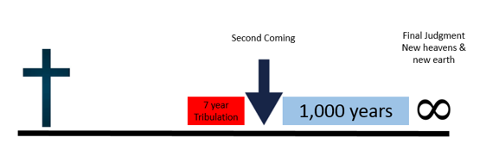
Premillennialism
All End Times prophecies are future. There will be a seven-year Tribulation period at the end of which will be Jesus’ Second Coming and Satan will be bound. Jesus will return literally and physically to the Earth before the literal 1,000 year Millennium, and He will reign on the Earth for 1,000 years.

Slide 32
Premillennialism Summary
All End Times events are future
There will be a seven-year Tribulation
There will be an actual Rapture that will occur either at the beginning, during, or at the end of the Tribulation depending on your interpretation
Jesus will physically return to the Earth and will reign from Jerusalem
There will be a literal 1,000 year Millennium during which Satan will be bound
At the end of the 1,000 years Satan will be loosed and lead a rebellion against God
Satan will be defeated
There will be a new heavens and new earth
Israel will fulfill its own promises and not the church

Slide 33
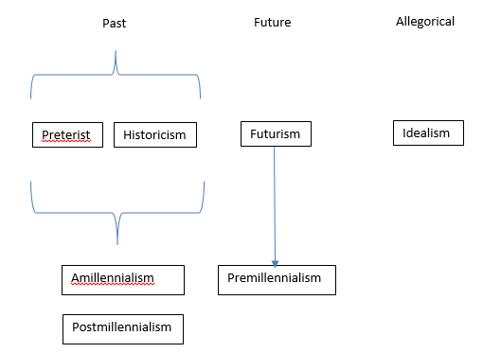
Millennialism Conclusion

Slide 34
Rapture
“Rapture” means “to be caught up” or “to carry off.”

Slide 35
Order of the Rapture
Jesus will leave Heaven
Jesus will shout. This is a military expression and indicates that a command is being given. Strong’s Greek defines it as “an arousing outcry.” Another defines the Greek as “a mutual cheer.”
There will be a voice of an archangel
A trumpet sound
Jesus will come down to the Earth but only as far as the sky so He will not actually touch the Earth
Christians (those who have been saved from Pentecost on) who are already dead will rise first and meet Jesus in the clouds
Then living Christians will rise and meet Jesus and the risen dead Christians in the clouds
All will return to Heaven
At some point in Heaven these believers will celebrate the Marriage Feast of the Lamb (Revelation 19:17-18)

Slide 36
Five Rapture Theories
Pre-Tribulation Rapture
Partial Rapture
Mid-Tribulation Rapture
Pre-Wrath Rapture
Post-Tribulation Rapture

Slide 37
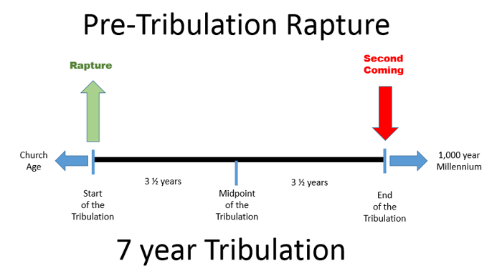
Pre-Tribulation Rapture

Slide 38
Scripture for Pre-Tribulational Rapture
1 Thessalonians 1:10
“and to wait for His Son from heaven, whom He raised from the dead, that is Jesus, who rescues us from the wrath to come.”
Revelation 6:17
“for the great day of their wrath has come, and who is able to stand?”

Slide 39
1 Thessalonians 5:1-11
Now as to the times and the epochs, brethren, you have no need of anything to be written to you. 2 For you yourselves know full well that the day of the Lord will come just like a thief in the night. 3 While they are saying, “Peace and safety!” then destruction will come upon them suddenly like labor pains upon a woman with child, and they will not escape. 4 But you, brethren, are not in darkness, that the day would overtake you like a thief; 5 for you are all sons of light and sons of day. We are not of night nor of darkness; 6 so then let us not sleep as others do, but let us be alert and sober. 7 For those who sleep do their sleeping at night, and those who get drunk get drunk at night. 8 But since we are of the day, let us be sober, having put on the breastplate of faith and love, and as a helmet, the hope of salvation. 9 For God has not destined us for wrath, but for obtaining salvation through our Lord Jesus Christ, 10 who died for us, so that whether we are awake or asleep, we will live together with Him. 11 Therefore encourage one another and build up one another, just as you also are doing.

Slide 40
Revelation 3:10
“Because you have kept the word of My perseverance, I also will keep you from the hour of testing, that hour which is about to come upon the whole world, to test those who dwell on the earth.”

Slide 41
2 Thessalonians 2:1-7
Now we request you, brethren, with regard to the coming of our Lord Jesus Christ and our gathering together to Him, 2 that you not be quickly shaken from your composure or be disturbed either by a spirit or a message or a letter as if from us, to the effect that the day of the Lord has come. 3 Let no one in any way deceive you, for it will not come unless the apostasy comes first, and the man of lawlessness is revealed, the son of destruction, 4 who opposes and exalts himself above every so-called god or object of worship, so that he takes his seat in the temple of God, displaying himself as being God. 5 Do you not remember that while I was still with you, I was telling you these things? 6 And you know what restrains him now, so that in his time he will be revealed. 7 For the mystery of lawlessness is already at work; only he who now restrains will do so until he is taken out of the way.

Slide 42
The antichrist is already in power before the Tribulation which makes sense since it is unlikely that he would go from someone with no political power to ruler of the world in such a short time.
But the antichrist is being restrained by the church from putting his evil plans into action.
The Holy Spirit dwells with believers in the church.
When the church is Raptured the Holy Spirit, in a sense, goes with it and is gone from the Earth.
The antichrist is no longer restrained.
The antichrist then sets in motion his evil plans and that is the start of the Tribulation.
Therefore, the Rapture of the church occurs that the start of the Tribulation.

Slide 43
Revelation 4:4
“Around the throne were twenty-four thrones; and upon the thrones I saw twenty-four elders sitting, clothed in white garments, and golden crowns on their heads.”

Slide 44
The Judgment Seat of Christ
2 Corinthians 5:10
“For we must all appear before the judgment seat of Christ, so that each one may be recompensed for his deeds in the body, according to what he has done, whether good or bad.”

Slide 45
Bema seat
“judgment seat” is the translation of the one Greek word “bema.”
Matthew 27:19
“While he [Pilate] was sitting on the judgment seat, his wife sent him a message, saying, ‘Have nothing to do with that righteous Man; for last night I suffered greatly in a dream because of Him.’”
John 19:13
“Therefore when Pilate heard these words, he brought Jesus out, and sat down on the judgment seat at a place called The Pavement, but in Hebrew, Gabbatha.”

Slide 46
2 Timothy 2:5
“Also if anyone competes as an athlete, he does not win the prize unless he competes according to the rules.”

Slide 47
Luke 14:14b
“for you will be repaid at the resurrection of the righteous.”

Slide 48
Revelation 19
8 “It was given to her to clothe herself in fine linen, bright and clean; for the fine linen is the righteous acts of the saints,”

Slide 49
Sequence of Events at the Rapture
The church is removed from the Earth
We enter into Heaven
We appear before the judgment seat of Christ
We receive our rewards

Slide 50
Imminent Return of Jesus
That Jesus can return at any time.
There are no signs or events required to the Rapture
Matthew 24:42, “Therefore be on the alert, for you do not know which day your Lord is coming.”
Matthew 24:44, “For this reason you also must be ready; for the Son of Man is coming at an hour when you do not think He will.”
Mark 13:33, “Take heed, keep on the alert; for you do not know when the appointed time will come.”

Slide 51
1 Thessalonians 5:2
“For you yourselves know full well that the day of the Lord will come just like a thief in the night.”

Slide 52
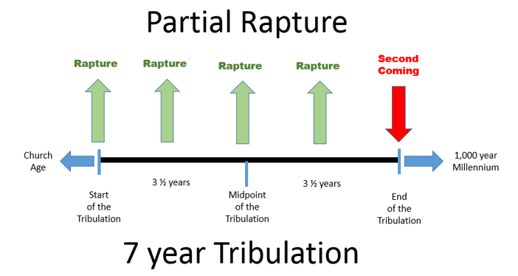
Partial Rapture

Slide 53
Scripture for Partial Rapture
Matthew 24:40-41
“Then there will be two men in the field; one will be taken and one will be left. 41 Two women will be grinding at the mill; one will be taken and one will be left.”
Luke 20:35
“but those who are considered worthy to attain to that age and the resurrection from the dead, neither marry nor are given in marriage”

Slide 54
1 Thessalonians 5:6
“so then let us not sleep as others do, but let us be alert and sober.”
2 Timothy 4:8
“in the future there is laid up for me the crown of righteousness, which the Lord, the righteous Judge, will award to me on that day; and not only to me, but also to all who have loved His appearing.”

Slide 55
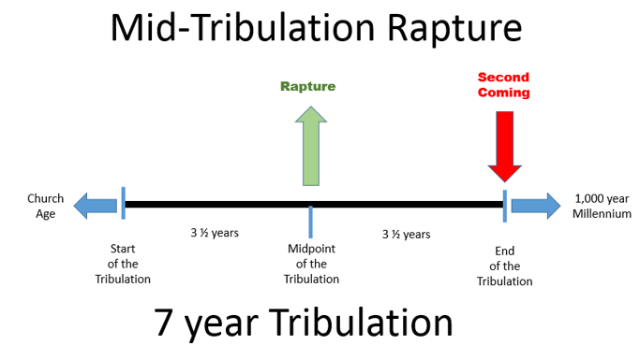
Mid-Tribulation Rapture

Slide 56
Scripture for Mid-Tribulation Rapture
Revelation 11:15a
“Then the seventh angel sounded”
1 Corinthians 15:51-52
“Behold, I tell you a mystery; we will not all sleep, but we will all be changed, 52 in a moment, in the twinkling of an eye, at the last trumpet; for the trumpet will sound, and the dead will be raised imperishable, and we will be changed.”

Slide 57
Daniel 7:25
“He will speak out against the Most High and wear down the saints of the Highest One, and he will intend to make alterations in times and in law; and they will be given into his hand for a time, times, and half a time.”

Slide 58
Revelation 11:11-12
“But after the three and a half days, the breath of life from God came into them, and they stood on their feet; and great fear fell upon those who were watching them. 12 And they heard a loud voice from heaven saying to them, ‘Come up here.’ Then they went up into heaven in the cloud, and their enemies watched them.”

Slide 59
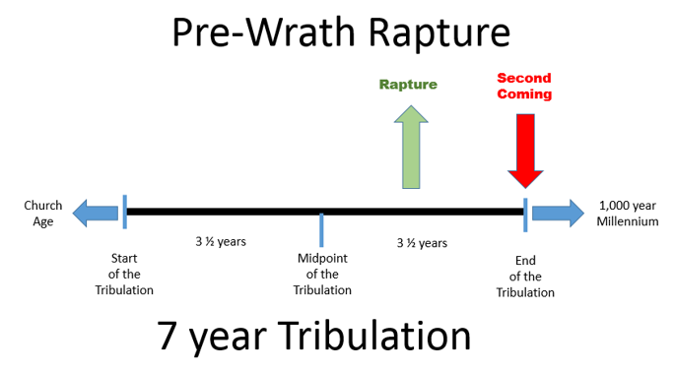
Pre-Wrath Rapture

Slide 60
The Tribulation is Divided into Three Parts
The Tribulation which is the first 3 ½ years which is the beginning of birth pangs (Matthew 24:8).
The Great Tribulation which is the next 2 ½ years.
The Day of the Lord which is the final 1 year and which is the final judgments.

Slide 61
Scripture for Pre-Wrath Rapture
Matthew 24:22
“Unless those days had been cut short, no life would have been saved; but for the sake of the elect those days will be cut short.”

Slide 62
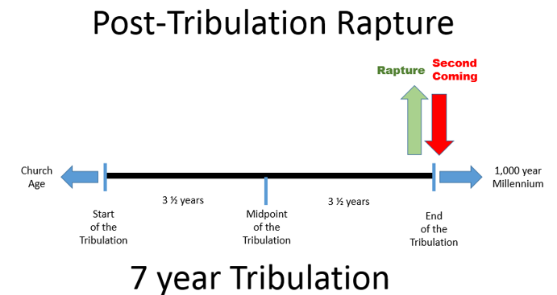
Post-Tribulation Rapture

Slide 63
Events for a Post-Tribulation Rapture
Jesus leaves Heaven with a shout, the voice of an angel, and a trumpet sound (1 Thessalonians 4:16-18)
As He is coming towards the Earth the Rapture occurs
The Raptured church meets Jesus in the air and is given glorified bodies
The church then turns around and follows Jesus back to the Earth for the Second Coming

Slide 64
Scripture for Post-Tribulation Rapture
Matthew 24:29-31
29 “But immediately after the tribulation of those days the sun will be darkened, and the moon will not give its light, and the stars will fall from the sky, and the powers of the heavens will be shaken. 30 And then the sign of the Son of Man will appear in the sky, and then all the tribes of the earth will mourn, and they will see the Son of Man coming on the clouds of the sky with power and great glory. 31 And He will send forth His angels with a great trumpet and they will gather together His elect from the four winds, from one end of the sky to the other.”

Slide 65
Daniel 12:1-2
“Now at that time Michael, the great prince who stands guard over the sons of your people, will arise. And there will be a time of distress such as never occurred since there was a nation until that time; and at that time your people, everyone who is found written in the book, will be rescued. 2 Many of those who sleep in the dust of the ground will awake, these to everlasting life, but the others to disgrace and everlasting contempt.”

Slide 66
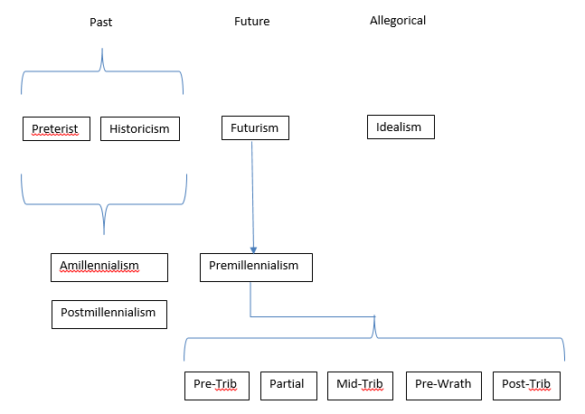
Rapture Summary

Slide 67
Rapture Passages
1 Thessalonians 4:13-18
13 But we do not want you to be uninformed, brethren, about those who are asleep, so that you will not grieve as do the rest who have no hope. 14 For if we believe that Jesus died and rose again, even so God will bring with Him those who have fallen asleep in Jesus. 15 For this we say to you by the word of the Lord, that we who are alive and remain until the coming of the Lord, will not precede those who have fallen asleep. 16 For the Lord Himself will descend from heaven with a shout, with the voice of the archangel and with the trumpet of God, and the dead in Christ will rise first. 17 Then we who are alive and remain will be caught up together with them in the clouds to meet the Lord in the air, and so we shall always be with the Lord. 18 Therefore comfort one another with these words.

Slide 68
John 14:2-3
2 In My Father’s house are many dwelling places; if it were not so, I would have told you; for I go to prepare a place for you. 3 If I go and prepare a place for you, I will come again and receive you to Myself, that where I am, there you may be also.
Christ goes to Heaven to prepare a place for us
Christ comes back again
Christ receives us to Himself
We return with Christ to this place prepared in Heaven for us

Slide 69
Comparison John 14:1-3 and 1 Thess. 4:13-18
John 14:1-3 | 1 Thessalonians 4:13-18
trouble v. 1 | sorrow v. 13
believe v. 1 | believe v. 14
God, Me [Jesus] v. 1 | Jesus, God v. 14
told you v. 2 | say to you v. 15
come again v. 3 | coming of the Lord v. 15
receive you v. 3 | caught up v. 17
to myself v. 3 | to meet the Lord v. 17
be where I am v. 3 | ever be with the Lord v. 17

Slide 70
1 Thessalonians 1:10
“and to wait for His Son from heaven, whom He raised from the dead, that is Jesus, who rescues us from the wrath to come.”

Slide 71
1 Thessalonians 5:1-11
Now as to the times and the epochs, brethren, you have no need of anything to be written to you. ² For you yourselves know full well that the day of the Lord will come just like a thief in the night. ³ While they are saying, “Peace and safety!” then destruction will come upon them suddenly like labor pains upon a woman with child, and they will not escape. ⁴ But you, brethren, are not in darkness, that the day would overtake you like a thief; ⁵ for you are all sons of light and sons of day. We are not of night nor of darkness; ⁶ so then let us not sleep as others do, but let us be alert and sober. ⁷ For those who sleep do their sleeping at night, and those who get drunk get drunk at night. ⁸ But since we are of the day, let us be sober, having put on the breastplate of faith and love, and as a helmet, the hope of salvation. ⁹ For God has not destined us for wrath, but for obtaining salvation through our Lord Jesus Christ, ¹⁰ who died for us, so that whether we are awake or asleep, we will live together with Him. ¹¹ Therefore encourage one another and build up one another, just as you also are doing.

Slide 72
2 Thessalonians 2:1-12
Now we request you, brethren, with regard to the coming of our Lord Jesus Christ and our gathering together to Him, ² that you not be quickly shaken from your composure or be disturbed either by a spirit or a message or a letter as if from us, to the effect that the day of the Lord has come. ³ Let no one in any way deceive you, for it will not come unless the apostasy comes first, and the man of lawlessness is revealed, the son of destruction, ⁴ who opposes and exalts himself above every so-called god or object of worship, so that he takes his seat in the temple of God, displaying himself as being God. ⁵ Do you not remember that while I was still with you, I was telling you these things?⁶ And you know what restrains him now, so that in his time he will be revealed. ⁷ For the mystery of lawlessness is already at work; only he who now restrains will do so until he is taken out of the way. ⁸ Then that lawless one will be revealed whom the Lord will slay with the breath of His mouth and bring to an end by the appearance of His coming; ⁹ that is, the one whose coming is in accord with the activity of Satan, with all power and signs and false wonders, ¹⁰ and with all the deception of wickedness for those who perish, because they did not receive the love of the truth so as to be saved. ¹¹ For this reason God will send upon them a deluding influence so that they will believe what is false,¹² in order that they all may be judged who did not believe the truth, but took pleasure in wickedness.

Slide 73
1 Corinthians 15:51-54
51 Behold, I tell you a mystery; we will not all sleep, but we will all be changed, 52 in a moment, in the twinkling of an eye, at the last trumpet; for the trumpet will sound, and the dead will be raised imperishable, and we will be changed. 53 For this perishable must put on the imperishable, and this mortal must put on immortality. 54 But when this perishable will have put on the imperishable, and this mortal will have put on immortality, then will come about the saying that is written, “Death is swallowed up in victory.

Slide 74
Acts 1:10-11
10 And as they were gazing intently into the sky while He was going, behold, two men in white clothing stood beside them. 11 They also said, “Men of Galilee, why do you stand looking into the sky? This Jesus, who has been taken up from you into heaven, will come in just the same way as you have watched Him go into heaven.”

Slide 75
Second Coming Passage
Luke 17:22-37
22 And He said to the disciples, “The days will come when you will long to see one of the days of the Son of Man, and you will not see it. 23 They will say to you, ‘Look there! Look here!’ Do not go away, and do not run after them. 24 For just like the lightning, when it flashes out of one part of the sky, shines to the other part of the sky, so will the Son of Man be in His day. 25 But first He must suffer many things and be rejected by this generation. 26 And just as it happened in the days of Noah, so it will be also in the days of the Son of Man: 27 they were eating, they were drinking, they were marrying, they were being given in marriage, until the day that Noah entered the ark, and the flood came and destroyed them all. 28 It was the same as happened in the days of Lot: they were eating, they were drinking, they were buying, they were selling, they were planting, they were building; 29 but on the day that Lot went out from Sodom it rained fire and brimstone from heaven and destroyed them all. 30 It will be just the same on the day that the Son of Man is revealed. 31 On that day, the one who is on the housetop and whose goods are in the house must not go down to take them out; and likewise the one who is in the field must not turn back. 32 Remember Lot’s wife. 33 Whoever seeks to keep his life will lose it, and whoever loses his life will preserve it. 34 I tell you, on that night there will be two in one bed; one will be taken and the other will be left. 35 There will be two women grinding at the same place; one will be taken and the other will be left. 36 [Two men will be in the field; one will be taken and the other will be left.”] 37 And answering they *said to Him, “Where, Lord?” And He said to them, “Where the body is, there also the vultures will be gathered.”

Slide 76
Differences Between the Rapture and the Second Coming
Rapture | Second Coming
Christ comes for His own | Christ comes with His own (Revelation 19:14)
Christ comes only as far as the air (1 Thess 4:17) | Christ steps foot on the Earth (Zechariah 14:4)
Removes believers and leaves the unsaved | Removes unsaved and leaves believers
Christ only seen by believers | Everyone on Earth will see Christ (Revelation 1:7)
All living believers go to Heaven (1 Thess 4:15) | All living believers remain on the Earth (Luke 17:34-37)
The only angel mentioned speaks or shouts at the beginning (1 Thess 4:16-17) | Angels are dispatched to gather the wicked (Matt 13:40, 49) and the elect (Matt 24:31)
Is a mystery—a truth not revealed until the New Testament (1 Cor 15:51) | Clearly revealed throughout the Old Testament (Zech 14 and many other places)
Christ comes to reward (1 Thess 4:17) | Christ comes to judge (Matt 25:31-46)

Slide 77
Pre-Tribulation Differences
Rapture | Second Coming
Initiates the Tribulation | At the end of the Tribulation
No signs are required (Christ’s return is imminent) | All of the signs in Revelation must occur first
The antichrist (man of sin) is unrestrained | The antichrist is cast into the lake of fire
The world is not judged | The world is judged
Satan is not bound | Satan is bound for 1,000 years

Slide 78
False Predictions of the Second Coming
Perhaps first false prediction
Martin of Tours
The Great Flood
The Prophet Hen of Leeds
Millerism
John Wesley
Harold Camping
2012 Maya Apocalypse

Slide 79
Israel and the Church
God’s six covenants with Israel
Noahic
Abrahamic
Mosaic
Priestly
Davidic
New
God’s six covenants with Israel
Noahic - Unconditional promise of the land forever
Abrahamic - Unconditional promise of the land forever
Mosaic
Priestly
Davidic
New - Unconditional promise of the land forever

Slide 80
Hebrews 9:16-20
16 For where a covenant is, there must of necessity be the death of the one who made it. 17 For a covenant is valid only when men are dead, for it is never in force while the one who made it lives. 18 Therefore even the first covenant was not inaugurated without blood. 19 For when every commandment had been spoken by Moses to all the people according to the Law, he took the blood of the calves and the goats, with water and scarlet wool and hyssop, and sprinkled both the book itself and all the people, 20 saying, “This is the blood of the covenant which God commanded you.”

Slide 81
Hebrews 9:14-15
14 how much more will the blood of Christ, who through the eternal Spirit offered Himself without blemish to God, cleanse your conscience from dead works to serve the living God? 15 For this reason He is the mediator of a new covenant, so that, since a death has taken place for the redemption of the transgressions that were committed under the first covenant, those who have been called may receive the promise of the eternal inheritance.

Slide 82
Hebrews 8:6-7
6 But now He has obtained a more excellent ministry, by as much as He is also the mediator of a better covenant, which has been enacted on better promises. 7 For if that first covenant had been faultless, there would have been no occasion sought for a second.
Luke 22:20
“And in the same way He took the cup after they had eaten, saying, ‘This cup which is poured out for you is the new covenant in My blood.’”

Slide 83
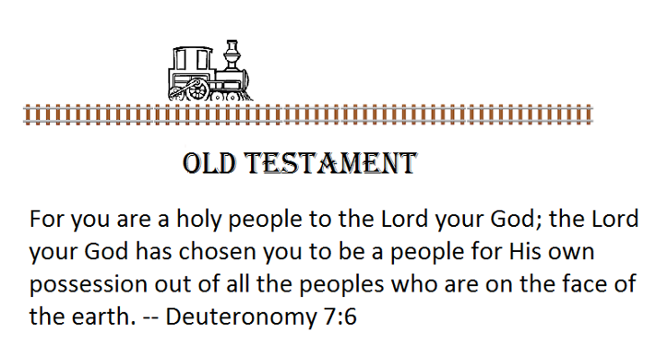

Slide 84
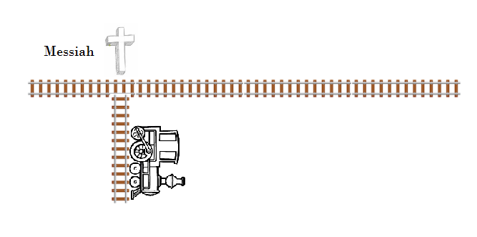

Slide 85
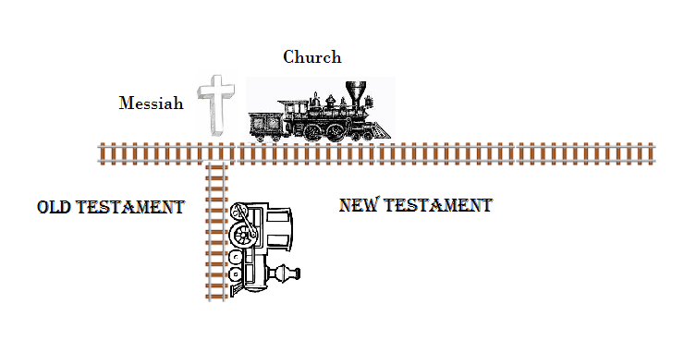

Slide 86
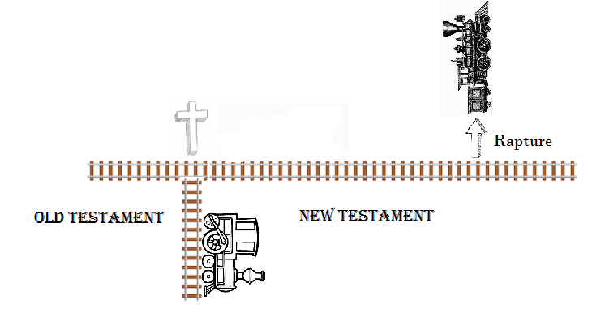

Slide 87
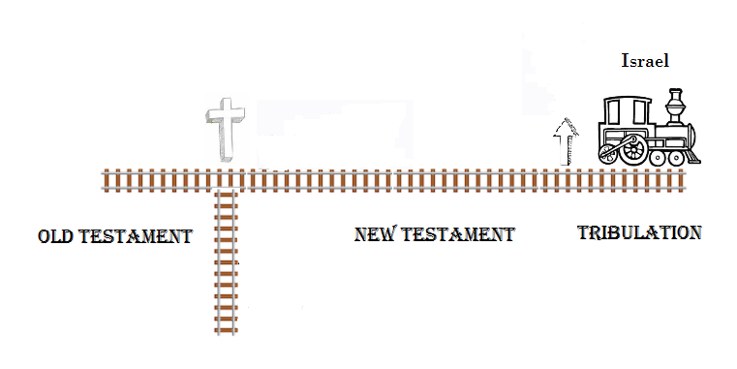

Slide 88
Five Major Resurrections
Ten individual or limited resurrections in the Bible:
Elijah raised the widow’s son
Elisha raised the son of a Shunammite woman
When the dead Elisha was thrown into a grave his bones the body originally in the grace came to life
Jesus resurrected the only son of a widowed woman from Nain
Jesus resurrected the young daughter of Jarius
Jesus resurrected Lazarus
A number of saints came out of their graves immediately after Jesus’ resurrection
Peter resurrects Tabitha in Joppa
Paul raises Eutychus from the dead in Troas
Paul was stoned to dead in Lystra but came back to life

Slide 89
Five Major Resurrections
The dead in Christ and living believers at the Rapture (1 Thessalonians 4:15-17)
Believers who were killed during the Tribulation (Revelation 20:4)
Old Testament believers (Daniel 12:1-2)
Believers both dead and alive who either entered the Millennium or were born in the Millennium
All of the unsaved at the end of the Millennium (Revelation 20:11-15)

Slide 90
Afterlife

Slide 91
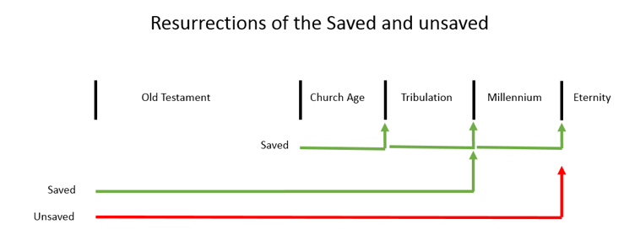

Slide 92
Sheol and Hades
Psalm 16:10
“For You will not abandon my soul to Sheol; Nor will You allow Your Holy One to undergo decay.”
Acts 2:31
“he looked ahead and spoke of the resurrection of the Christ, that He was neither abandoned to Hades, nor did His flesh suffer decay.”

Slide 93
Hell
Hell (13 times) with two of those times it being referred to as “fiery Hell.”
The Lake of Fire (four times, Revelation 19:20; 20:10, 14, 15)
Furnace of Fire (two times, Matthew 13:42, 50). This is a similar phrase as “lake of fire.”
Outer Darkness (three times, Matthew 8:12; 22:13; 25:30).
Black darkness (two times, 2 Peter 2:17, Jude 1:13)
Second death (four times, Revelation 2:11; 20:6, 14; 21:8)
Some Bibles use the Greek word Gehenna.

Slide 94
First fruits
Leviticus 23:9-10
“Then the Lord spoke to Moses, saying, 10 “Speak to the sons of Israel and say to them, ‘When you enter the land which I am going to give to you and reap its harvest, then you shall bring in the sheaf of the first fruits of your harvest to the priest.”

Slide 95
Jesus as First Fruits
1 Corinthians 15:20-23
20 But now Christ has been raised from the dead, the first fruits of those who are asleep. 21 For since by a man came death, by a man also came the resurrection of the dead. 22 For as in Adam all die, so also in Christ all will be made alive. 23 But each in his own order: Christ the first fruits, after that those who are Christ’s at His coming
Romans 8:29
For those whom He foreknew, He also predestined to become conformed to the image of His Son, so that He would be the firstborn among many brethren

Slide 96
Ephesians 4:8
“Therefore it says, ‘When He ascended on high, He led captive a host of captives, And He gave gifts to men.’”
Psalm 68:18
“You have ascended on high, You have led captive Your captives; You have received gifts among men, Even among the rebellious also, that the Lord God may dwell there.”

Slide 97
Matthew 12:40
“for just as Jonah was three days and three nights in the belly of the sea monster, so will the Son of Man be three days and three nights in the heart of the earth.”
1 Peter 3:18-19
“For Christ also died for sins once for all, the just for the unjust, so that He might bring us to God, having been put to death in the flesh, but made alive in the spirit; 19 in which also He went and made proclamation to the spirits now in prison”
Luke 23:43
“And He said to him, ‘Truly I say to you, today you shall be with Me in Paradise.’”

Slide 98
2 Corinthians 12:4
“was caught up into Paradise and heard inexpressible words, which a man is not permitted to speak.”

Slide 99
Hades and Abraham’s Bosom
Luke 16:19-31
19 “Now there was a rich man, and he habitually dressed in purple and fine linen, joyously living in splendor every day. 20 And a poor man named Lazarus was laid at his gate, covered with sores, 21 and longing to be fed with the crumbs which were falling from the rich man’s table; besides, even the dogs were coming and licking his sores. 22 Now the poor man died and was carried away by the angels to Abraham’s bosom; and the rich man also died and was buried. 23 In Hades he lifted up his eyes, being in torment, and saw Abraham far away and Lazarus in his bosom. 24 And he cried out and said, ‘Father Abraham, have mercy on me, and send Lazarus so that he may dip the tip of his finger in water and cool off my tongue, for I am in agony in this flame.’

Slide 100
25 But Abraham said, ‘Child, remember that during your life you received your good things, and likewise Lazarus bad things; but now he is being comforted here, and you are in agony. 26 And besides all this, between us and you there is a great chasm fixed, so that those who wish to come over from here to you will not be able, and that none may cross over from there to us.’ 27 And he said, ‘Then I beg you, father, that you send him to my father’s house— 28 for I have five brothers—in order that he may warn them, so that they will not also come to this place of torment.’ 29 But Abraham *said, ‘They have Moses and the Prophets; let them hear them.’ 30 But he said, ‘No, father Abraham, but if someone goes to them from the dead, they will repent!’ 31 But he said to him, ‘If they do not listen to Moses and the Prophets, they will not be persuaded even if someone rises from the dead.’”

Slide 101
Hades and Abraham’s Bosom
Hades
Abraham’s Bosom
Hades
  It is a place of fire and torment
  The wicked (aka unsaved) go there

Slide 102
Abraham’s bosom
  It is a place of comfort.
  The righteous (aka saved) go there
  Abraham died some 1800 years prior and was buried in the cave of Machpelah. In the Bible when you are an honored guest in someone’s house you were allowed to rest your head in their lap or bosom. This implies acceptance and comfort. Was Abraham actually there? It does not really say. But Abraham was one of God’s most faithful men. So to rest in Abraham’s bosom was to be given a place of honor in God’s eyes.
  The saved were carried to here by angels.

Slide 103
There was a chasm between the two sides so no one could cross over. Once you have died your eternal faith is determined. There is nothing that you can do to change that.
Neither man was annihilated. They were both conscious and were aware of their eternal fate.

Slide 104
Sheol/Hades
Abraham’s Bosom/Paradise
Lazarus
Jesus
Thief on the cross
Saved Dead
Christ’s Resurrection
Great chasm/golf
Torment
Rich man
Unsaved Dead
Great White Throne

Slide 105
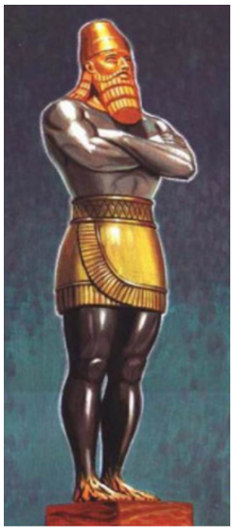
Nebuchadnezzar’s Statue
Head of gold - Babylon
Arms of silver – Medo-Persia
Thighs of brass - Greece
Legs of iron - Rome
Feet of iron and clay – Rome or Future antichrist empire

Slide 106
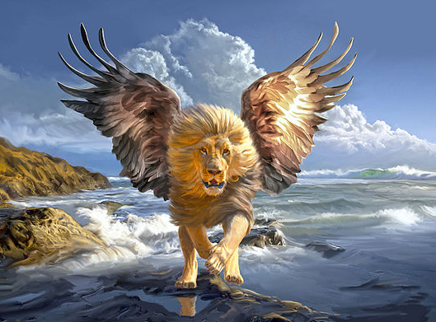
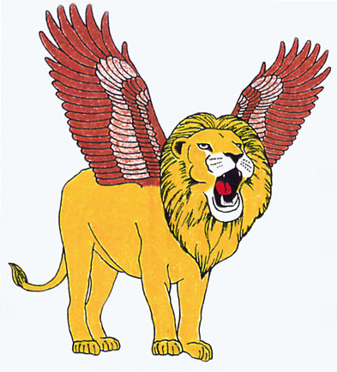
The First Beast

Slide 107
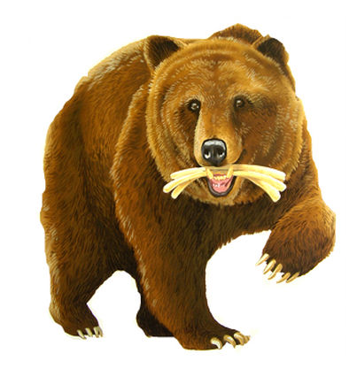
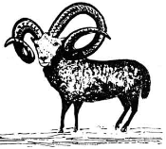
The Second Beast

Slide 108
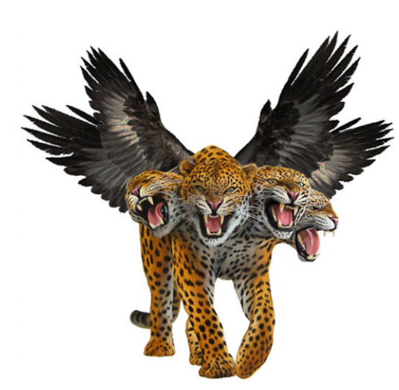
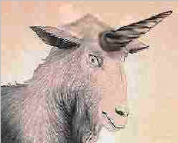
The Third Beast

Slide 109
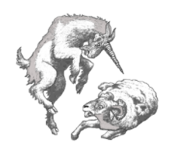
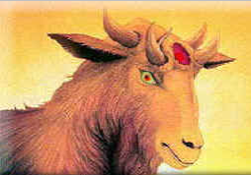

Slide 110
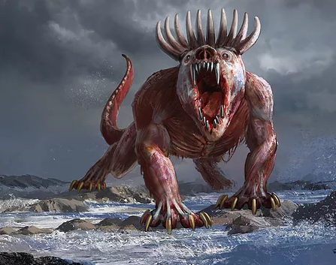
The Fourth Beast

Slide 111
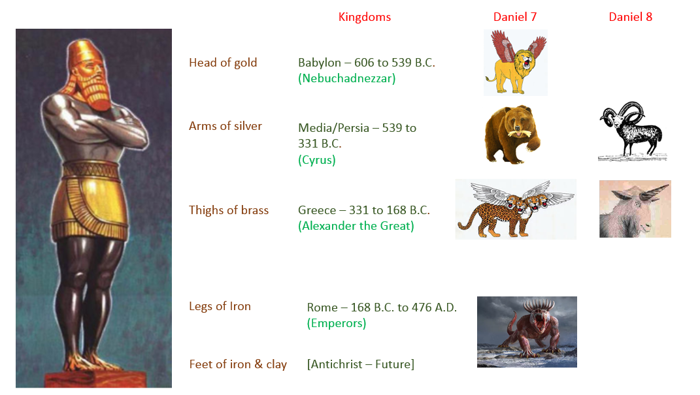

Slide 112
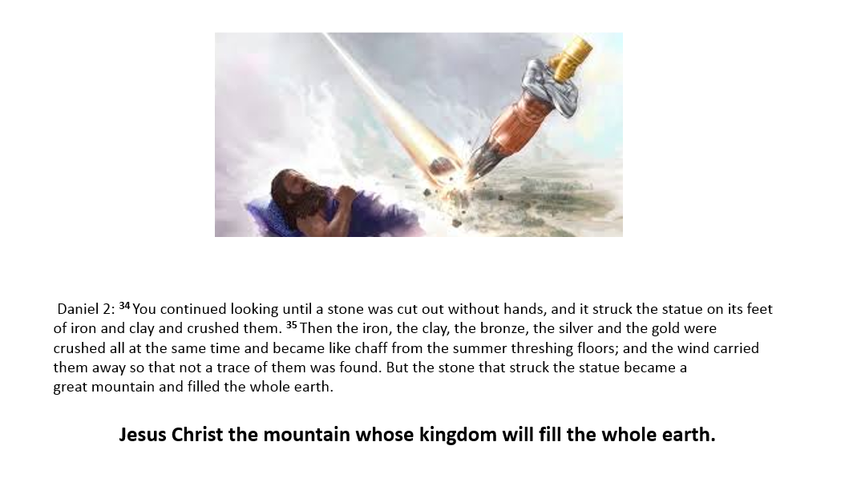
The Conquering Stone

Slide 113
Daniel’s 70 Weeks
Daniel 9:24-27
24 “Seventy weeks have been decreed for your people and your holy city, to finish the transgression, to make an end of sin, to make atonement for iniquity, to bring in everlasting righteousness, to seal up vision and prophecy and to anoint the most holy place. 25 So you are to know and discern that from the issuing of a decree to restore and rebuild Jerusalem until Messiah the Prince there will be seven weeks and sixty-two weeks; it will be built again, with plaza and moat, even in times of distress.

Slide 114
26 Then after the sixty-two weeks the Messiah will be cut off and have nothing, and the people of the prince who is to come will destroy the city and the sanctuary. And its end will come with a flood; even to the end there will be war; desolations are determined. 27 And he will make a firm covenant with the many for one week, but in the middle of the week he will put a stop to sacrifice and grain offering; and on the wing of abominations will come one who makes desolate, even until a complete destruction, one that is decreed, is poured out on the one who makes desolate.”

Slide 115
Three Views
Only refers to the current 70 years of Israel’s captivity in Babylon
Theological (spiritual)
Past and future interpretation

Slide 116
Six Purposes
To finish the transgression
To make an end of sins
To make reconciliation for iniquity
To bring in everlasting righteousness
To seal up vision and prophecy
To anoint the most Holy

Slide 117
Time Period Division
Three parts
7 weeks
62 weeks
1 week

Slide 118
Day for a Year
Numbers 14:34
“According to the number of days which you spied out the land, forty days, for every day you shall bear your guilt a year, even forty years, and you will know My opposition.”
Ezekiel 4:6b
“I have assigned it to you for forty days, a day for each year”

Slide 119
Genesis 29:27
“Complete the week of this one, and we will give you the other also for the service which you shall serve with me for another seven years
Genesis 31:41
“These twenty years I have been in your house; I served you fourteen years for your two daughters and six years for your flock, and you changed my wages ten times.”

Slide 120
Starting Point – Four Decrees
1) Ezra 1:1-4; Isa 45:1 (538/7 B.C.) Cyrus issued a decree to allow the Jews to return to Judah and rebuild the temple.
2) Ezra 3 (520 B.C.) Darius reiterated the decree of Cyrus.
3) Ezra 7:11-26 (458/7 B.C.) Artaxerxes, King of Persia, issued a decree to Ezra authorizing him to reinstitute the Temple services, to appoint judges and magistrates, and to teach the Law.
4) Nehemiah 2:1-8 (445/4 B.C.) Artaxerxes issued another decree this time to Nehemiah to rebuild the walls of Jerusalem.

Slide 121
Sir Robert Anderson’s Calculations
Started on March 14, 445 B.C.
1st part is 7 weeks = 49 years (7 x 7 years)
This takes us to the time when Jerusalem was rebuilt.
2nd part is 62 weeks = 434 years (7 x 62 years)
Multiple 434 years x 360 days = 173,880 days

Slide 122
Why 360 Days?
Lunar calendar (360 days) versus solar calendar (365 days)
Revelation 11:2-3 mentions 42 months which is exactly 3 ½ years and then says 1,260 days
1,260 days exactly equals 3 ½ months but only if you use a lunar calendar (1260 / 360 = 3 ½)

Slide 123
Genesis 7:11
“In the six hundredth year of Noah’s life, in the second month, on the seventeenth day of the month, on the same day all the fountains of the great deep burst open, and the floodgates of the sky were opened.”
Genesis 8:4
“In the seventh month, on the seventeenth day of the month, the ark rested upon the mountains of Ararat.”
Genesis 7:24
“The water prevailed upon the earth one hundred and fifty days

Slide 124
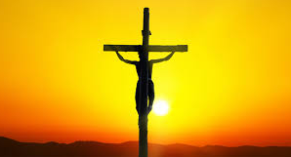
173,880 Days
April 6, 32 A.D. -> Jesus’ crucifixion

Slide 125
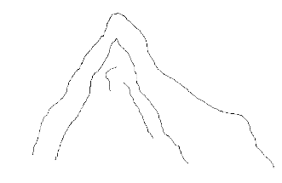
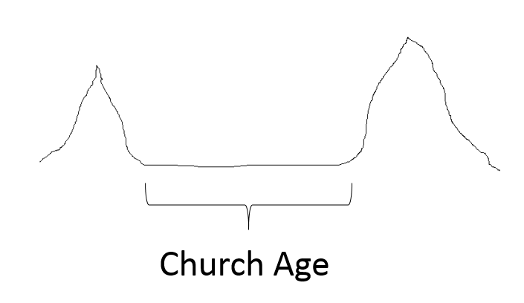
The Gap

Slide 126
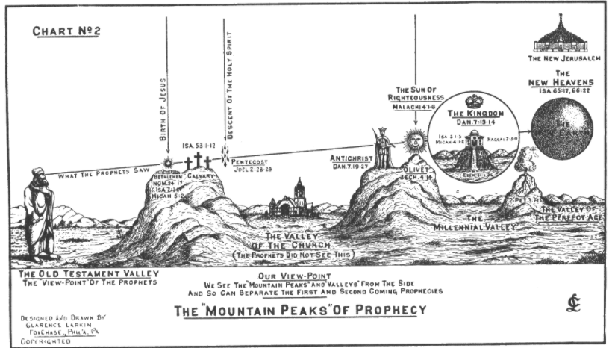

Slide 127
Gaps in the Bible
Micah 5:2
“But as for you, Bethlehem Ephrathah, Too little to be among the clans of Judah, From you One will go forth for Me to be ruler in Israel. His goings forth are from long ago, From the days of eternity.”

Slide 128
The 70th Week
Daniel 9:27
“And he will make a firm covenant with the many for one week, but in the middle of the week he will put a stop to sacrifice and grain offering; and on the wing of abominations will come one who makes desolate, even until a complete destruction, one that is decreed, is poured out on the one who makes desolate.”

Slide 129
Abomination of Desolation
Three times in the Old Testament
1) Here in Daniel 9:27.
2) Daniel 11:31, “Forces from him will arise, desecrate the sanctuary fortress, and do away with the regular sacrifice. And they will set up the abomination of desolation.”
3) Daniel 12:11, “From the time that the regular sacrifice is abolished and the abomination of desolation is set up, there will be 1,290 days.”

Slide 130
Twice in the New Testament
Matthew 24:15, “Therefore when you see the abomination of desolation which was spoken of through Daniel the prophet, standing in the holy place (let the reader understand).”
Mark 13:14

Slide 131

The Book of Revelation

Slide 132
History’s Timeline
Great White Throne Judgement
Start of the Tribulation
Second Coming
Creation
Jesus
Old Testament
New Testament
7 year
Tribulation
1000 year
Millennium

Slide 133


Tribulation Timeline
7 Seals
7 Trumpets
7 Bowls
Start
Second
Coming
7 years

Slide 134
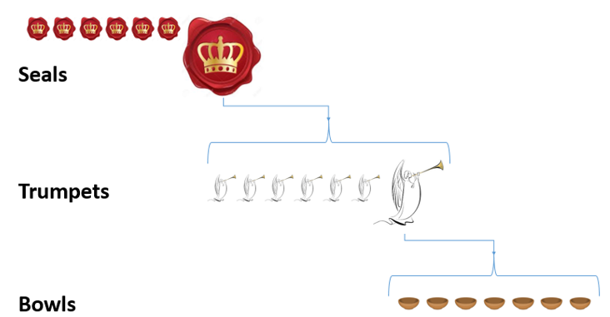
The Seven Bowls or Vials

Slide 135
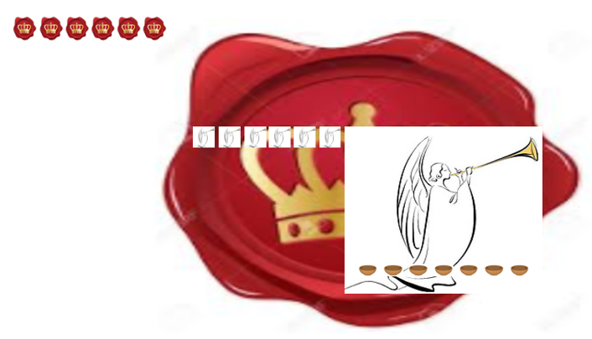

Slide 136

“I looked”

Slide 137
Revelation 1:1
“The Revelation of Jesus Christ, which God gave Him to show to His bond-servants, the things which must soon take place; and He sent and communicated it by His angel to His bond-servant John.”
Revelation 4:1-2
“After these things I looked, and behold, a door standing open in heaven, and the first voice which I had heard, like the sound of a trumpet speaking with me, said, ‘Come up here, and I will show you what must take place after these things.’ 2 Immediately I was in the Spirit; and behold, a throne was standing in heaven, and One sitting on the throne.’”

Slide 138
The First Seal – A White Horse – Conquering Ruler
Revelation 6:1-2
Then I saw when the Lamb broke one of the seven seals, and I heard one of the four living creatures saying as with a voice of thunder, “Come.” 2 I looked, and behold, a white horse, and he who sat on it had a bow; and a crown was given to him, and he went out conquering and to conquer.

Slide 139
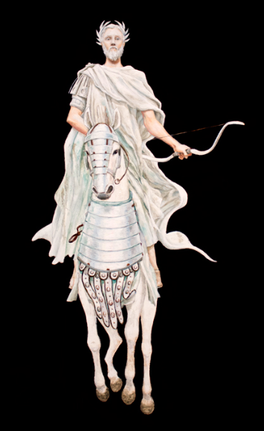
The First Horseman of the Apocalypse

Slide 140
Antichrist
Man of sin or man of lawlessness (depending on your translation) – 2 Thessalonians 2:3
Son of perdition or son of destruction (depending on your translation) – 2 Thessalonians 2:3
The beast – Revelation 13:5
The Worthless Shepherd -- Zechariah 11:17
The prince who is to come – Daniel 9:26
The little horn – Daniel 7:8

Slide 141
2 Thessalonians 2:3-4
“Let no one in any way deceive you, for it will not come unless the apostasy comes first, and the man of lawlessness is revealed, the son of destruction, 4 who opposes and exalts himself above every so-called god or object of worship, so that he takes his seat in the temple of God, displaying himself as being God.”

Slide 142
1 John 2:18
“Children, it is the last hour; and just as you heard that antichrist is coming, even now many antichrists have appeared; from this we know that it is the last hour.”

Slide 143
2 Thessalonians 2:7-12
“7 For the mystery of lawlessness is already at work; only he who now restrains will do so until he is taken out of the way. 8 Then that lawless one will be revealed whom the Lord will slay with the breath of His mouth and bring to an end by the appearance of His coming; 9 that is, the one whose coming is in accord with the activity of Satan, with all power and signs and false wonders, 10 and with all the deception of wickedness for those who perish, because they did not receive the love of the truth so as to be saved. 11 For this reason God will send upon them a deluding influence so that they will believe what is false, 12 in order that they all may be judged who did not believe the truth, but took pleasure in wickedness.”

Slide 144
Daniel 7:24-26
24 As for the ten horns, out of this kingdom ten kings will arise; and another will arise after them, and he will be different from the previous ones and will subdue three kings. 25 He will speak out against the Most High and wear down the saints of the Highest One, and he will intend to make alterations in times and in law; and they will be given into his hand for a time, times, and half a time. 26 But the court will sit for judgment, and his dominion will be taken away, annihilated and destroyed forever. 27 Then the sovereignty, the dominion and the greatness of all the kingdoms under the whole heaven will be given to the people of the saints of the Highest One; His kingdom will be an everlasting kingdom, and all the dominions will serve and obey Him.’

Slide 145
Characteristics of the antichrist
He is a leader of a country. In verse 24 he is called a king but that might be a generic term for a leader of a country since that is pretty much all that they had back then.
Since he is arising out of the old Roman empire it is thought that he will be European.
He is initially small which indicates that he is somewhat obscure and insignificant at first.
He overthrows or subdues three of the other kings.
He is highly intelligent as seen by it having the eyes of a man.
He is arrogant and boastful.
He persecutes the saints of the Most High for 3 ½ years which is the second half of the seven-year Tribulation aka The Great Tribulation. Verse 25.
He will overcome the nation Israel.
His empire and/or influence will be the entire Earth. Verse 23. Revelation 13:7.
He will speak against God. Verse 25.
He will institute his own system of laws. Verse 25. Many think that he will be an economic genius.
God will destroy him. Verse 26.
The antichrist will appear to be fatally killed by a head wound but then will appear to be resurrected (Revelation 13:1-3).

Slide 146
Revelation 13:16-18
And he causes all, the small and the great, and the rich and the poor, and the free men and the slaves, to be given a mark on their right hand or on their forehead, 17 and he provides that no one will be able to buy or to sell, except the one who has the mark, either the name of the beast or the number of his name. 18 Here is wisdom. Let him who has understanding calculate the number of the beast, for the number is that of a man; and his number is six hundred and sixty-six.

Slide 147
Tribulation Timeline
Antichrist conquers
7 Seals
7 Trumpets
7 Bowls

Slide 148
The Second Seal – A Red Horse - War
Revelation 6:3-4
3 When He broke the second seal, I heard the second living creature saying, “Come.” 4 And another, a red horse, went out; and to him who sat on it, it was granted to take peace from the Earth, and that men would slay one another; and a great sword was given to him.

Slide 149
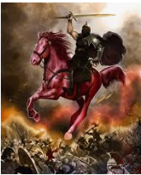
The Second Horseman of the Apocalypse

Slide 150
Battle in Daniel 11:5-45
This is a great series of battles between the king of the North and the king of the South. The directions are in relation to Israel so the king of the South is south of Israel.
Because of its many similarities the king of the North is thought to be the antichrist which is the “little horn” of Daniel 8.
The king of the South starts off very powerful and tries to form an alliance with the king of the North by giving him his daughter but it will not work out.
The result is war.
The North wins and occupies Israel where he causes much destruction (verse 16).
The North tries to make peace but this fails.
The North will try to conquer the coastlands but a commander will defeat him.
The king of the North will apparently be killed and another king will take his place by seizing the throne using political skill and deceit.

Slide 151
This new king of the North then attacks the king of the South and, once again, defeats him.
The two kings will sit down to negotiate but will tell each other lies and the effort falls apart.
The North will invade the South but this time is defeated by forces from what is called today Cyprus.
On his way back he will stop in Israel to take out his vengeance. He will desecrated the temple, stop the sacrifices, and set up the “abomination of desolation.” So this is the halfway point of the Tribulation. So all that happens previously was probably during the first half of the Tribulation.
This king—the antichrist—will blaspheme God and magnify himself above all gods.
There will be another war between the North and the South and the North will win.
The last half of the last verse in Daniel 11 tells us what happens to the antichrist, “yet he will come to his end, and no one will help him.” As we shall, see the antichrist does come to his end when Jesus Christ returns and defeats him. Of course no one can help him.

Slide 152
Tribulation Timeline
Antichrist conquers
War
7 Seals
7 Trumpets
7 Bowls

Slide 153
The Third Seal – A Black Horse - Famine
Revelation 6:5-6
5 When He broke the third seal, I heard the third living creature saying, “Come.” I looked, and behold, a black horse; and he who sat on it had a pair of scales in his hand. 6 And I heard something like a voice in the center of the four living creatures saying, “A quart of wheat for a denarius, and three quarts of barley for a denarius; and do not damage the oil and the wine.”

Slide 154
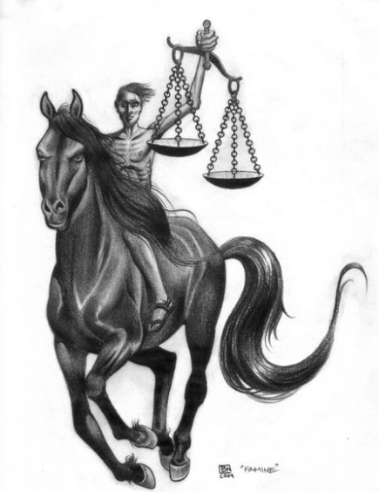
The Third Horseman of the Apocalypse

Slide 155
Tribulation Timeline
Antichrist conquers
War
Famine
7 Seals
7 Trumpets
7 Bowls

Slide 156
The Fourth Seal – An Ashen Horse – Death
Revelation 6:7-8
7 When the Lamb broke the fourth seal, I heard the voice of the fourth living creature saying, “Come.” 8 I looked, and behold, an ashen horse; and he who sat on it had the name Death; and Hades was following with him. Authority was given to them over a fourth of the earth, to kill with sword and with famine and with pestilence and by the wild beasts of the earth.

Slide 157
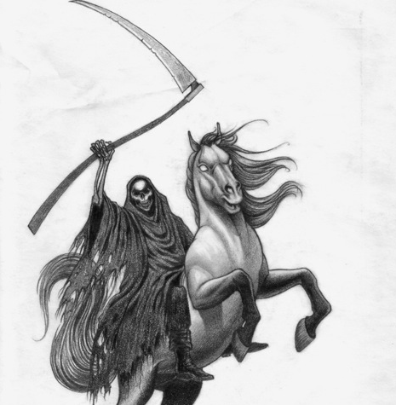
The Fourth Horseman of the Apocalypse

Slide 158
Tribulation Timeline
Antichrist conquers
War
Famine
Death
7 Seals
7 Trumpets
7 Bowls

Slide 159
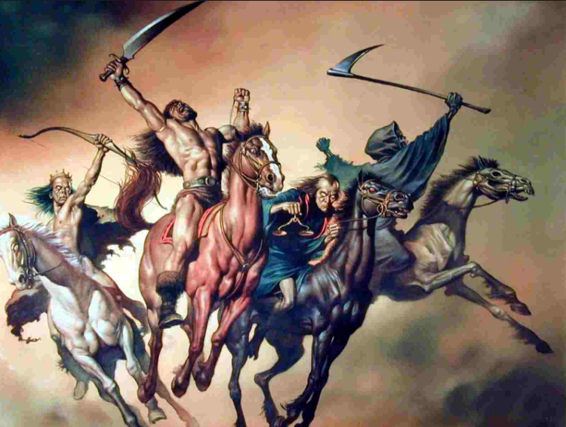
The Four Horsemen of the Apocalypse

Slide 160
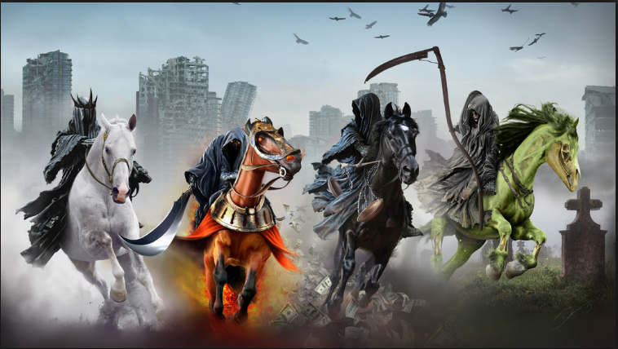

Slide 161
The Fifth Seal – Martyred Souls
Revelation 6:9-11
9 When the Lamb broke the fifth seal, I saw underneath the altar the souls of those who had been slain because of the word of God, and because of the testimony which they had maintained; 10 and they cried out with a loud voice, saying, “How long, O Lord, holy and true, will You refrain from judging and avenging our blood on those who dwell on the earth?” 11 And there was given to each of them a white robe; and they were told that they should rest for a little while longer, until the number of their fellow servants and their brethren who were to be killed even as they had been, would be completed also.

Slide 162
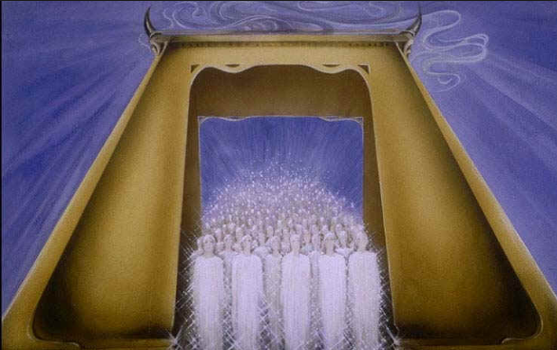

Slide 163
Tribulation Timeline
Antichrist conquers
War
Famine
Death
Martyred Souls
7 Seals
7 Trumpets
7 Bowls

Slide 164
The Sixth Seal – Divine Wrath
Revelation 6:12-17
12 I looked when He broke the sixth seal, and there was a great earthquake; and the sun became black as sackcloth made of hair, and the whole moon became like blood; 13 and the stars of the sky fell to the earth, as a fig tree casts its unripe figs when shaken by a great wind. 14 The sky was split apart like a scroll when it is rolled up, and every mountain and island were moved out of their places. 15 Then the kings of the earth and the great men and the commanders and the rich and the strong and every slave and free man hid themselves in the caves and among the rocks of the mountains; 16 and they said to the mountains and to the rocks, “Fall on us and hide us from the presence of Him who sits on the throne, and from the wrath of the Lamb; 17 for the great day of their wrath has come, and who is able to stand?”

Slide 165
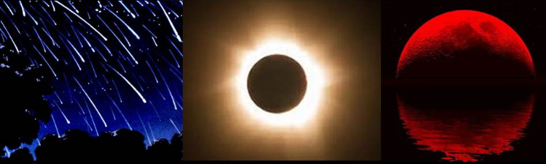

Slide 166
Tribulation Timeline
Antichrist conquers
War
Famine
Death
Martyred Souls
7 Seals
Divine Wrath
7 Trumpets
7 Bowls

Slide 167
Matthew 24:6-7
6 You will be hearing of wars and rumors of wars. See that you are not frightened, for those things must take place, but that is not yet the end. 7 For nation will rise against nation, and kingdom against kingdom, and in various places there will be famines and earthquakes.
Verse 8
“But all these things are merely the beginning of birth pangs.”

Slide 168
Joel 2:30-3
30 “I will display wonders in the sky and on the earth, Blood, fire and columns of smoke. 31 “The sun will be turned into darkness and the moon into blood before the great and awesome day of the Lord comes.
Verse 32
“And it will come about that whoever calls on the name of the Lord Will be delivered; For on Mount Zion and in Jerusalem There will be those who escape, As the Lord has said, Even among the survivors whom the Lord calls.”

Slide 169
Isaiah 34:4
And all the host of heaven will wear away, and the sky will be rolled up like a scroll; All their hosts will also wither away As a leaf withers from the vine, Or as one withers from the fig tree.

Slide 170
“Who is able to stand?”

Slide 171
Chapter 7 – The Saints
Isaiah 59:1
“Behold, the Lord’s hand is not so short that it cannot save; nor is His ear so dull that it cannot hear.”
Revelation 7:4
“And I heard the number of those who were sealed, one hundred and forty-four thousand sealed from every tribe of the sons of Israel”
Revelation 14:1
“Then I looked, and behold, the Lamb was standing on Mount Zion, and with Him one hundred and forty-four thousand , having His name and the name of His Father written on their foreheads..”

Slide 172
Revelation 7:9
“After these things I looked, and behold, a great multitude which no one could count, from every nation and all tribes and peoples and tongues, standing before the throne and before the Lamb, clothed in white robes, and palm branches were in their hands.”
Revelation 7:16
“They will hunger no longer, nor thirst anymore; nor will the sun beat down on them, nor any heat.”
Titus 2:13
“looking for the blessed hope.”

Slide 173
The Seventh Seal - Silence
Revelation 8:1
“When the Lamb broke the seventh seal, there was silence in heaven for about half an hour.”

Slide 174
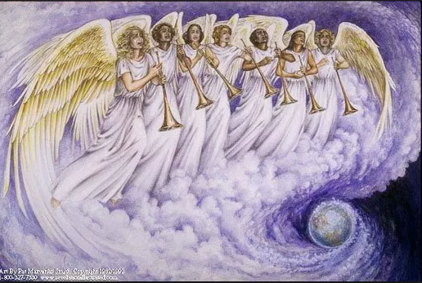

Slide 175
Tribulation Timeline
Antichrist conquers
War
Famine
Death
Martyred Souls
7 Seals
Divine Wrath
Silence -> Trumpets
7 Trumpets
7 Bowls

Slide 176
The First Trumpet – Trees and Grass Burnt up
Revelation 8:7
“The first sounded, and there came hail and fire, mixed with blood, and they were thrown to the earth; and a third of the earth was burned up, and a third of the trees were burned up, and all the green grass was burned up.”

Slide 177


Slide 178
Tribulation Timeline
Antichrist conquers
War
Famine
Death
Martyred Souls
7 Seals
Divine Wrath
Silence -> Trumpets -> Trees & Grass Burnt Up
7 Trumpets
7 Bowls

Slide 179
The Second Trumpet – 1/3 of Sea Life Killed and 1/3 of Ships Destroyed
Revelation 8:8-9
“The second angel sounded, and something like a great mountain burning with fire was thrown into the sea; and a third of the sea became blood, 9 and a third of the creatures which were in the sea and had life, died; and a third of the ships were destroyed.”

Slide 180


Slide 181
Tribulation Timeline
Antichrist conquers
War
Famine
Death
Martyred Souls
7 Seals
Divine Wrath
Silence -> Trumpets -> Trees & Grass Burnt Up
1/3 Sea Life & Ships Destroyed
7 Trumpets
7 Bowls

Slide 182
The Third Trumpet – 1/3 of Fresh Water is ruined
Revelation 8:10-11
“The third angel sounded, and a great star fell from heaven, burning like a torch, and it fell on a third of the rivers and on the springs of waters. 11 The name of the star is called Wormwood; and a third of the waters became wormwood, and many men died from the waters, because they were made bitter.”

Slide 183


Slide 184
Exodus 15:22-25
22 Then Moses led Israel from the Red Sea, and they went out into the wilderness of Shur; and they went three days in the wilderness and found no water. 23 When they came to Marah, they could not drink the waters of Marah, for they were bitter; therefore it was named Marah. 24 So the people grumbled at Moses, saying, “What shall we drink?” 25 Then he cried out to the Lord, and the Lord showed him a tree; and he threw it into the waters, and the waters became sweet.

Slide 185
Tribulation Timeline
Antichrist conquers
War
Famine
Death
Martyred Souls
7 Seals
Divine Wrath
Silence -> Trumpets -> Trees & Grass Burnt Up
1/3 Sea Life & Ships Destroyed
1/3 Fresh Water Ruined
7 Trumpets
7 Bowls

Slide 186
The Fourth Trumpet – Darkness
Revelation 8:12
“The fourth angel sounded, and a third of the sun and a third of the moon and a third of the stars were struck, so that a third of them would be darkened and the day would not shine for a third of it, and the night in the same way.”
Romans 1:20
“For since the creation of the world His invisible attributes, His eternal power and divine nature, have been clearly seen, being understood through what has been made, so that they are without excuse.”

Slide 187


Slide 188
Tribulation Timeline
Antichrist conquers
War
Famine
Death
Martyred Souls
7 Seals
Divine Wrath
Silence -> Trumpets -> Trees & Grass Burnt Up
1/3 Sea Life & Ships Destroyed
1/3 Fresh Water Ruined
Darkness
7 Trumpets
7 Bowls

Slide 189
The Fifth Trumpet – The First Woe - Demonic Torment
Revelation 9:1-12
Then the fifth angel sounded, and I saw a star from heaven which had fallen to the earth; and the key of the bottomless pit was given to him. 2 He opened the bottomless pit, and smoke went up out of the pit, like the smoke of a great furnace; and the sun and the air were darkened by the smoke of the pit. 3 Then out of the smoke came locusts upon the earth, and power was given them, as the scorpions of the earth have power. 4 They were told not to hurt the grass of the earth, nor any green thing, nor any tree, but only the men who do not have the seal of God on their foreheads. 5 And they were not permitted to kill anyone, but to torment for five months; and their torment was like the torment of a scorpion when it stings a man.

Slide 190
6 And in those days men will seek death and will not find it; they will long to die, and death flees from them. 7 The appearance of the locusts was like horses prepared for battle; and on their heads appeared to be crowns like gold, and their faces were like the faces of men. 8 They had hair like the hair of women, and their teeth were like the teeth of lions. 9 They had breastplates like breastplates of iron; and the sound of their wings was like the sound of chariots, of many horses rushing to battle. 10 They have tails like scorpions, and stings; and in their tails is their power to hurt men for five months. 11 They have as king over them, the angel of the abyss; his name in Hebrew is Abaddon, and in the Greek he has the name Apollyon. 12 The first woe is past; behold, two woes are still coming after these things.

Slide 191


Slide 192
Satan
Name | Scripture | Note
Satan | Mark 1:13, “And He was in the wilderness forty days being tempted by Satan; and He was with the wild beasts, and the angels were ministering to Him.” | Satan means “the adversary” in Hebrew. Because of his hatred of God, he opposes everything that God is and tries to do.
The Devil | 1 John 3:8, “the one who practices sin is of the devil; for the devil has sinned from the beginning. The Son of God appeared for this purpose, to destroy the works of the devil.” | “The Devil” in Greek (diabolos) means “false accuser.” He likes to accuse God’s children of things that are not true in order to pull them away from God.
Lucifer | Isaiah 14:12, ““How you have fallen from heaven, O star of the morning, son of the dawn!” | His original name before he fell is the “Morning Star” or “star of the morning” which can be translated as Lucifer.
Beelzebul | Matthew 12:24, “But when the Pharisees heard this, they said, ‘This man casts out demons only by Beelzebul the ruler of the demons.’” | Beelzebul means “ruler of demons.”
The Great Dragon | Revelation 12:9, “And the great dragon was thrown down, the serpent of old who is called the devil and Satan, who deceives the whole world; he was thrown down to the earth, and his angels were thrown down with him." | The Great Dragon tells of his intimidation and fury.
The Evil One | John 17:15, “I do not ask You to take them out of the world, but to keep them from the evil one.” | Satan is not just another evil being; he is “the” evil one.
The Tempter | Matthew 4:3, “And the tempter came and said to Him, ‘If You are the Son of God, command that these stones become bread.’” | One of Satan’s greatest weapons is to tempt people into not believing God and then disobeying Him.
Ruler of this world | John 12:31, “Now judgment is upon this world; now the ruler of this world will be cast out.” | Right now, this world is ruled and being led by Satan.
Abaddon or Apollyon | Revelation 9:11, “They have as king over them, the angel of the abyss; his name in Hebrew is Abaddon, and in the Greek he has the name Apollyon.” | These mean “destroyer.” Satan does not create unless it suits his purpose.
The Serpent of Old | Revelation 12: 9, “And the great dragon was thrown down, the serpent of old who is called the devil and Satan, who deceives the whole world; he was thrown down to the earth, and his angels were thrown down with him." | “Serpent of Old” refers back to the Garden when Satan was cursed and forced to crawl on his belly like a serpent.

Slide 193
Ezekiel 28:12-19
12 “Son of man, take up a lamentation over the king of Tyre and say to him, ‘Thus says the Lord God, “You had the seal of perfection, Full of wisdom and perfect in beauty.
13 “You were in Eden, the garden of God; Every precious stone was your covering: The ruby, the topaz and the diamond; The beryl, the onyx and the jasper; The lapis lazuli, the turquoise and the emerald; And the gold, the workmanship of your settings and sockets, Was in you. On the day that you were created They were prepared.
14 “You were the anointed cherub who covers, And I placed you there. You were on the holy mountain of God; You walked in the midst of the stones of fire.
15 “You were blameless in your ways From the day you were created Until unrighteousness was found in you.
16 “By the abundance of your trade You were internally filled with violence, And you sinned; Therefore I have cast you as profane From the mountain of God. And I have destroyed you, O covering cherub, From the midst of the stones of fire.
17 “Your heart was lifted up because of your beauty; You corrupted your wisdom by reason of your splendor. I cast you to the ground; I put you before kings, That they may see you.
18 “By the multitude of your iniquities, In the unrighteousness of your trade You profaned your sanctuaries. Therefore I have brought fire from the midst of you; It has consumed you, And I have turned you to ashes on the earth In the eyes of all who see you.
19 “All who know you among the peoples Are appalled at you; You have become terrified And you will cease to be forever.”’”

Slide 194
Revelation 12:9
“And the great dragon was thrown down, the serpent of old who is called the devil and Satan, who deceives the whole world; he was thrown down to the earth, and his angels were thrown down with him.”
Job 1:6
“Now there was a day when the sons of God came to present themselves before the Lord, and Satan also came among them.”

Slide 195
Genesis 3:14
“The Lord God said to the serpent, ‘Because you have done this, Cursed are you more than all cattle, And more than every beast of the field; on your belly you will go, And dust you will eat All the days of your life…’”
Genesis 3:5
“you will be like God, knowing good and evil”

Slide 196
1 Peter 5:8
“Be of sober spirit, be on the alert. Your adversary, the devil, prowls around like a roaring lion, seeking someone to devour.”
John 8:44
“You are of your father the devil, and you want to do the desires of your father. He was a murderer from the beginning, and does not stand in the truth because there is no truth in him. Whenever he speaks a lie, he speaks from his own nature, for he is a liar and the father of lies.”

Slide 197
Luke 8:31
“They were imploring Him not to command them to go away into the abyss.”
2 Peter 2:4
“For if God did not spare angels when they sinned, but cast them into hell and committed them to pits of darkness, reserved for judgment…”
Jude 6
“And angels who did not keep their own domain, but abandoned their proper abode, He has kept in eternal bonds under darkness for the judgment of the great day…”

Slide 198
1 John 4:4
“You are from God, little children, and have overcome them; because greater is He who is in you than he who is in the world.”

Slide 199
Tribulation Timeline
Antichrist conquers
War
Famine
Death
Martyred Souls
7 Seals
Divine Wrath
Silence -> Trumpets -> Trees & Grass Burnt Up
1/3 Sea Life & Ships Destroyed
1/3 Fresh Water Ruined
Darkness
Demonic Torment
7 Trumpets
7 Bowls

Slide 200
The Sixth Trumpet – The Second Woe – The Army of Two Hundred Million
Revelation 9:13-21
13 Then the sixth angel sounded, and I heard a voice from the four horns of the golden altar which is before God, 14 one saying to the sixth angel who had the trumpet, “Release the four angels who are bound at the great river Euphrates.” 15 And the four angels, who had been prepared for the hour and day and month and year, were released, so that they would kill a third of mankind. 16 The number of the armies of the horsemen was two hundred million; I heard the number of them. 17 And this is how I saw in the vision the horses and those who sat on them: the riders had breastplates the color of fire and of hyacinth and of brimstone; and the heads of the horses are like the heads of lions; and out of their mouths proceed fire and smoke and brimstone. 18 A third of mankind was killed by these three plagues, by the fire and the smoke and the brimstone which proceeded out of their mouths. 19 For the power of the horses is in their mouths and in their tails; for their tails are like serpents and have heads, and with them they do harm. 20 The rest of mankind, who were not killed by these plagues, did not repent of the works of their hands, so as not to worship demons, and the idols of gold and of silver and of brass and of stone and of wood, which can neither see nor hear nor walk; 21 and they did not repent of their murders nor of their sorceries nor of their immorality nor of their thefts.

Slide 201


A Real Army

Slide 202

A Demon Army

Slide 203
Tribulation Timeline
Antichrist conquers
War
Famine
Death
Martyred Souls
7 Seals
Divine Wrath
Silence -> Trumpets -> Trees & Grass Burnt Up
1/3 Sea Life & Ships Destroyed
1/3 Fresh Water Ruined
Darkness
Demonic Torment
7 Trumpets
200 Million Man Army
7 Bowls

Slide 204
The Times of the Gentiles
Revelation 11:1-2
Then there was given me a measuring rod like a staff; and someone said, “Get up and measure the temple of God and the altar, and those who worship in it. 2 Leave out the court which is outside the temple and do not measure it, for it has been given to the nations; and they will tread under foot the holy city for forty-two months.
Luke 21:24
“and they will fall by the edge of the sword, and will be led captive into all the nations; and Jerusalem will be trampled under foot by the Gentiles until the times of the Gentiles are fulfilled.”

Slide 205
The Two Witnesses
Revelation 11:3-13
3 And I will grant authority to my two witnesses, and they will prophesy for twelve hundred and sixty days, clothed in sackcloth.” 4 These are the two olive trees and the two lampstands that stand before the Lord of the earth. 5 And if anyone wants to harm them, fire flows out of their mouth and devours their enemies; so if anyone wants to harm them, he must be killed in this way. 6 These have the power to shut up the sky, so that rain will not fall during the days of their prophesying; and they have power over the waters to turn them into blood, and to strike the earth with every plague, as often as they desire. 7 When they have finished their testimony, the beast that comes up out of the abyss will make war with them, and overcome them and kill them. 8 And their dead bodies will lie in the street of the great city which mystically is called Sodom and Egypt, where also their Lord was crucified.

Slide 206
9 Those from the peoples and tribes and tongues and nations will look at their dead bodies for three and a half days, and will not permit their dead bodies to be laid in a tomb. 10 And those who dwell on the earth will rejoice over them and celebrate; and they will send gifts to one another, because these two prophets tormented those who dwell on the earth. 11 But after the three and a half days, the breath of life from God came into them, and they stood on their feet; and great fear fell upon those who were watching them. 12 And they heard a loud voice from heaven saying to them, “Come up here.” Then they went up into heaven in the cloud, and their enemies watched them. 13 And in that hour there was a great earthquake, and a tenth of the city fell; seven thousand people were killed in the earthquake, and the rest were terrified and gave glory to the God of heaven.

Slide 207


Slide 208
Are they Israel and the Church?
No
1) The church will never be killed and lie in the streets of Jerusalem for 3 ½ days.
2) The church does not devour its enemies, rather it shares God’s Gospel with them that they might be saved.
3) The church does not have fire flow out of its mouth. It would be an incredible stretch to even spiritualize this.
4) The church does not send forth plagues or turn water into blood.
5) Both the church and Israel have been witnessing for more than 3 ½ years.

Slide 209
Are they two actual people manifesting the spirits of Moses and Elijah?
1) Elijah commanded fire from heaven. In 1 Kings 18 Elijah prayed and it said, “Then the fire of the Lord fell and consumed the burnt offering and the wood and the stones and the dust, and licked up the water that was in the trench.” And also 2 Kings 1 when Elijah calls down fire from heaven and it devours a company of soldiers. In verse 5 the two witnesses use fire to devour their enemies.
2) In Numbers 16:35 during the rebellion of Korah against Moses fire came down from heaven and devoured 250 men. “Fire also came forth from the Lord and consumed the two hundred and fifty men who were offering the incense.”

Slide 210
3) The heavens were shut up so that it did not rain during Elijah’s time as seen in 1 Kings 17. In verse 6 the two witnesses can shut up the sky.
4) Two of the ten plagues in Egypt for Moses was turning water in to blood (Exodus 7:17) and plagues (Incests, boils, hail, locusts, death of the first born). We see that in verse 6.
5) Micah 4:5 says, “Behold, I am going to send you Elijah the prophet before the coming of the great and terrible day of the Lord.” John the Baptist at least partially fulfilled this. But Jesus’ incarnation was not the “great and terrible day of the Lord.” That would be Jesus’ Second Coming.

Slide 211
6) In Matthew 17 it is Moses and Elijah that are the ones who appear at the Transfiguration.
Yes

Slide 212
The Third Woe and the Seventh Trumpet – Glory to God
Revelation 11:15-18
15 Then the seventh angel sounded; and there were loud voices in heaven, saying, “The kingdom of the world has become the kingdom of our Lord and of His Christ; and He will reign forever and ever.” 16 And the twenty-four elders, who sit on their thrones before God, fell on their faces and worshiped God, 17 saying, “We give You thanks, O Lord God, the Almighty, who are and who were, because You have taken Your great power and have begun to reign. 18 And the nations were enraged, and Your wrath came, and the time came for the dead to be judged, and the time to reward Your bond-servants the prophets and the saints and those who fear Your name, the small and the great, and to destroy those who destroy the earth.”

Slide 213


Slide 214
Tribulation Timeline
Antichrist conquers
War
Famine
Death
Martyred Souls
7 Seals
Divine Wrath
Silence -> Trumpets -> Trees & Grass Burnt Up
1/3 Sea Life & Ships Destroyed
1/3 Fresh Water Ruined
Darkness
Demonic Torment
7 Trumpets
200 Million Man Army
Glory to God -> Bowls
7 Bowls

Slide 215
Events in Heaven and earth
There are seven main characters in this section.
  The woman who represents Israel
  The dragon who is Satan
  The child who represents Jesus
  Michael the archangel
  Israel
  The beast out of the sea who is the antichrist
  The beast out of the earth who is the false prophet

Slide 216
The Woman and Child – The First Sign
Revelation 12:1-2
A great sign appeared in heaven: a woman clothed with the sun, and the moon under her feet, and on her head a crown of twelve stars; 2 and she was with child; and she cried out, being in labor and in pain to give birth.
Genesis 37:9
“Now he had still another dream, and related it to his brothers, and said, ‘Lo, I have had still another dream; and behold, the sun and the moon and eleven stars were bowing down to me.’”

Slide 217
The Great Dragon – The Second Sign
Revelation 12:3-4
3 Then another sign appeared in heaven: and behold, a great red dragon having seven heads and ten horns, and on his heads were seven diadems. 4 And his tail swept away a third of the stars of heaven and threw them to the earth. And the dragon stood before the woman who was about to give birth, so that when she gave birth he might devour her child.

Slide 218


Slide 219
The Child – Jesus
Revelation 12:5-6
5 And she gave birth to a son, a male child, who is to rule all the nations with a rod of iron; and her child was caught up to God and to His throne. 6 Then the woman fled into the wilderness where she had a place prepared by God, so that there she would be nourished for one thousand two hundred and sixty days.

Slide 220
Satan Cast out of Heaven
Revelation 12:7-9
7 And there was war in heaven, Michael and his angels waging war with the dragon. The dragon and his angels waged war, 8 and they were not strong enough, and there was no longer a place found for them in heaven. 9 And the great dragon was thrown down, the serpent of old who is called the devil and Satan, who deceives the whole world; he was thrown down to the earth, and his angels were thrown down with him.

Slide 221


Slide 222
Daniel 10:13
“Then he said to me, “Do not be afraid, Daniel, for from the first day that you set your heart on understanding this and on humbling yourself before your God, your words were heard, and I have come in response to your words. But the prince of the kingdom of Persia was withstanding me for twenty-one days; then behold, Michael, one of the chief princes, came to help me, for I had been left there with the kings of Persia.”
Daniel 12:1
“Now at that time Michael, the great prince who stands guard over the sons of your people, will arise. And there will be a time of distress such as never occurred since there was a nation until that time; and at that time your people, everyone who is found written in the book, will be rescued.”

Slide 223
Satan’s Wrath
Revelation 12:10-12
10 Then I heard a loud voice in heaven, saying, “Now the salvation, and the power, and the kingdom of our God and the authority of His Christ have come, for the accuser of our brethren has been thrown down, he who accuses them before our God day and night. 11 And they overcame him because of the blood of the Lamb and because of the word of their testimony, and they did not love their life even when faced with death. 12 For this reason, rejoice, O heavens and you who dwell in them. Woe to the earth and the sea, because the devil has come down to you, having great wrath, knowing that he has only a short time.”

Slide 224
Satan’s Persecution of Israel
Revelation 12:13-16
13 And when the dragon saw that he was thrown down to the earth, he persecuted the woman who gave birth to the male child. 14 But the two wings of the great eagle were given to the woman, so that she could fly into the wilderness to her place, where she was nourished for a time and times and half a time, from the presence of the serpent. 15 And the serpent poured water like a river out of his mouth after the woman, so that he might cause her to be swept away with the flood. 16 But the earth helped the woman, and the earth opened its mouth and drank up the river which the dragon poured out of his mouth. 17 So the dragon was enraged with the woman, and went off to make war with the rest of her children, who keep the commandments of God and hold to the testimony of Jesus.

Slide 225
The Beast out of the Sea
Revelation 13:1-10
And the dragon stood on the sand of the seashore. Then I saw a beast coming up out of the sea, having ten horns and seven heads, and on his horns were ten diadems, and on his heads were blasphemous names. 2 And the beast which I saw was like a leopard, and his feet were like those of a bear, and his mouth like the mouth of a lion. And the dragon gave him his power and his throne and great authority. 3 I saw one of his heads as if it had been slain, and his fatal wound was healed. And the whole earth was amazed and followed after the beast; 4 they worshiped the dragon because he gave his authority to the beast; and they worshiped the beast, saying, “Who is like the beast, and who is able to wage war with him?” 5 There was given to him a mouth speaking arrogant words and blasphemies, and authority to act for forty-two months was given to him.

Slide 226
6 And he opened his mouth in blasphemies against God, to blaspheme His name and His tabernacle, that is, those who dwell in heaven. 7 It was also given to him to make war with the saints and to overcome them, and authority over every tribe and people and tongue and nation was given to him. 8 All who dwell on the earth will worship him, everyone whose name has not been written from the foundation of the world in the book of life of the Lamb who has been slain. 9 If anyone has an ear, let him hear. 10 If anyone is destined for captivity, to captivity he goes; if anyone kills with the sword, with the sword he must be killed. Here is the perseverance and the faith of the saints.

Slide 227
The Second Beast
Revelation 13:11-18
Then I saw another beast coming up out of the earth; and he had two horns like a lamb and he spoke as a dragon. 12 He exercises all the authority of the first beast in his presence. And he makes the earth and those who dwell in it to worship the first beast, whose fatal wound was healed. 13 He performs great signs, so that he even makes fire come down out of heaven to the earth in the presence of men. 14 And he deceives those who dwell on the earth because of the signs which it was given him to perform in the presence of the beast, telling those who dwell on the earth to make an image to the beast who had the wound of the sword and has come to life. 15 And it was given to him to give breath to the image of the beast, so that the image of the beast would even speak and cause as many as do not worship the image of the beast to be killed. 16 And he causes all, the small and the great, and the rich and the poor, and the free men and the slaves, to be given a mark on their right hand or on their forehead, 17 and he provides that no one will be able to buy or to sell, except the one who has the mark, either the name of the beast or the number of his name. 18 Here is wisdom. Let him who has understanding calculate the number of the beast, for the number is that of a man; and his number is six hundred and sixty-six.

Slide 228
False Prophet
Just like Jesus is the Lamb of God, this beast is said to resemble a lamb (verse 11)
He causes people to worship the antichrist (verse 12)
He performs signs (verse 13)
He is given what appears to be the breath of life (verse 15)
He is called a prophet (Revelation 19:20)

Slide 229
How Satan tries to Imitate God
God | Satan
God is a trinity: the Father, the Son, and the Holy Spirit | Satan has set up a trinity: Satan as the father, the antichrist as the son, and the false prophet as the holy spirit
God had temples in the OT and the church in the NT | Satan has established the “synagogue of Satan” Revelation 2:9 and 3:9
God has holy communion | Satan has established his own unholy table, 1 Corinthians 10:21, “You cannot drink the cup of the Lord and the cup of demons; you cannot partake of the table of the Lord and the table of demons.”
God is light | Satan can appear as an angel of light, 2 Corinthians 11:14, “No wonder, for even Satan disguises himself as an angel of light.”
God gave Peter the keys to the kingdom, Matthew 16:19a, “I will give you the keys of the kingdom of heaven” | Satan is given the key to the bottomless pit, Revelation 9:1b, “I saw a star from heaven which had fallen to the earth; and the key of the bottomless pit was given to him.”
God has his army of holy angels | Satan has his army of unholy angels: demons
Jesus suffered death at the crucifixion and then was actually raised from the dead | The antichrist has a seemingly fatal head would and then it is made to appear that he is raised from the dead
Jesus’ church is His bride (Revelation 2:9) | Satan has his “great harlot” (Revelation 17:1)

Slide 230
Numerology in the Bible
Signifies completeness
  God is a Trinity
  Jesus prayed three times in the Garden of Gethsemane – He was the complete sacrifice
  Jesus rose on the third day – Our sins were completely paid for
  Three enemies: the world, the flesh, and the devil – complete evil
  Three times in a row the Seraphim call God holy (“holy, holy, holy”) in Isaiah 6:3 and Revelation 4:8 – God is perfectly holy
  Jesus’ ministry lasted three years – it was a perfect ministry

Slide 231
6 The number of man and the manifestation of sin
  Man was created on the sixth day
  Jesus was accused of being demon possessed six times
  Six people proclaimed Jesus innocent during the Passion but did nothing to stop His crucifixion (Pilate, Pilate’s wife, Herod, Judas, the thief on the cross (not that he could be anything), and the Roman centurion)
  There are six New Testament references to people practicing sorcery
  The sixth clause in the “Our Father/Lord’s prayer” is “lead us not into temptation but deliver us from evil.”
  Jesus was on the cross for six hours (3 to 9)
  Goliath was 6 cubits high (1 Samuel 17:4-7)
  Nebuchadnezzar’s golden image was 60 cubits high and 6 cubits wide (Daniel 3:1)

Slide 232
7 Spiritual perfection and fullness
In Hebrew the word “seven’s” root word means “to be full”
  God rested on the seventh day
  Seven Sabbatical years followed by the year of Jubilee
  There are seven gifts of the Holy Spirit
  It took Solomon seven years to build the Temple in Jerusalem (1 Kings 6:37-38)
  There are seven holy feasts days observed by Israel
  Seven covenants of God with man: Adamic, Noah, Abrahamic, Mosaic, Levitic, Davidic, Messianic or new
  Seven days was the usual time of mourning for the dead
  Seven of Jesus’ miracles were on the Sabbath
  There are seven churches in Revelation chapters 1 – 3
  Many sevens in Revelation: seals, trumpets, bowls, angels, hills, kings, and final visions (chapters 20 – 21)

Slide 233
God’s authority and government
  Twelve tribes of Israel
  Twelve Apostles
  Ishmael had 12 princes
  Twelve unleavened cakes of bread be placed every week in the temple
  In Revelation, 12,000 are called from each of the 12 tribes to be 144,000 witnesses
  The New Jerusalem will have 12 gates and its walls will be 144 (12 x 12) cubits high and will be 12,000 furlongs square
  Jesus’ first recorded words were when He was 12 years old
  The Trees of Life in the new creation will bear twelve kinds of fruit (Revelation 22:2)

Slide 234
Testing, Trials, or Probation
  Jonah warned Nineveh for 40 days
  Ezekiel laid on his side for 40 days
  Elijah went 40 days without food
  Jesus fasted in the desert for 40 days
  Jesus appeared to His disciples for 40 days after His resurrection
  Israel wandered the desert for 40 years
  It rained for 40 days and nights for The Flood
  Forty days Moses was on Mount Sinai when God gave him the Law
  The spies were in Canaan for 40 days
  Forty years Israel ate manna

Slide 235
The 144,000 persevere
Revelation 14:1
“Then I looked, and behold, the Lamb was standing on Mount Zion, and with Him one hundred and forty-four thousand, having His name and the name of His Father written on their foreheads.”

Slide 236
Judgment is coming swiftly and surely
Revelation 14:7
7 and he said with a loud voice, “Fear God, and give Him glory, because the hour of His judgment has come; worship Him who made the heaven and the earth and sea and springs of waters.”
Revelation 14:9-11
9 Then another angel, a third one, followed them, saying with a loud voice, “If anyone worships the beast and his image, and receives a mark on his forehead or on his hand, 10 he also will drink of the wine of the wrath of God, which is mixed in full strength in the cup of His anger; and he will be tormented with fire and brimstone in the presence of the holy angels and in the presence of the Lamb. 11 And the smoke of their torment goes up forever and ever; they have no rest day and night, those who worship the beast and his image, and whoever receives the mark of his name.”

Slide 237
Psalm 73 – The Wicked
3 For I was envious of the arrogant As I saw the prosperity of the wicked.
4 For there are no pains in their death, And their body is fat.
5 They are not in trouble as other men, Nor are they plagued like mankind.
6 Therefore pride is their necklace; The garment of violence covers them.
7 Their eye bulges from fatness; The imaginations of their heart run riot.
8 They mock and wickedly speak of oppression; They speak from on high.
9 They have set their mouth against the heavens, And their tongue parades through the earth.
10 Therefore his people return to this place, And waters of abundance are drunk by them.
11 They say, “How does God know? And is there knowledge with the Most High?”
12 Behold, these are the wicked; And always at ease, they have increased in wealth.

Slide 238
14 For I have been stricken all day long And chastened every morning.
13 Surely in vain I have kept my heart pure And washed my hands in innocence;

Slide 239
Psalm 73 – The Righteous
17 Until I came into the sanctuary of God; Then I perceived their end.
18 Surely You set them in slippery places; You cast them down to destruction.
19 How they are destroyed in a moment! They are utterly swept away by sudden terrors!
20 Like a dream when one awakes, O Lord, when aroused, You will despise their form.

Slide 240
23 Nevertheless I am continually with You; You have taken hold of my right hand.
24 With Your counsel You will guide me, And afterward receive me to glory.
25 Whom have I in heaven but You? And besides You, I desire nothing on earth.
26 My flesh and my heart may fail, But God is the strength of my heart and my portion forever.
27 For, behold, those who are far from You will perish; You have destroyed all those who are unfaithful to You.
28 But as for me, the nearness of God is my good; I have made the Lord God my refuge, That I may tell of all Your works.

Slide 241
God is with us
He is continually with us
He has hold of our hand
He counsels us
He will receive us into glory
He is the strength of our heart
He is our portion forever
He is near to us
He is our refuge

Slide 242
Revelation 15:1-2
Then I saw another sign in heaven, great and marvelous, seven angels who had seven plagues, which are the last, because in them the wrath of God is finished. 2 And I saw something like a sea of glass mixed with fire, and those who had been victorious over the beast and his image and the number of his name, standing on the sea of glass, holding harps of God.
Revelation 4:6
“and before the throne there was something like a sea of glass, like crystal.”
Revelation 15:2
“And I saw something like a sea of glass mixed with fire.”

Slide 243
Revelation 15:5-7
5 After these things I looked, and the temple of the tabernacle of testimony in heaven was opened, 6 and the seven angels who had the seven plagues came out of the temple, clothed in linen, clean and bright, and girded around their chests with golden sashes. 7 Then one of the four living creatures gave to the seven angels seven golden bowls full of the wrath of God, who lives forever and ever.

Slide 244
Similarity of the Trumpets and the Bowls
Trumpet | Bowl | Focus
1 | 1 | earth
2 | 2 | Sea
3 | 3 | Rivers and fountains of water
4 | 4 | Sun
5 | 5 | Darkness
6 | 6 | Euphrates River
7 | 7 | Lightning, thunder, and a great earthquake

Slide 245
The First Bowl – Sores
Revelation 16:2
So the first angel went and poured out his bowl on the earth; and it became a loathsome and malignant sore on the people who had the mark of the beast and who worshiped his image.

Slide 246


Slide 247
Tribulation Timeline
Antichrist conquers
War
Famine
Death
Martyred Souls
7 Seals
Divine Wrath
Silence -> Trumpets -> Trees & Grass Burnt Up
1/3 Sea Life & Ships Destroyed
1/3 Fresh Water Ruined
Darkness
Demonic Torment
7 Trumpets
200 Million Man Army
Glory to God -> Bowls -> Sores
7 Bowls

Slide 248
The Second Bowl – Life in the sea dies
Revelation 16:3
3 The second angel poured out his bowl into the sea, and it became blood like that of a dead man; and every living thing in the sea died.

Slide 249


Slide 250
Tribulation Timeline
Antichrist conquers
War
Famine
Death
Martyred Souls
7 Seals
Divine Wrath
Silence -> Trumpets -> Trees & Grass Burnt Up
1/3 Sea Life & Ships Destroyed
1/3 Fresh Water Ruined
Darkness
Demonic Torment
7 Trumpets
200 Million Man Army
Glory to God -> Bowls -> Sores
Life in the Sea Dies
7 Bowls

Slide 251
The Third Bowl – Life in rivers die
Revelation 16:4-7
4 Then the third angel poured out his bowl into the rivers and the springs of waters; and they became blood. 5 And I heard the angel of the waters saying, “Righteous are You, who are and who were, O Holy One, because You judged these things; 6 for they poured out the blood of saints and prophets, and You have given them blood to drink. They deserve it.” 7 And I heard the altar saying, “Yes, O Lord God, the Almighty, true and righteous are Your judgments.”

Slide 252


Slide 253
Tribulation Timeline
Antichrist conquers
War
Famine
Death
Martyred Souls
7 Seals
Divine Wrath
Silence -> Trumpets -> Trees & Grass Burnt Up
1/3 Sea Life & Ships Destroyed
1/3 Fresh Water Ruined
Darkness
Demonic Torment
7 Trumpets
200 Million Man Army
Glory to God -> Bowls -> Sores
Life in the Sea Dies
Life in the Rivers Die
7 Bowls

Slide 254
The Fourth Bowl – Scorching sun
Revelation 16:8-9
The fourth angel poured out his bowl upon the sun, and it was given to it to scorch men with fire. 9 Men were scorched with fierce heat; and they blasphemed the name of God who has the power over these plagues, and they did not repent so as to give Him glory.

Slide 255


Slide 256
Tribulation Timeline
Antichrist conquers
War
Famine
Death
Martyred Souls
7 Seals
Divine Wrath
Silence -> Trumpets -> Trees & Grass Burnt Up
1/3 Sea Life & Ships Destroyed
1/3 Fresh Water Ruined
Darkness
Demonic Torment
7 Trumpets
200 Million Man Army
Glory to God -> Bowls -> Sores
Life in the Sea Dies
Life in the Rivers Die
Scorching Sun
7 Bowls

Slide 257
The Fifth Bowl – Darkness
Revelation 16:10-11
10 Then the fifth angel poured out his bowl on the throne of the beast, and his kingdom became darkened; and they gnawed their tongues because of pain, 11 and they blasphemed the God of heaven because of their pains and their sores; and they did not repent of their deeds.

Slide 258


Slide 259
Tribulation Timeline
Antichrist conquers
War
Famine
Death
Martyred Souls
7 Seals
Divine Wrath
Silence -> Trumpets -> Trees & Grass Burnt Up
1/3 Sea Life & Ships Destroyed
1/3 Fresh Water Ruined
Darkness
Demonic Torment
7 Trumpets
200 Million Man Army
Glory to God -> Bowls -> Sores
Life in the Sea Dies
Life in the Rivers Die
Scorching Sun
Darkness
7 Bowls

Slide 260
The Sixth Bowl – Preparation for Armageddon
Revelation 16:12-16
12 The sixth angel poured out his bowl on the great river, the Euphrates; and its water was dried up, so that the way would be prepared for the kings from the east. 13 And I saw coming out of the mouth of the dragon and out of the mouth of the beast and out of the mouth of the false prophet, three unclean spirits like frogs; 14 for they are spirits of demons, performing signs, which go out to the kings of the whole world, to gather them together for the war of the great day of God, the Almighty. 15 (“Behold, I am coming like a thief. Blessed is the one who stays awake and keeps his clothes, so that he will not walk about naked and men will not see his shame.”) 16 And they gathered them together to the place which in Hebrew is called Har-Magedon.

Slide 261



Slide 262
Tribulation Timeline
Antichrist conquers
War
Famine
Death
Martyred Souls
7 Seals
Divine Wrath
Silence -> Trumpets -> Trees & Grass Burnt Up
1/3 Sea Life & Ships Destroyed
1/3 Fresh Water Ruined
Darkness
Demonic Torment
7 Trumpets
200 Million Man Army
Glory to God -> Bowls -> Sores
Life in the Sea Dies
Life in the Rivers Die
Scorching Sun
Darkness
7 Bowls
Prep Armageddon

Slide 263
The Seventh Bowl – earthquake and 100 pound hail
Revelation 16:17-21
17 Then the seventh angel poured out his bowl upon the air, and a loud voice came out of the temple from the throne, saying, “It is done.” 18 And there were flashes of lightning and sounds and peals of thunder; and there was a great earthquake, such as there had not been since man came to be upon the earth, so great an earthquake was it, and so mighty. 19 The great city was split into three parts, and the cities of the nations fell. Babylon the great was remembered before God, to give her the cup of the wine of His fierce wrath. 20 And every island fled away, and the mountains were not found. 21 And huge hailstones, about one hundred pounds each, came down from heaven upon men; and men blasphemed God because of the plague of the hail, because its plague was extremely severe.

Slide 264


Slide 265
Tribulation Timeline
Antichrist conquers
War
Famine
Death
Martyred Souls
7 Seals
Divine Wrath
Silence -> Trumpets -> Trees & Grass Burnt Up
1/3 Sea Life & Ships Destroyed
1/3 Fresh Water Ruined
Darkness
Demonic Torment
7 Trumpets
200 Million Man Army
Glory to God -> Bowls -> Sores
Life in the Sea Dies
Life in the Rivers Die
Scorching Sun
Darkness
7 Bowls
Prep Armageddon
EQ & Hail

Slide 266

Revelation 17 Ecclesiastical Babylon
Genesis 11

Slide 267
Ezekiel 8:14 - 15
“Then He brought me to the entrance of the gate of the Lord’s house which was toward the north; and behold, women were sitting there weeping for Tammuz. 15 He said to me, ‘Do you see this, son of man? Yet you will see still greater abominations than these.’”
Jeremiah 7:18
“The children gather wood, and the fathers kindle the fire, and the women knead dough to make cakes for the queen of heaven; and they pour out drink offerings to other gods in order to spite Me.”

Slide 268
Revelation 13:8
“All who dwell on the earth will worship him, everyone whose name has not been written from the foundation of the world in the book of life of the Lamb who has been slain.”
Daniel 11:36-39
“Then the king will do as he pleases, and he will exalt and magnify himself above every god and will speak monstrous things against the God of gods; and he will prosper until the indignation is finished, for that which is decreed will be done. 37 He will show no regard for the gods of his fathers or for the desire of women, nor will he show regard for any other god; for he will magnify himself above them all. 38 But instead he will honor a god of fortresses, a god whom his fathers did not know; he will honor him with gold, silver, costly stones and treasures. 39 He will take action against the strongest of fortresses with the help of a foreign god; he will give great honor to those who acknowledge him and will cause them to rule over the many, and will parcel out land for a price.”

Slide 269
Revelation 18 Political Babylon
Revelation 18:20
“Rejoice over her, O heaven, and you saints and apostles and prophets, because God has pronounced judgment for you against her.”

Slide 270
The Second Coming
Jeremiah 23:5-6
5 “Behold, the days are coming,” declares the Lord, “When I will raise up for David a righteous Branch; And He will reign as king and act wisely And do justice and righteousness in the land. 6 “In His days Judah will be saved, And Israel will dwell securely; And this is His name by which He will be called, ‘The Lord our righteousness.’”

Slide 271
Job 19:25
As for me, I know that my Redeemer lives, And at the last He will take His stand on the earth.
Zechariah 14:3-4
3 Then the Lord will go forth and fight against those nations, as when He fights on a day of battle. 4 In that day His feet will stand on the Mount of Olives, which is in front of Jerusalem on the east; and the Mount of Olives will be split in its middle from east to west by a very large valley, so that half of the mountain will move toward the north and the other half toward the south.

Slide 272
Isaiah 66:15-16
15 For behold, the Lord will come in fire
And His chariots like the whirlwind,
To render His anger with fury,
And His rebuke with flames of fire.
16 For the Lord will execute judgment by fire
And by His sword on all flesh,
And those slain by the Lord will be many.

Slide 273
Daniel 7:13-14
13 “I kept looking in the night visions,
And behold, with the clouds of heaven
One like a Son of Man was coming,
And He came up to the Ancient of Days
And was presented before Him.
14 “And to Him was given dominion,
Glory and a kingdom,
That all the peoples, nations and men of every language
Might serve Him.
His dominion is an everlasting dominion
Which will not pass away;
And His kingdom is one
Which will not be destroyed.

Slide 274
Joel 2:1-2
Blow a trumpet in Zion,
And sound an alarm on My holy mountain!
Let all the inhabitants of the land tremble,
For the day of the Lord is coming;
Surely it is near,
2 A day of darkness and gloom,
A day of clouds and thick darkness.
As the dawn is spread over the mountains,
So there is a great and mighty people;
There has never been anything like it,
Nor will there be again after it
To the years of many generations.

Slide 275
Malachi 4:1-3
For behold, the day is coming, burning like a furnace; and all the arrogant and every evildoer will be chaff; and the day that is coming will set them ablaze,” says the Lord of hosts, “so that it will leave them neither root nor branch.” 2 “But for you who fear My name, the sun of righteousness will rise with healing in its wings; and you will go forth and skip about like calves from the stall. 3 You will tread down the wicked, for they will be ashes under the soles of your feet on the day which I am preparing,” says the Lord of hosts.

Slide 276
The Announcement
Revelation 19:1-6
After these things I heard something like a loud voice of a great multitude in heaven, saying, “Hallelujah! Salvation and glory and power belong to our God; 2 because His judgments are true and righteous; for He has judged the great harlot who was corrupting the earth with her immorality, and He has avenged the blood of His bond-servants on her.” 3 And a second time they said, “Hallelujah! Her smoke rises up forever and ever.” 4 And the twenty-four elders and the four living creatures fell down and worshiped God who sits on the throne saying, “Amen. Hallelujah!” 5 And a voice came from the throne, saying, “Give praise to our God, all you His bond-servants, you who fear Him, the small and the great.” 6 Then I heard something like the voice of a great multitude and like the sound of many waters and like the sound of mighty peals of thunder, saying, “Hallelujah! For the Lord our God, the Almighty, reigns.

Slide 277
Hallelujah
Hallelu = “joyous praise in song”
Jah = variant of Yah which is a shortened form of YHWH
YHWH = Tetragrammaton = four letters
Hallelujah = a joyous song of praise to God

Slide 278
What those close to God say about Him
Salvation – We are delivered from the just penalty of our sin
Glory – God is infinitely above us in majesty, holiness, honor, and everything else that is good
Power -- God is the sovereign king who created all things and holds all things together
True – God keeps all of His promises and He is without sin
Righteous – Sin is punished either by the person them self or by Jesus Christ and His free gift of forgiveness

Slide 279
The Marriage Supper of the Lamb
Revelation 19:7-10
Let us rejoice and be glad and give the glory to Him, for the marriage of the Lamb has come and His bride has made herself ready.” 8 It was given to her to clothe herself in fine linen, bright and clean; for the fine linen is the righteous acts of the saints. 9 Then he said to me, “Write, ‘Blessed are those who are invited to the marriage supper of the Lamb.’” And he said to me, “These are true words of God.” 10 Then I fell at his feet to worship him. But he *said to me, “Do not do that; I am a fellow servant of yours and your brethren who hold the testimony of Jesus; worship God. For the testimony of Jesus is the spirit of prophecy.”

Slide 280
Ephesians 5:25-32
25 Husbands, love your wives, just as Christ also loved the church and gave Himself up for her, 26 so that He might sanctify her, having cleansed her by the washing of water with the word, 27 that He might present to Himself the church in all her glory, having no spot or wrinkle or any such thing; but that she would be holy and blameless. 28 So husbands ought also to love their own wives as their own bodies. He who loves his own wife loves himself; 29 for no one ever hated his own flesh, but nourishes and cherishes it, just as Christ also does the church, 30 because we are members of His body. 31 For this reason a man shall leave his father and mother and shall be joined to his wife, and the two shall become one flesh. 32 This mystery is great; but I am speaking with reference to Christ and the church.

Slide 281
2 Corinthians 11:2
“For I am jealous for you with a godly jealousy; for I betrothed you to one husband, so that to Christ I might present you as a pure virgin.”

Slide 282
Marriage Customs
The marriage contract which was arranged by the parents. This usually required a dowry and meant that the two were now engaged.
At a later time when they had reached a suitable age and were more financially stable the bridegroom accompanied by his friends would go to the house of the bride and escort her back to his home. This is the symbolism of the parable of the virgins in Matthew 25:1-13.
Then they would have the wedding feast with many guests. An example is the wedding feast in Cana in John 2:1-12.

Slide 283
Marriage Christ and the Church
The marriage contract was determined by the Father before time existed. Ephesians 1:4 tells us, “just as He chose us in Him before the foundation of the world, that we would be holy and blameless before Him.”
At the Rapture, Jesus will come and bring us back to His home.
These verses in Revelation 19 are the wedding feast.

Slide 284
Jesus Returns
Revelation 19:11-16
11 And I saw heaven opened, and behold, a white horse, and He who sat on it is called Faithful and True, and in righteousness He judges and wages war. 12 His eyes are a flame of fire, and on His head are many diadems; and He has a name written on Him which no one knows except Himself. 13 He is clothed with a robe dipped in blood, and His name is called The Word of God. 14 And the armies which are in heaven, clothed in fine linen, white and clean, were following Him on white horses. 15 From His mouth comes a sharp sword, so that with it He may strike down the nations, and He will rule them with a rod of iron; and He treads the wine press of the fierce wrath of God, the Almighty. 16 And on His robe and on His thigh He has a name written, “KING OF KINGS, AND LORD OF LORDS.”

Slide 285
Matthew 24:27-31
27 For just as the lightning comes from the east and flashes even to the west, so will the coming of the Son of Man be. 28 Wherever the corpse is, there the vultures will gather.29 “But immediately after the tribulation of those days the sun will be darkened, and the moon will not give its light, and the stars will fall from the sky, and the powers of the heavens will be shaken. 30 And then the sign of the Son of Man will appear in the sky, and then all the tribes of the earth will mourn, and they will see the Son of Man coming on the clouds of the sky with power and great glory. 31 And He will send forth His angels with a great trumpet and they will gather together His elect from the four winds, from one end of the sky to the other.

Slide 286
Zechariah 14:1-5
Behold, a day is coming for the Lord when the spoil taken from you will be divided among you. 2 For I will gather all the nations against Jerusalem to battle, and the city will be captured, the houses plundered, the women ravished and half of the city exiled, but the rest of the people will not be cut off from the city. 3 Then the Lord will go forth and fight against those nations, as when He fights on a day of battle. 4 In that day His feet will stand on the Mount of Olives, which is in front of Jerusalem on the east; and the Mount of Olives will be split in its middle from east to west by a very large valley, so that half of the mountain will move toward the north and the other half toward the south. 5 You will flee by the valley of My mountains, for the valley of the mountains will reach to Azel; yes, you will flee just as you fled before the earthquake in the days of Uzziah king of Judah. Then the Lord, my God, will come, and all the holy ones with Him!

Slide 287
Isaiah 64:1-2
Oh, that You would rend the heavens and come down, That the mountains might quake at Your presence—2 As fire kindles the brushwood, as fire causes water to boil—To make Your name known to Your adversaries, That the nations may tremble at Your presence!

Slide 288
“His eyes are a flame of fire” tells of His righteous judgment that has been happening and now will come with great fury
“On His head are many diadems” reminds us that He is King of all
“His robe dipped in blood” symbolizes His sacrifice on the cross for our sins
“He treads the wine press of the fierce wrath of God” refers to Joel 3:13, “Put in the sickle, for the harvest is ripe. Come, tread, for the wine press is full; The vats overflow, for their wickedness is great.” Sin has overflowed throughout the earth. Judgment is here.

Slide 289
He is “KING OF KINGS, AND LORD OF LORDS.” Many kings, dictators, and presidents throughout history have exalted themselves. They treat their people and subordinates with disdain while treating themselves to the best of everything that they can get their hands on. But they are fooling themselves. They are in the position that they are in only because God allowed it. God is the only “KING OF KINGS, AND LORD OF LORDS.” And yet in contrast to the world’s rulers we read in Psalm 138:6, “For though the Lord is exalted, Yet He regards the lowly, But the haughty He knows from afar.”

Slide 290
Psalm 2
Why are the nations in an uproar
And the peoples devising a vain thing?
2 The kings of the earth take their stand
And the rulers take counsel together
Against the Lord and against His Anointed, saying,
3 “Let us tear their fetters apart
And cast away their cords from us!”
4 He who sits in the heavens laughs,
The Lord scoffs at them.
5 Then He will speak to them in His anger
And terrify them in His fury, saying,
6 “But as for Me, I have installed My King
Upon Zion, My holy mountain.”
7 “I will surely tell of the decree of the Lord:

Slide 291
He said to Me, ‘You are My Son,
Today I have begotten You.
8 ‘Ask of Me, and I will surely give the nations as Your inheritance,
And the very ends of the earth as Your possession.
9 ‘You shall break them with a rod of iron,
You shall shatter them like earthenware.’”
10 Now therefore, O kings, show discernment;
Take warning, O judges of the earth.
11 Worship the Lord with reverence
And rejoice with trembling.
12 Do homage to the Son, that He not become angry, and you perish in the way,
For His wrath may soon be kindled.
How blessed are all who take refuge in Him!

Slide 292
Chapter Outline
The wicked rail against God and proclaim their emancipation from Him
God scoffs at them
Jesus is the one who receives the earth as His possession
God warns the wicked
The ones who draw near to God will be blessed

Slide 293
The Defeat of the Army of the Beast
Revelation 19:17-19
17 Then I saw an angel standing in the sun, and he cried out with a loud voice, saying to all the birds which fly in midheaven, “Come, assemble for the great supper of God, 18 so that you may eat the flesh of kings and the flesh of commanders and the flesh of mighty men and the flesh of horses and of those who sit on them and the flesh of all men, both free men and slaves, and small and great.”

Slide 294
The Defeat of the Beast and the False Prophet
Revelation 19:20
20 And the beast was seized, and with him the false prophet who performed the signs in his presence, by which he deceived those who had received the mark of the beast and those who worshiped his image; these two were thrown alive into the lake of fire which burns with brimstone.

Slide 295
The Doom of the Beast’s Army
Revelation 19:21
21 And the rest were killed with the sword which came from the mouth of Him who sat on the horse, and all the birds were filled with their flesh.

Slide 296
The Binding of Satan
Revelation 20:1-3
Then I saw an angel coming down from heaven, holding the key of the abyss and a great chain in his hand. 2 And he laid hold of the dragon, the serpent of old, who is the devil and Satan, and bound him for a thousand years; 3 and he threw him into the abyss, and shut it and sealed it over him, so that he would not deceive the nations any longer, until the thousand years were completed; after these things he must be released for a short time.

Slide 297
Revelation 9:1-2
“Then the fifth angel sounded, and I saw a star from heaven which had fallen to the earth; and the key of the bottomless pit was given to him. 2 He opened the bottomless pit, and smoke went up out of the pit, like the smoke of a great furnace; and the sun and the air were darkened by the smoke of the pit.”
Luke 8:30-31
30 And Jesus asked him, “What is your name?” And he said, “Legion”; for many demons had entered him. 31 They were imploring Him not to command them to go away into the abyss.

Slide 298
Romans 10:7
“or ‘Who will descend into the abyss?’ (that is, to bring Christ up from the dead).”
Matthew 25:41
“Then He will also say to those on His left, ‘Depart from Me, accursed ones, into the eternal fire which has been prepared for the devil and his angels.’”

Slide 299
Seal
Matthew 27:66
“And they went and made the grave secure, and along with the guard they set a seal on the stone.”
Ephesians 1:13
“In Him, you also, after listening to the message of truth, the gospel of your salvation—having also believed, you were sealed in Him with the Holy Spirit of promise.”
Ephesians 4:30
“Do not grieve the Holy Spirit of God, by whom you were sealed for the day of redemption.”

Slide 300
Numbers 31:50
“So we have brought as an offering to the Lord what each man found, articles of gold, armlets and bracelets, signet rings, earrings and necklaces, to make atonement for ourselves before the Lord.”

Slide 301
The Resurrection of the Tribulation Saints
Revelation 20:4-6
4 Then I saw thrones, and they sat on them, and judgment was given to them. And I saw the souls of those who had been beheaded because of their testimony of Jesus and because of the word of God, and those who had not worshiped the beast or his image, and had not received the mark on their forehead and on their hand; and they came to life and reigned with Christ for a thousand years. 5 The rest of the dead did not come to life until the thousand years were completed. This is the first resurrection. 6 Blessed and holy is the one who has a part in the first resurrection; over these the second death has no power, but they will be priests of God and of Christ and will reign with Him for a thousand years.

Slide 302
Satan Freed
Revelation 20:7-9
7 When the thousand years are completed, Satan will be released from his prison, 8 and will come out to deceive the nations which are in the four corners of the earth, Gog and Magog, to gather them together for the war; the number of them is like the sand of the seashore. 9 And they came up on the broad plain of the earth and surrounded the camp of the saints and the beloved city, and fire came down from heaven and devoured them. 10 And the devil who deceived them was thrown into the lake of fire and brimstone, where the beast and the false prophet are also; and they will be tormented day and night forever and ever.

Slide 303
People Groups at the Start of the Millennium
 | People/beings | What happens to them when the Millennium starts
1 | Fallen angels, aka demons, who are imprisoned in the Bottomless Pit (the Abyss) | They remain in the Bottomless Pit
2 | Fallen angels—demons—who were free | Cast into the Bottomless Pit
3 | Satan | Cast into the Bottomless Pit
4 | All unsaved | Remain in Hades/Sheol
5 | OT saved | Are resurrected and enter the Millennium in their glorified bodies
6 | Church age believers | Were previously raptured and after the Marriage Feast of the Lamb return to the Earth with Jesus at the Second Coming and enter the Millennium
7 | Tribulation believers who were martyred during the Tribulation | Are resurrected and enter the Millennium in their glorified bodies
8 | Tribulation believers who lived through to the end of the Millennium | Enter the Millennium in their natural bodies; these are the ones who will have children in the Millennium

Slide 304
Millennium Passages
Isaiah 2:2-4
2 Now it will come about that In the last days The mountain of the house of the Lord Will be established as the chief of the mountains, And will be raised above the hills; And all the nations will stream to it. 3 And many peoples will come and say, “Come, let us go up to the mountain of the Lord, To the house of the God of Jacob; That He may teach us concerning His ways And that we may walk in His paths.” For the law will go forth from Zion And the word of the Lord from Jerusalem. 4 And He will judge between the nations, And will render decisions for many peoples; And they will hammer their swords into plowshares and their spears into pruning hooks. Nation will not lift up sword against nation, And never again will they learn war.

Slide 305
Isaiah 11:4-9
4 But with righteousness He will judge the poor, And decide with fairness for the afflicted of the earth; And He will strike the earth with the rod of His mouth, And with the breath of His lips He will slay the wicked. 5 Also righteousness will be the belt about His loins, And faithfulness the belt about His waist. 6 And the wolf will dwell with the lamb, And the leopard will lie down with the young goat, And the calf and the young lion and the fatling together; And a little boy will lead them. 7 Also the cow and the bear will graze, Their young will lie down together, And the lion will eat straw like the ox. 8 The nursing child will play by the hole of the cobra, And the weaned child will put his hand on the viper’s den. 9 They will not hurt or destroy in all My holy mountain, For the earth will be full of the knowledge of the Lord As the waters cover the sea.

Slide 306


Slide 307
Satan Sentenced
Revelation 20:10
And the devil who deceived them was thrown into the lake of fire and brimstone, where the beast and the false prophet are also; and they will be tormented day and night forever and ever.

Slide 308
The Great White Throne Judgment
Revelation 20:11-15
11 Then I saw a great white throne and Him who sat upon it, from whose presence earth and heaven fled away, and no place was found for them. 12 And I saw the dead, the great and the small, standing before the throne, and books were opened; and another book was opened, which is the book of life; and the dead were judged from the things which were written in the books, according to their deeds. 13 And the sea gave up the dead which were in it, and death and Hades gave up the dead which were in them; and they were judged, every one of them according to their deeds. 14 Then death and Hades were thrown into the lake of fire. This is the second death, the lake of fire. 15 And if anyone’s name was not found written in the book of life, he was thrown into the lake of fire.

Slide 309
John 5:22
“For not even the Father judges anyone, but He has given all judgment to the Son.”
Psalm 69:28
“May they be blotted out of the book of life and may they not be recorded with the righteous”
Revelation 3:5
“He who overcomes will thus be clothed in white garments; and I will not erase his name from the book of life, and I will confess his name before My Father and before His angels.”

Slide 310
New Heavens and New Earth
Revelation 21:1
Then I saw a new heaven and a new earth; for the first heaven and the first earth passed away, and there is no longer any sea.

Slide 311
2 Peter 3:10-13
10 But the day of the Lord will come like a thief, in which the heavens will pass away with a roar and the elements will be destroyed with intense heat, and the earth and its works will be burned up. 11 Since all these things are to be destroyed in this way, what sort of people ought you to be in holy conduct and godliness, 12 looking for and hastening the coming of the day of God, because of which the heavens will be destroyed by burning, and the elements will melt with intense heat! 13 But according to His promise we are looking for new heavens and a new earth, in which righteousness dwells.
14
“Therefore, beloved, since you look for these things, be diligent to be found by Him in peace, spotless and blameless.”

Slide 312
Peace, Spotlessness, and Blamelessness
Peace because we know that God is in control. If He can determine and steer the entire fate of the universe and every life in it then He can certainly steer our lives.
Spotless because there will be justice and reward at the end. Do we want to stand before the Judgment Seat of Christ and have nothing good to show for our lives? Do we really want an eternity of no rewards?
Blameless because how we treated others will matter in the end. Did we forgive? Did we stand with the oppressed? Did we sacrifice for others who could give back nothing in return? Being spotless is how our own lives are pure. Blameless is how we lived our lives before and with others.

Slide 313
C.T. Studd
Only one life, ’twill soon be past,
Only what’s done for Christ will last.
And when I am dying, how happy I’ll be,
If the lamp of my life has been burned out for Thee.

Slide 314
New Heavens and New Earth Passages
Isaiah 65:17-18
17 “For behold, I create new heavens and a new earth; And the former things will not be remembered or come to mind. 18 “But be glad and rejoice forever in what I create; For behold, I create Jerusalem for rejoicing And her people for gladness.
Isaiah 66:22
“For just as the new heavens and the new earth Which I make will endure before Me,” declares the Lord, “So your offspring and your name will endure.

Slide 315
Revelation 21:2
2 And I saw the holy city, new Jerusalem, coming down out of heaven from God, made ready as a bride adorned for her husband.
Revelation 21:3-4
3 And I heard a loud voice from the throne, saying, “Behold, the tabernacle of God is among men, and He will dwell among them, and they shall be His people, and God Himself will be among them, 4 and He will wipe away every tear from their eyes; and there will no longer be any death; there will no longer be any mourning, or crying, or pain; the first things have passed away.”

Slide 316
God’s Nearness
In the Garden God walked among Adam and Eve. We see close, intimate fellowship. They saw God in His glory.
Then they sinned and were cast away from God’s presence.
Then God dwelt in the Ark of Covenant, but only the High Priest was allowed near it. When Israel was on the move it was carried in the middle but it was covered and everyone was at a distance. So God was present but at a distance.
Then in the church age Jesus walked among us so He was close but His glory was veiled.
In the Millennium Jesus once again is physically on the Earth but reigns from Jerusalem. There is no indication that He traveled around.
But finally in eternity we once again have God completely and closer to us in His full glory.

Slide 317
“God Himself will be among us.”

Slide 318
The New Jerusalem
Revelation 21:15-16
15 The one who spoke with me had a gold measuring rod to measure the city, and its gates and its wall. 16 The city is laid out as a square, and its length is as great as the width; and he measured the city with the rod, fifteen hundred miles; its length and width and height are equal.

Slide 319
Revelation 21:22
I saw no temple in it, for the Lord God the Almighty and the Lamb are its temple. 23 And the city has no need of the sun or of the moon to shine on it, for the glory of God has illumined it, and its lamp is the Lamb. 24 The nations will walk by its light, and the kings of the earth will bring their glory into it. 25 In the daytime (for there will be no night there) its gates will never be closed; 26 and they will bring the glory and the honor of the nations into it; 27 and nothing unclean, and no one who practices abomination and lying, shall ever come into it, but only those whose names are written in the Lamb’s book of life.

Slide 320
Revelation 22:20
“Come, Lord Jesus.”

