Slide 1
Imitating Jesus

Slide 2
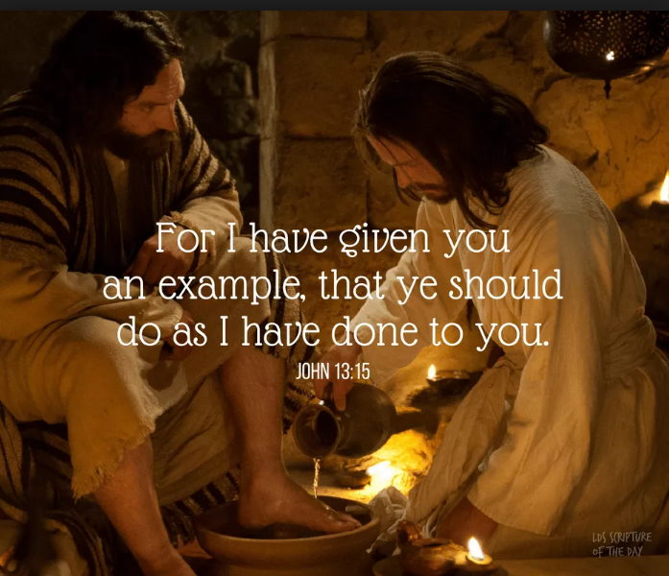

Slide 3
imitatio Christi

Slide 4
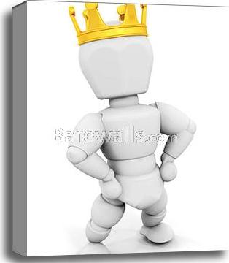

Slide 5
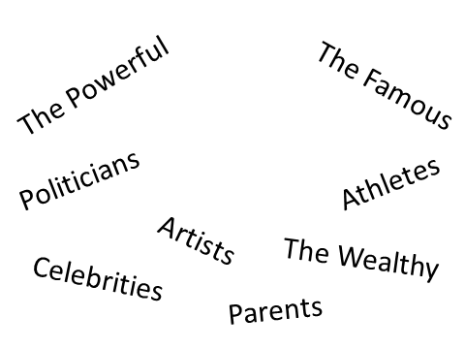

Slide 6
“A slave will not be instructed by words alone; for though he understands, there will be no response.” -- Proverbs 29:19
“Be imitators of me, just as I also am of Christ” -- 1 Corinthians 11:1
“Therefore be imitators of God, as beloved children…” -- Ephesians 5:1

Slide 7
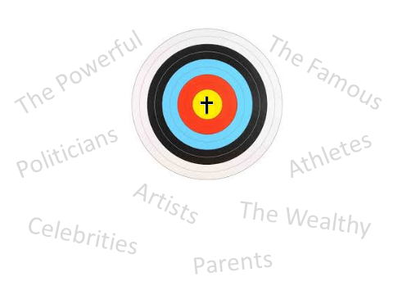

Slide 8
“Therefore you are to be perfect, as your heavenly Father is perfect.” -- Matthew 5:48
“but like the Holy One who called you, be holy yourselves also in all your behavior; because it is written, ‘YOU SHALL BE HOLY, FOR I AM HOLY.’” -- 1 Peter 1:15-16

Slide 9
Why should we imitate Jesus?
Because we are commanded to
Ephesians 5:1, “Therefore be imitators of God, as beloved children…”
Because it glorifies God
Matthew 5:16, “Let your light shine before men in such a way that they may see your good works, and glorify your Father who is in heaven.”

Slide 10


Slide 11
Because we will be more joyful and fulfilled
1 Thessalonians 1:6, “You also became imitators of us and of the Lord, having received the word in much tribulation with the joy of the Holy Spirit…”

Slide 12
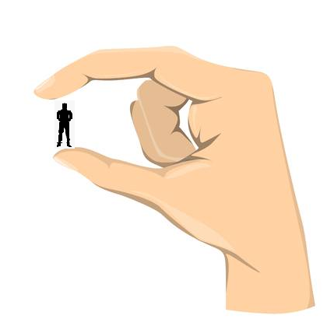

Slide 13


Slide 14


Slide 15
To be an example to other believers
1 Thessalonians 1:6-7, You also became imitators of us and of the Lord, having received the word in much tribulation with the joy of the Holy Spirit, so that you became an example to all the believers in Macedonia and in Achaia.
Because it will witness to and make an impression on non-believers
2 Corinthians 3:2-3, “2 You are our letter, written in our hearts, known and read by all men; 3 being manifested that you are a letter of Christ, cared for by us, written not with ink but with the Spirit of the living God, not on tablets of stone but on tablets of human hearts.”

Slide 16
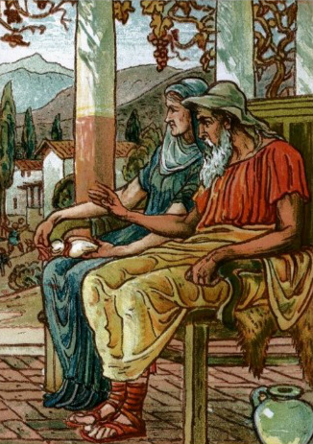
Philemon and Baucis

Slide 17
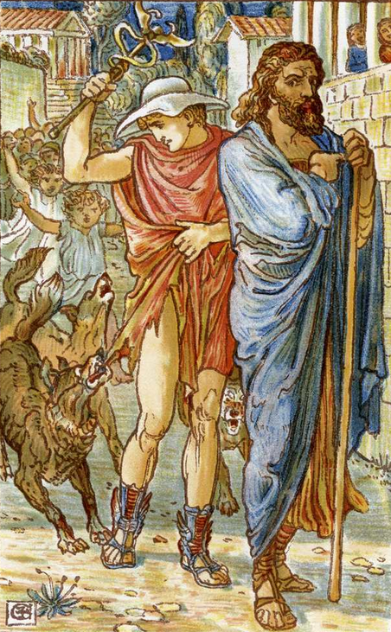

Slide 18
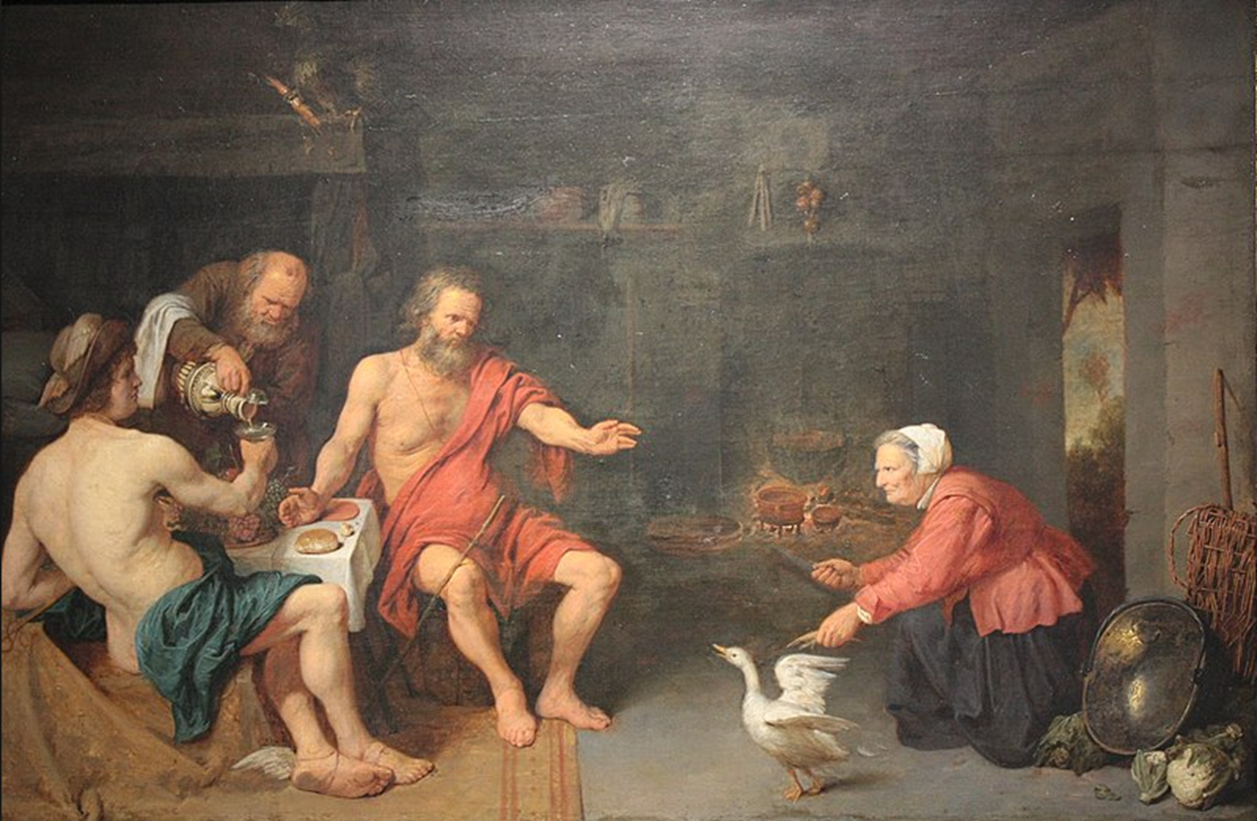

Slide 19
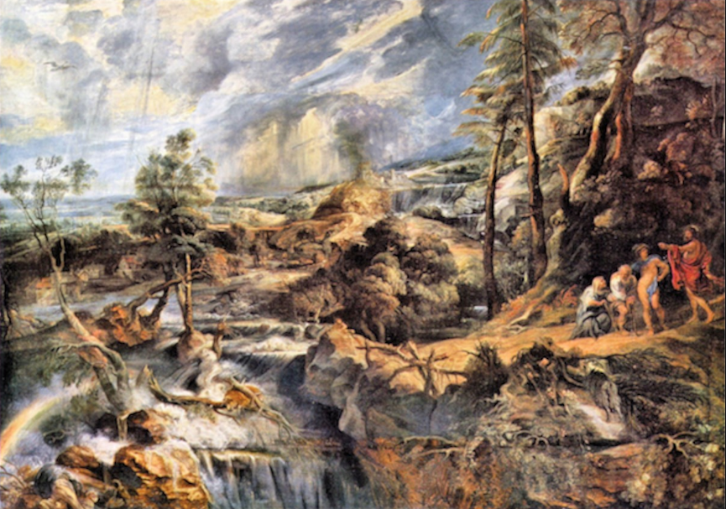

Slide 20
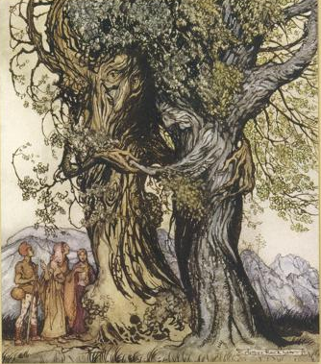

Slide 21
Jesus went before us
Romans 15:7 Therefore, accept one another, just as Christ also accepted us to the glory of God.
Ephesians 5:2 and walk in love, just as Christ also loved you and gave Himself up for us, an offering and a sacrifice to God as a fragrant aroma.
Ephesians 5:25 Husbands, love your wives, just as Christ also loved the church and gave Himself up for her,
Ephesians 5:29 for no one ever hated his own flesh, but nourishes and cherishes it, just as Christ also does the church,
Matthew 20:28 just as the Son of Man did not come to be served, but to serve, and to give His life a ransom for many.”

Slide 22
Luke 6:36 Be merciful, just as your Father is merciful.
John 15:12 [ Disciples’ Relation to Each Other ] “This is My commandment, that you love one another, just as I have loved you.
John 17:22 [ Their Future Glory ] The glory which You have given Me I have given to them, that they may be one, just as We are one;
Ephesians 4:32 Be kind to one another, tender-hearted, forgiving each other, just as God in Christ also has forgiven you.
Colossians 3:13 bearing with one another, and forgiving each other, whoever has a complaint against anyone; just as the Lord forgave you, so also should you.
1 John 3:3 And everyone who has this hope fixed on Him purifies himself, just as He is pure.

Slide 23
1 John 3:7 Little children, make sure no one deceives you; the one who practices righteousness is righteous, just as He is righteous;
1 Peter 2:21 For you have been called for this purpose, since Christ also suffered for you, leaving you an example for you to follow in His steps,
1 Peter 4:4 Therefore, since Christ has suffered in the flesh, arm yourselves also with the same purpose, because he who has suffered in the flesh has ceased from sin,
Philippians 2:5 Have this attitude in yourselves which was also in Christ Jesus,
John 13:34 A new commandment I give to you, that you love one another, even as I have loved you, that you also love one another.
1 Peter 1:16 because it is written, “You shall be holy, for I am holy.”

Slide 24
Compassion

Slide 25
Matthew 20:29-34
29 As they were leaving Jericho, a large crowd followed Him.
30 And two blind men sitting by the road, hearing that Jesus was passing by, cried out, “Lord, have mercy on us, Son of David!”
31 The crowd sternly told them to be quiet, but they cried out all the more, “Lord, Son of David, have mercy on us!”
32 And Jesus stopped and called them, and said, “What do you want Me to do for you?”
33 They said to Him, “Lord, we want our eyes to be opened.”
34 Moved with compassion, Jesus touched their eyes; and immediately they regained their sight and followed Him.

Slide 26
Matthew 20:18-19
Behold, we are going up to Jerusalem; and the Son of Man will be delivered to the chief priests and scribes, and they will condemn Him to death, and will hand Him over to the Gentiles to mock and scourge and crucify Him, and on the third day He will be raised up.

Slide 27
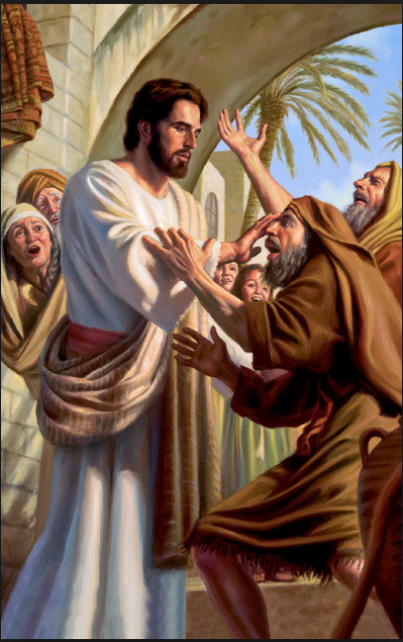
“Lord,
Son of David,
have mercy on us!”

Slide 28
2 Samuel 7:12-13
12 When your days are complete and you lie down with your fathers, I will raise up your descendant after you, who will come forth from you, and I will establish his kingdom.
13 He shall build a house for My name, and I will establish the throne of his kingdom forever.”

Slide 29
Matthew 12:22-23
22 Then a demon-possessed man who was blind and mute was brought to Jesus, and He healed him, so that the mute man spoke and saw.
23 All the crowds were amazed, and were saying, “This man cannot be the Son of David, can he?”

Slide 30
Faith is not limited by money
Faith is not limited by social status
Faith is not limited by lack of skills
Faith is not limited by education
Faith is not limited by what others think of you
Faith is only limited by one thing: you

Slide 31
1 Samuel 16:7
But the Lord said to Samuel, “Do not look at his appearance or at the height of his stature, because I have rejected him; for God sees not as man sees, for man looks at the outward appearance, but the Lord looks at the heart.”

Slide 32
Hosea 6:3a
“So let us know, let us press on to know the Lord.”

Slide 33
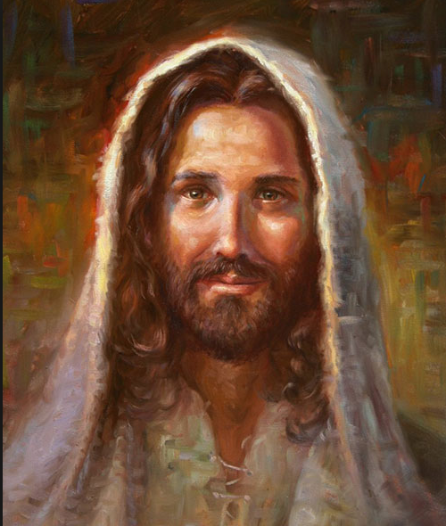
“What do you want Me to do for you?”

Slide 34
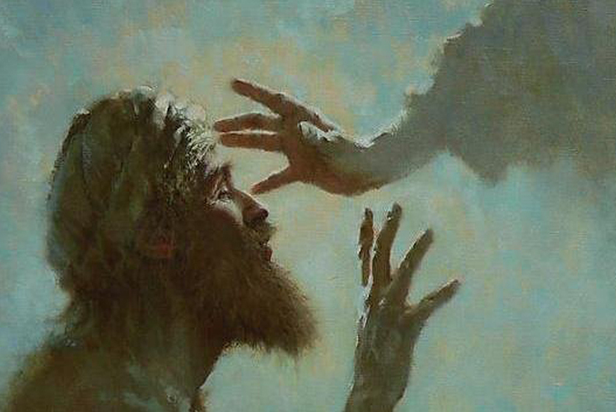

Slide 35
Imitation
Let your heart be broken
Nehemiah 1
1 The words of Nehemiah the son of Hacaliah. Now it happened in the month Chislev, in the twentieth year, while I was in Susa the capitol,
2 that Hanani, one of my brothers, and some men from Judah came; and I asked them concerning the Jews who had escaped and had survived the captivity, and about Jerusalem.
3 They said to me, “The remnant there in the province who survived the captivity are in great distress and reproach, and the wall of Jerusalem is broken down and its gates are burned with fire.”
4 When I heard these words, I sat down and wept and mourned for days; and I was fasting and praying before the God of heaven.

Slide 36
Nehemiah 2:17
17 Then I said to them, “You see the bad situation we are in, that Jerusalem is desolate and its gates burned by fire. Come, let us rebuild the wall of Jerusalem so that we will no longer be a reproach.”

Slide 37
Practice Acceptance
Matthew 5:7
Blessed are the merciful, for they shall receive mercy.
Matthew 7:12
In everything, therefore, treat people the same way you want them to treat you…
Romans 12:18
If possible, so far as it depends on you, be at peace with all men.

Slide 38
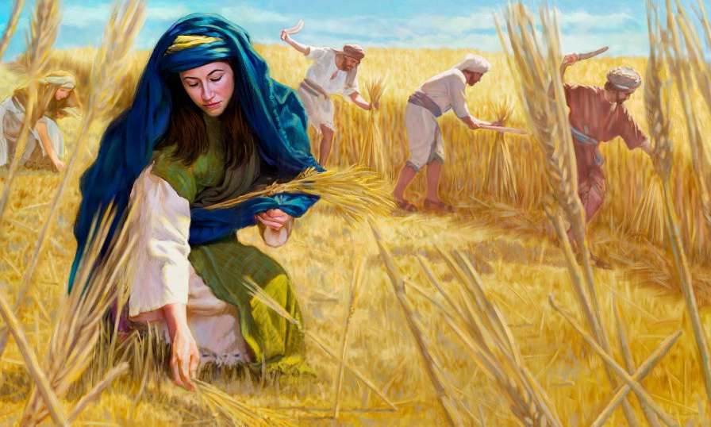
When she rose to glean, Boaz commanded his servants, saying, “Let her glean even among the sheaves, and do not insult her.”

Slide 39
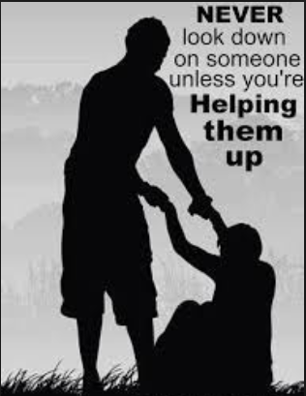
Stand with the oppressed

Slide 40
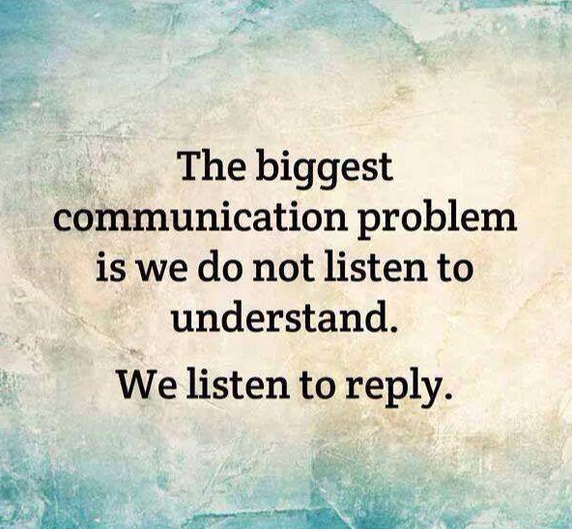
Listen to people

Slide 41
Philippians 2:3-5
Do nothing from selfishness or empty conceit, but with humility of mind regard one another as more important than yourselves; do not merely look out for your own personal interests, but also for the interests of others. Have this attitude in yourselves which was also in Christ Jesus…

Slide 42
Get off of your phone and computer and spend time with people
“When people are socially isolated, they’re more likely to be depressed and more likely to not deal with their weight problem or something like that.” “Being online a lot may be what’s keeping us from more valuable, supportive in-person relationships.”
-- Dr. Primack, professor of medicine, pediatrics, and clinical and translational science at the University of Pittsburgh School of Medicine
A study of depression 612,000 adolescents and young adults found a 52% increase in depression from 2005 to 2017 for teenagers and a 63% increase in depression for young adults. This was correlated with cell phone use.
Smartphone or Internet addiction can also negatively impact your life by:
Increasing loneliness and depression
Fueling anxiety
Increasing stress
Exacerbating attention deficit disorders
Diminishing your ability to concentrate and think deeply or creatively
Disturbing your sleep
Encouraging self-absorption

Slide 43
Look around you; be aware of others
Mark 16:7
“But go, tell His disciples and Peter, ‘He is going ahead of you to Galilee; there you will see Him, just as He told you.’”

Slide 44
Praise and encourage
1 Thessalonians 5:11
Therefore encourage one another and build up one another…
Hebrews 3:13
But encourage one another day after day, as long as it is still called “Today,” so that none of you will be hardened by the deceitfulness of sin.

Slide 45

Actually help
Psalm 102:20
To hear the groaning of the prisoner, To set free those who were doomed to death.

Slide 46
Compassion International

Slide 47
Once a month plan to do something compassionate

Slide 48
I was hungry
  and you formed a humanities club
  and you discussed my hunger.
  Thank you.
I was imprisoned
  and you crept off quietly to your basement chapel
  and prayed for my release.
I was naked
  and in your mind you debated the morality of my appearance.
I was sick
  and you knelt
  and thanked God for your health.
I was homeless
  and you preached to me of the spiritual shelter of the love of God.

Slide 49
I was lonely
  and you left me alone to pray for me.
You seem so holy
  so close to God.
But I'm still hungry
  and lonely
  and cold.
So where have the prayers gone?
  What have they done?
What does it profit a man to page through his book of prayers
  when the rest of the world
  is crying for his help?

Slide 50
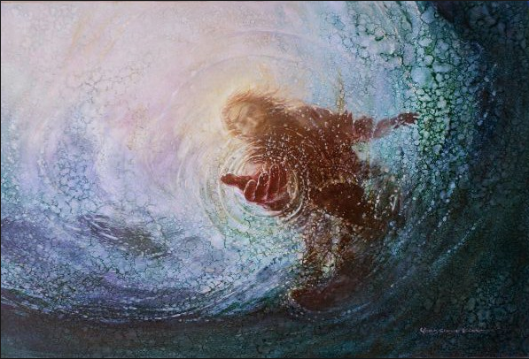
When someone is drowning in life’s crises you be the one to pull them out

Slide 51
“Do you want to do something beautiful for God?
There is a person who needs you.
This is your chance.”
– Mother Theresa

Slide 52
Standing for Righteousness

Slide 53
Mark 11:12-26
12 On the next day, when they had left Bethany, He became hungry.
13 Seeing at a distance a fig tree in leaf, He went to see if perhaps He would find anything on it; and when He came to it, He found nothing but leaves, for it was not the season for figs.
14 He said to it, “May no one ever eat fruit from you again!” And His disciples were listening.
15 Then they came to Jerusalem. And He entered the temple and began to drive out those who were buying and selling in the temple, and overturned the tables of the money changers and the seats of those who were selling doves;
16 and He would not permit anyone to carry merchandise through the temple.
17 And He began to teach and say to them, “Is it not written, ‘My house shall be called a house of prayer for all the nations’? But you have made it a robbers’ den.”
18 The chief priests and the scribes heard this, and began seeking how to destroy Him; for they were afraid of Him, for the whole crowd was astonished at His teaching.

Slide 54
19 When evening came, they would go out of the city.
20 As they were passing by in the morning, they saw the fig tree withered from the roots up.
21 Being reminded, Peter said to Him, “Rabbi, look, the fig tree which You cursed has withered.”
22 And Jesus answered saying to them, “Have faith in God.
23 Truly I say to you, whoever says to this mountain, ‘Be taken up and cast into the sea,’ and does not doubt in his heart, but believes that what he says is going to happen, it will be granted him.
24 Therefore I say to you, all things for which you pray and ask, believe that you have received them, and they will be granted you.
25 Whenever you stand praying, forgive, if you have anything against anyone, so that your Father who is in heaven will also forgive you your transgressions.
26 [But if you do not forgive, neither will your Father who is in heaven forgive your transgressions.”]

Slide 55
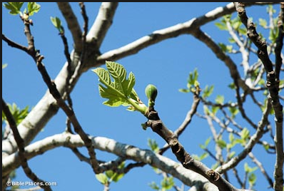

Slide 56
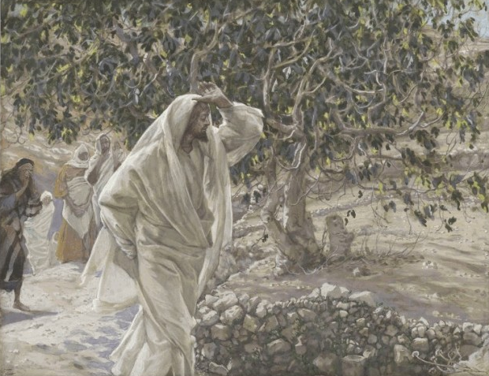

Slide 57
2 Corinthians 9:8
And God is able to bless you abundantly, so that in all things at all times, having all that you need, you will abound in every good work.
Bless you abundantly
All things
All times
All that you need
Abound
Every good work
God

Slide 58
2 Timothy 4:7
I have fought the good fight, I have finished the course, I have kept the faith.

Slide 59
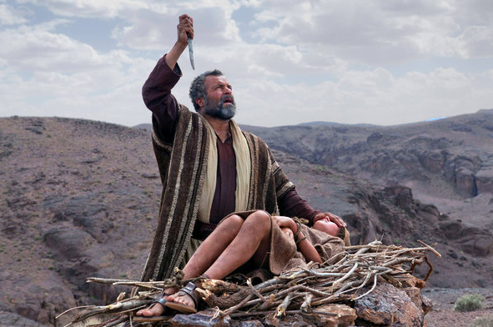
Temple
Genesis 22:14
So Abraham called that place The Lord Will Provide. And to this day it is said, ‘On the mountain of the Lord it will be provided.’

Slide 60
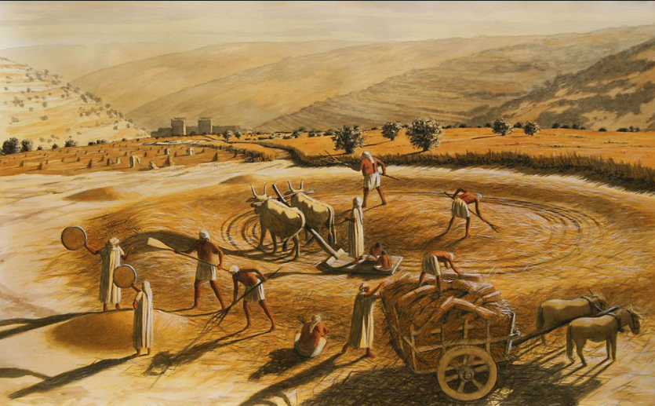
2 Samuel 24:18
On that day Gad went to David and said to him, ‘Go up and build an altar to the Lord on the threshing floor of Araunah the Jebusite.’

Slide 61
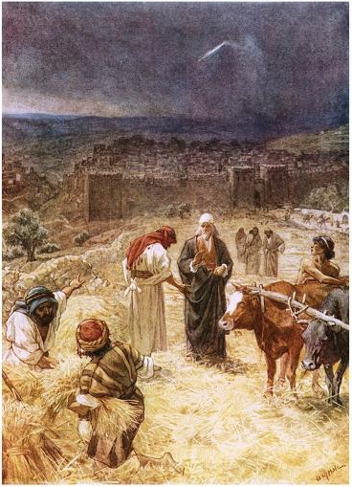

Slide 62
1 Chronicles 22:6-10
6 Then he called for his son Solomon and charged him to build a house for the Lord, the God of Israel.
7 David said to Solomon: “My son, I had it in my heart to build a house for the Name of the Lord my God.
8 But this word of the Lord came to me: ‘You have shed much blood and have fought many wars. You are not to build a house for my Name, because you have shed much blood on the earth in my sight.
9 But you will have a son who will be a man of peace and rest, and I will give him rest from all his enemies on every side. His name will be Solomon, and I will grant Israel peace and quiet during his reign.
10 He is the one who will build a house for my Name. He will be my son, and I will be his father. And I will establish the throne of his kingdom over Israel forever.’

Slide 63
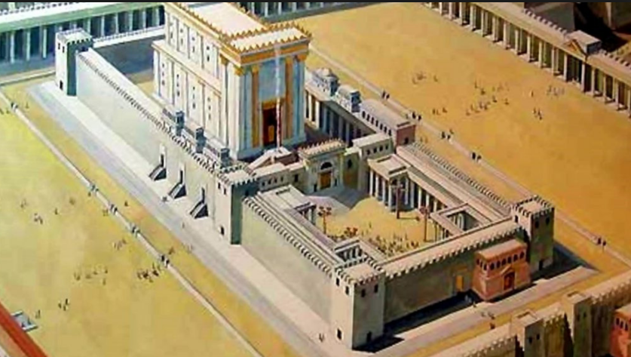

Slide 64
Genesis 3:23
So the Lord God banished him from the Garden of Eden to work the ground from which he had been taken.
Genesis 33:19-20
And He said, “I Myself will make all My goodness pass before you, and will proclaim the name of the Lord before you; and I will be gracious to whom I will be gracious, and will show compassion on whom I will show compassion.”
20 But He said, “You cannot see My face, for no man can see Me and live!”

Slide 65
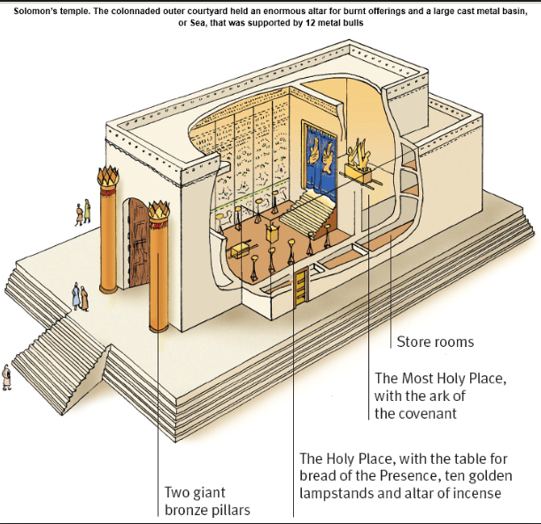

Slide 66
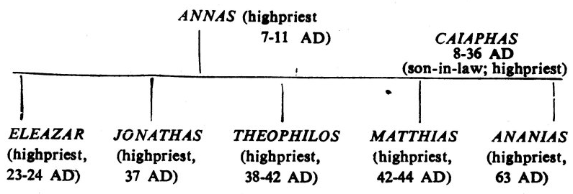
John 12:10
But the chief priests planned to put Lazarus to death also…

Slide 67
Matthew 26:57
Those who had seized Jesus led Him away to Caiaphas, the high priest, where the scribes and the elders were gathered together.
Luke 3:2
in the high priesthood of Annas and Caiaphas, the word of God came to John, the son of Zacharias, in the wilderness.

Slide 68
Leviticus 1:2
Speak to the sons of Israel and say to them, “When any man of you brings an offering to the Lord, you shall bring your offering of animals from the herd or the flock.”
Exodus 22:25
If you lend money to My people, to the poor among you, you are not to act as a creditor to him; you shall not charge him interest.

Slide 69
Mark 12:41-44
41 And He sat down opposite the treasury, and began observing how the people were putting money into the treasury; and many rich people were putting in large sums.
42 A poor widow came and put in two small copper coins, which amount to a cent.
43 Calling His disciples to Him, He said to them, “Truly I say to you, this poor widow put in more than all the contributors to the treasury;
44 for they all put in out of their surplus, but she, out of her poverty, put in all she owned, all she had to live on.”

Slide 70
2 Chronicles 16:9a
For the eyes of the Lord move to and fro throughout the earth that He may strongly support those whose heart is completely His.

Slide 71
X
For God so loved the world that He gave His only begotten Son so that whoever believes in Him shall not perish but have eternal life.
For God so demanded only the very best that He took and those who did not bring the very best He rejected.

Slide 72
“The chief priests and the scribes heard this, and began seeking how to destroy Him; for they were afraid of Him, for the whole crowd was astonished at His teaching.”

Slide 73
verses 22-25
Faith
Prayer
forgiveness

Slide 74
Luke 6:45
The good man out of the good treasure of his heart brings forth what is good; and the evil man out of the evil treasure brings forth what is evil; for his mouth speaks from that which fills his heart.

Slide 75
Imitation
We must be courageous
Matthew 5:6
Blessed are those who hunger and thirst for righteousness, for they shall be satisfied.
Matthew 5:10
Blessed are those who have been persecuted for the sake of righteousness, for theirs is the kingdom of heaven.”

Slide 76
Joshua 1:9
Have I not commanded you? Be strong and courageous! Do not tremble or be dismayed, for the Lord your God is with you wherever you go.
2 Timothy 1:7
For God has not given us a spirit of timidity, but of power and love and discipline.
Verse 8
Therefore do not be ashamed of the testimony of our Lord or of me His prisoner, but join with me in suffering for the gospel according to the power of God...

Slide 77
Deuteronomy 20:1
When you go out to battle against your enemies and see horses and chariots and people more numerous than you, do not be afraid of them; for the Lord your God, who brought you up from the land of Egypt, is with you.

Slide 78
Matthew 10:16
Behold, I send you out as sheep in the midst of wolves; so be shrewd as serpents and innocent as doves.

Slide 79
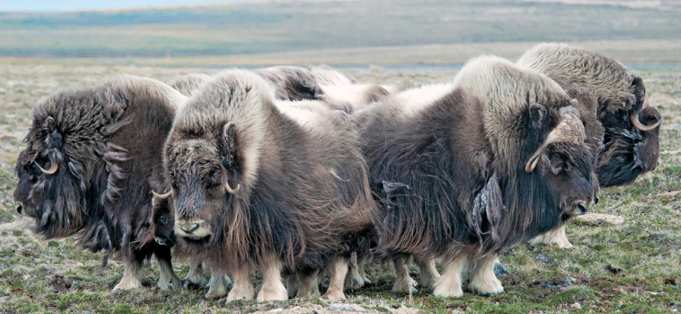

Slide 80
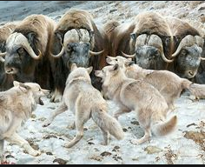

Slide 81
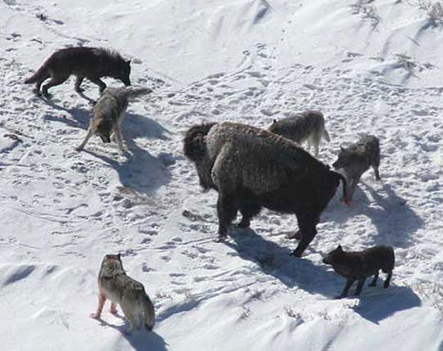

Slide 82
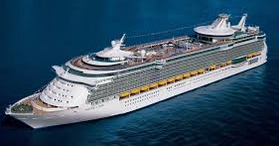
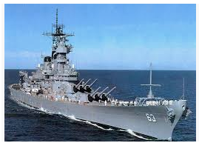

Slide 83
Moses stood against Pharaoh and led the children of Israel out of Egypt.
Elijah stood against the prophets of Baal and won a mighty contest on Mount Carmel.
Daniel stood up for his God by faithfully praying to Him even though he ended up in a lion’s den.
Shadrach, Meshach, and Abednego stood against idolatry by refusing to bow down to Nebuchadnezzar’s image and ended up in the fiery furnace.
Peter and John stood up against the Sanhedrin to stress the importance of sharing the Gospel.
The 144,000 in Revelation will stand against the anti-Christ and his armies and see many saved during the Tribulation.

Slide 84
Be righteous yourself
2 Timothy 2:22
Now flee from youthful lusts and pursue righteousness, faith, love and peace, with those who call on the Lord from a pure heart.
2 Timothy 3:16
All Scripture is inspired by God and profitable for teaching, for reproof, for correction, for training in righteousness; 17 so that the man of God may be adequate, equipped for every good work.

Slide 85
1) Watch your language
2) Matthew 7:12, “In everything, therefore, treat people the same way you want them to treat you…”
3) Don’t gossip – Romans 1:29 “being filled with all unrighteousness, wickedness, greed, evil; full of envy, murder, strife, deceit, malice; they are gossips…”
4) Practice the fruit of the Spirit (Galatians 5:22-23, “love, joy, peace, patience, kindness, goodness, faithfulness, gentleness, self-control”)
5) Be quick to repent and quicker to forgive

Slide 86
Actively expose sin
Ephesians 6:14
Stand firm therefore, having girded your loins with truth, and having put on the breastplate of righteousness
Philippians 2:15
so that you will prove yourselves to be blameless and innocent, children of God above reproach in the midst of a crooked and perverse generation, among whom you appear as lights in the world…

Slide 87
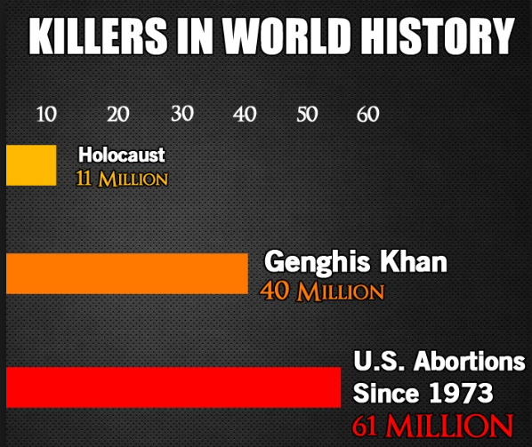
Actively expose sin

Slide 88
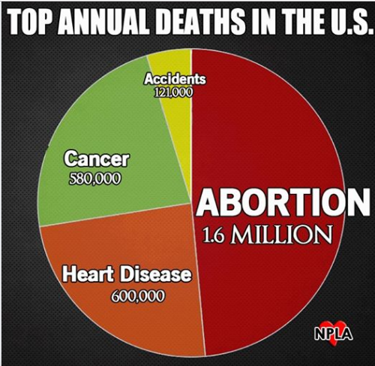

Slide 89
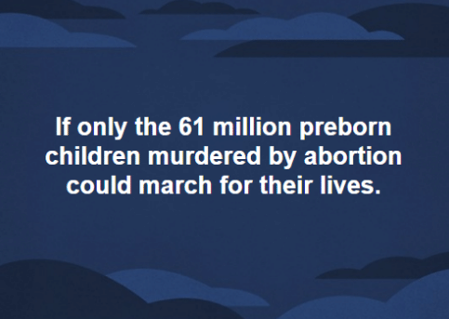

Slide 90
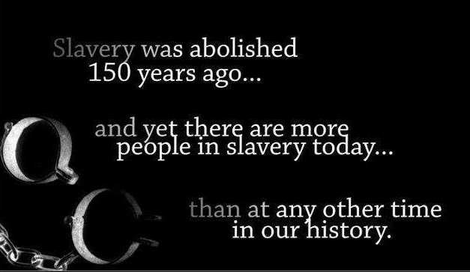

Slide 91
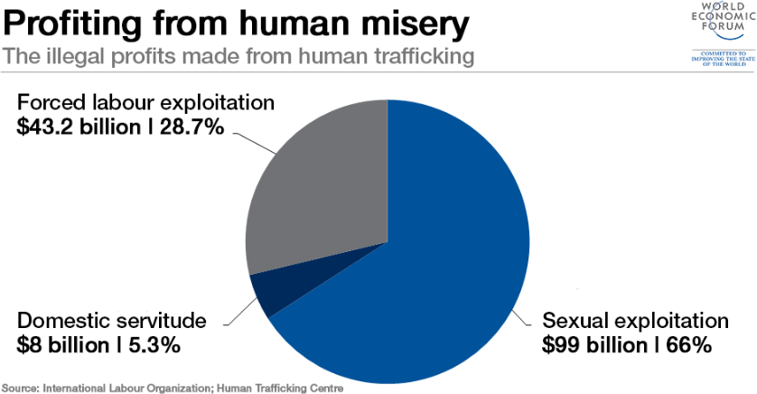

Slide 92
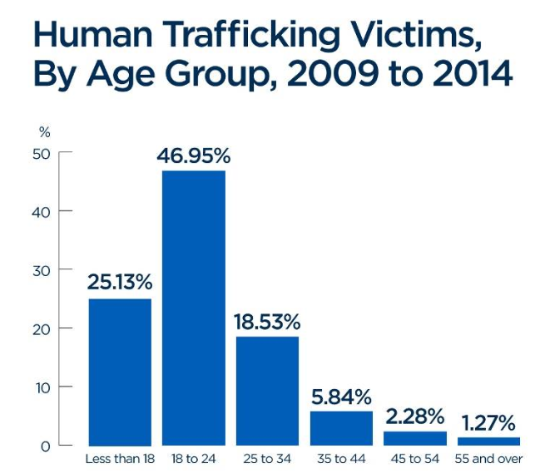

Slide 93
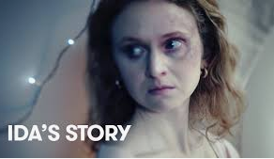

Slide 94
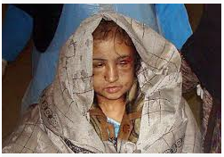

Slide 95
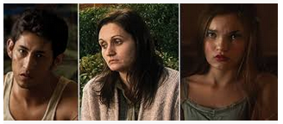

Slide 96
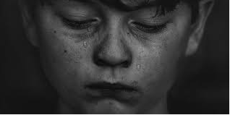

Slide 97
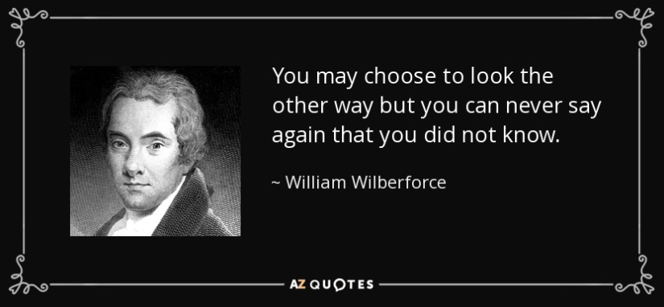

Slide 98


Slide 99
Choose what is right over being right
Your goal is not to prove that your view is the correct one. Your goal is to align yourself with what is true and right.

Slide 100
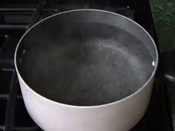
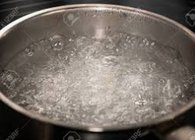
Persevere
211˚ Fahrenheit
212˚ Fahrenheit
Galatians 6:9
Let us not lose heart in doing good, for in due time we will reap if we do not grow weary.

Slide 101
People in the Bible who Persevered
Job
Joseph
Moses
Peter

Slide 102
2 Peter 1:3-4
Seeing that His divine power has granted to us everything pertaining to life and godliness, through the true knowledge of Him who called us by His own glory and excellence.
4 For by these He has granted to us His precious and magnificent promises, so that by them you may become partakers of the divine nature, having escaped the corruption that is in the world by lust.

Slide 103
Hebrews 11
Noah
Abraham
Sarah
Gideon
Barak
Samson
Jephthah
David
Samuel
Those who were tortured
Those who were mocked
Those who were scourged
Those in chains and imprisonment
Those who were stoned
Those who were sawn in two
Those who were tempted
Those who were put to death with the sword
Those who were went about in goatskins
Those who were destitute
Those who were afflicted
Those who were ill-treated
Those who wandered in deserts and mountains and caves and holes in the ground
Verse 38
Those of whom the world was not worthy

Slide 104


Slide 105
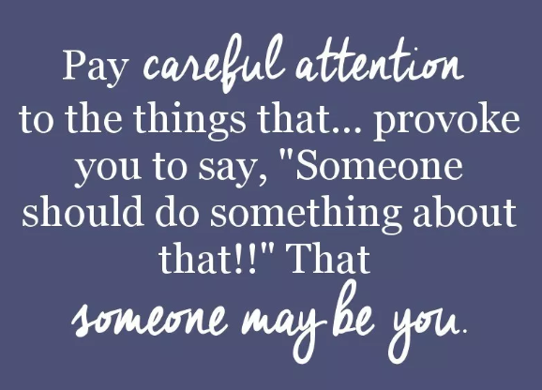
You’re the one to do it

Slide 106
First they came for the socialists, and I did not speak out—because I was not a socialist.
Then they came for the trade unionists, and I did not speak out— because I was not a trade unionist.
Then they came for the Jews, and I did not speak out—because I was not a Jew.
Then they came for me—and there was no one left to speak for me.
Martin Niemöller

Slide 107
Forgiveness

Slide 108
Forgiveness
Luke 23:33-34
33 When they came to the place called The Skull, there they crucified Him and the criminals, one on the right and the other on the left.
34 But Jesus was saying, “Father, forgive them; for they do not know what they are doing.” And they cast lots, dividing up His garments among themselves.

Slide 109
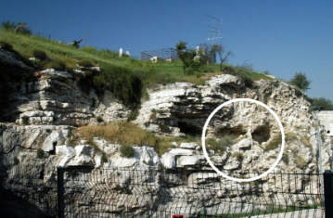
the place called The Skull

Slide 110
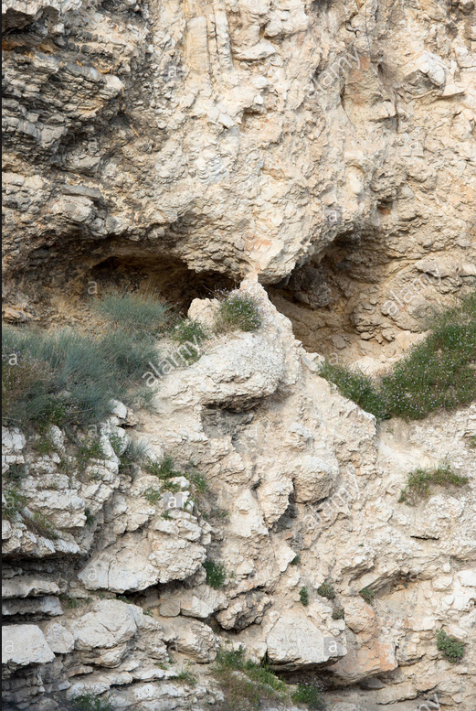

Slide 111
Seven Phrases of Jesus on the Cross
Order | Scripture | Saying | Words of:
1 | Luke 23:34 | Father, forgive them; for they do not know what they are doing. | Forgiveness
2 | Luke 23:43 | Truly, I say to you, today you will be with me in paradise. | Salvation
3 | John 19:26–27 | Woman, behold your son. Son, behold your mother. | Relationship
4 | Matthew 27:46, Mark 15:34 | My God, My God, why have you forsaken me? | Abandonment
5 | John 19:28 | I thirst. | Distress
6 | John 19:30 | It is finished. | Triumph
7 | Luke 23:46 | Father, into thy hands I commit my spirit. | Reunion

Slide 112
The two criminals on either side of Him were insulting Him.
The Roman soldiers were gambling for His clothes.
The crowd that was passing by Him were hurling abuse at Him.
The religious leaders were mocking Him.
His Father in Heaven would forsake Him

Slide 113
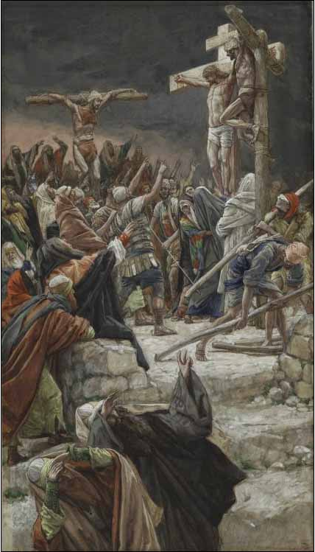
After the shouts of the soldiers giving instructions

Slide 114
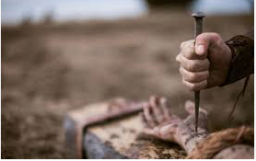
After the clank of the hammer hitting the nails into His hands and feet

Slide 115
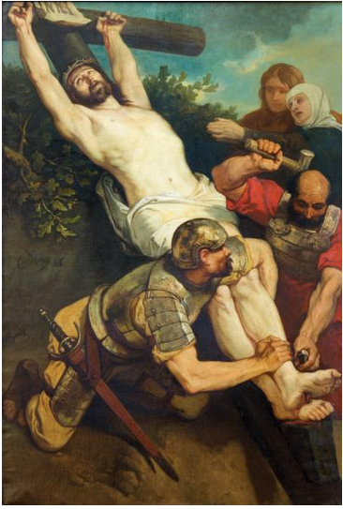
After the thump of the cross hitting the bottom of the hole as it was raised upright

Slide 116
“Father, forgive them; for they do not know what they are doing.”

Slide 117
One of the two criminals had the faith to believe and Jesus promised that he would be with Jesus in Paradise.
A Roman centurion proclaimed, “Surely this man was the Son of God!”
Nicodemus, one of the religious leaders, came to the tomb to anoint Jesus with 75 pounds of myrrh and aloes.
3,000 in Acts 2 will be saved at the start of the church.
Eventually, millions will come to receive Jesus as Lord and Savior

Slide 118
“And they cast lots, dividing up His garments among themselves”
Psalm 22:18
They divide my garments among them, and for my clothing they cast lots.

Slide 119
Matthew 18:21-35
21 Then Peter came and said to Him, “Lord, how often shall my brother sin against me and I forgive him? Up to seven times?”
22 Jesus said to him, “I do not say to you, up to seven times, but up to seventy times seven.
23 “For this reason the kingdom of heaven may be compared to a king who wished to settle accounts with his slaves.
24 When he had begun to settle them, one who owed him ten thousand talents was brought to him.
25 But since he did not have the means to repay, his lord commanded him to be sold, along with his wife and children and all that he had, and repayment to be made.

Slide 120
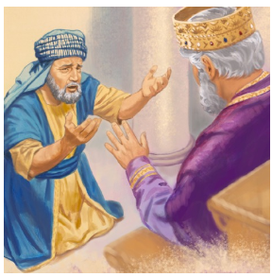
26 So the slave fell to the ground and prostrated himself before him, saying, ‘Have patience with me and I will repay you everything.’

Slide 121

27 And the lord of that slave felt compassion and released him and forgave him the debt.
28 But that slave went out and found one of his fellow slaves who owed him a hundred denarii; and he seized him and began to choke him, saying, ‘Pay back what you owe.’

Slide 122

29 So his fellow slave fell to the ground and began to plead with him, saying, ‘Have patience with me and I will repay you.’
30 But he was unwilling and went and threw him in prison until he should pay back what was owed.

Slide 123
31 So when his fellow slaves saw what had happened, they were deeply grieved and came and reported to their lord all that had happened.
32 Then summoning him, his lord said to him, ‘You wicked slave, I forgave you all that debt because you pleaded with me.
33 Should you not also have had mercy on your fellow slave, in the same way that I had mercy on you?’

Slide 124

34 And his lord, moved with anger, handed him over to the torturers until he should repay all that was owed him.

Slide 125
35 My heavenly Father will also do the same to you, if each of you does not forgive his brother from your heart.”

Slide 126
The number 7 in the Bible indicates spiritual perfection and fullness
In Hebrew the word “seven’s” root word means “to be full”
God rested on the seventh day
Seven Sabbatical years followed by the year of Jubilee
There are seven gifts of the Holy Spirit
It took Solomon seven years to build the Temple in Jerusalem (1 Kings 6:37-38)
There are seven holy feasts days observed by Israel
Seven covenants of God with man: Adamic, Noahic, Abrahamic, Mosaic, Levitic, Davidic, and Messianic or new
Seven days was the usual time of mourning for the dead
Seven of Jesus’ miracles were on the Sabbath
There are seven churches in Revelation chapters 1 – 3
Many sevens in Revelation: seals, trumpets, bowls, angels, hills, kings, and final visions (chapters 20 – 21)

Slide 127


Talent
Denarius
Matthew 20:2, “When he had agreed with the laborers for a denarius for the day, he sent them into his vineyard.”

Slide 128
Mark 6:37
But He [Jesus] answered them, ‘You give them something to eat!’ And they said to Him, ‘Shall we go and spend two hundred denarii on bread and give them something to eat?’
1 Talent = 6,000 Denarii
10,000 Talents = 60,000,000 Denarii
750,000 lbs. to 14 oz.
$4,260,000,000 to $7,100

Slide 129

6 miles long

Slide 130

One person

Slide 131
2 Kings 4:1
Now a certain woman of the wives of the sons of the prophets cried out to Elisha, “Your servant my husband is dead, and you know that your servant feared the Lord; and the creditor has come to take my two children to be his slaves.”

Slide 132


Isaiah 59:2
For your sins have made a separation between you and your God.

Slide 133


Slide 134


Slide 135


Slide 136
2 Corinthians 5:21
He made Him who knew no sin to be sin on our behalf, so that we might become the righteousness of God in Him.
Colossians 2:13-14
When you were dead in your transgressions and the uncircumcision of your flesh, He made you alive together with Him, having forgiven us all our transgressions, having canceled out the certificate of debt consisting of decrees against us, which was hostile to us; and He has taken it out of the way, having nailed it to the cross.

Slide 137

Gal 3:27
For all of you who were baptized into Christ have clothed yourselves with Christ.

Slide 138
• It is free.
• It is complete.
• It is totally unconditional.
• He wants us to be just as free in our forgiveness of others.
• He wants us to be just as complete in our forgiveness of others.
• He wants us to be just as unconditional in our forgiveness of others.

Slide 139
It is far better to forgive and forget
than to hate and remember.

Slide 140


Slide 141

“they gave Him wine to drink mixed with gall; and after tasting it, He was unwilling to drink.” Matthew 27:34

Slide 142
Steps in Forgiving Others
The first step in forgiving is to recognize that God has greatly and abundantly and completely forgiven us.
We must first see in God what we want to have in ourselves.

Slide 143
Second, we need to pray.

Slide 144
Why don’t we forgive?
We want to see them suffer for what they did.
We want them to feel the same hurt that they made us to feel.
We want to give them the message that if they hurt me then they will feel pain also, so they better think twice about hurting me again.

Slide 145
Third, we need to see the deeper truth about the people who have hurt us; a truth that blinds us what they really are.

Slide 146


Slide 147


Slide 148
Fourth, you must realize that a lack of forgiveness will enslave you.

Slide 149
Hebrews 12:15
See to it that no one comes short of the grace of God; that no root of bitterness springing up causes trouble, and by it many be defiled.

Slide 150


Slide 151
Fifth, if necessary, tell someone else about your lack of forgiveness and ask them to pray for you.

Slide 152
Sixth, you will know that you have truly forgiven someone when you can spontaneously wish them well.

Slide 153


Slide 154


Slide 155
There is always a time to forgive.
That time is always now.
Your season of bitterness is over.
Your season of anger and plotting revenge is over.
Your season of chaining yourself to this other person’s hurt or disappointment is over.
It is a new season, a fresh season, a season is plant something new.

Slide 156


Slide 157
X
NOT WANT

Slide 158
The first slave did not ask for forgiveness; he asked for an extension of time.
The first slave didn’t understand the offer of forgiveness and so he was unable to grant it.

Slide 159



Slide 160


“Should you not also have had mercy on your fellow slave, even as I had mercy on you?”

Slide 161
• Because God has forgiven us
• Because unforgiveness will take over our lives and make us its slave
• Because forgiveness allows us to exhibit God’s grace, power, and forgiveness in our own lives
• Because God has so richly forgiven us how could not return even a morsel of forgiveness to someone else?

Slide 162
Stories

Slide 163
Matt 13:1-3a, 10-17
That day Jesus went out of the house and was sitting by the sea.
2 And large crowds gathered to Him, so He got into a boat and sat down, and the whole crowd was standing on the beach.
3 And He spoke many things to them in parables, saying [the parable of the sower]
10 And the disciples came and said to Him, “Why do You speak to them in parables?”
11 Jesus answered them, “To you it has been granted to know the mysteries of the kingdom of heaven, but to them it has not been granted.
12 For whoever has, to him more shall be given, and he will have an abundance; but whoever does not have, even what he has shall be taken away from him.
13 Therefore I speak to them in parables; because while seeing they do not see, and while hearing they do not hear, nor do they understand.
14 In their case the prophecy of Isaiah is being fulfilled, which says,

Slide 164
‘You will keep on hearing, but will not understand;
You will keep on seeing, but will not perceive;
15 For the heart of this people has become dull,
With their ears they scarcely hear,
And they have closed their eyes,
Otherwise they would see with their eyes,
Hear with their ears,
And understand with their heart and return,
And I would heal them.’
16 But blessed are your eyes, because they see; and your ears, because they hear.
17 For truly I say to you that many prophets and righteous men desired to see what you see, and did not see it, and to hear what you hear, and did not hear it.

Slide 165


Slide 166
There were those who were His followers. These people hung on Jesus’ every word and desired to understand what He said. This is why when they didn’t understand something they asked. For example in Matthew 13:36, “And His disciples came to Him and said, ‘Explain to us the parable of the tares of the field.’”
The second group was those who opposed Jesus and who had closed their ears and hearts to His message.
The third group was that great crowd who were on the fence. They would consider what Jesus had to say but to what effort would they make to understand it? If they realized that Jesus was more than a good teacher then they would know that He was not giving them lessons on where to plant seed. They would then think about it and think about it. Sometimes they might figure it out although that might be difficult and would require illumination by the Holy Spirit. Other times they would want to hear more from Jesus so they would come back. With additional information they then might be able to connect the dots.

Slide 167


Why Parables?
First, Jesus used parables in order to hide or conceal the true spiritual meaning of what He was teaching.

Slide 168
Matthew 10:27, “What I tell you in the darkness, speak in the light; and what you hear whispered in your ear, proclaim upon the housetops.”

Slide 169
Second, parables were a common means of communication and had been for many centuries in the Mideast culture.
Ezekiel 17:2-10 is the parable of the two eagles and the vine
2 Samuel 12:1-4 Nathan rebukes David with the parable of the rich man and his flocks who takes the one ewe lamb from the poor man.
Judges 9:8-15 is the parable of the trees trying to anoint a king.

Slide 170
Third, Jesus used parables to fulfill prophecy.
Matthew 13:34-35, “All these things Jesus spoke to the crowds in parables, and He did not speak to them without a parable. This was to fulfill what was spoken through the prophet: ‘I will open My mouth in parables; I will utter things hidden since the foundation of the world.’”
Psalm 78:1-4 particularly verse 2, “I will open my mouth in a parable; I will utter dark sayings of old…”

Slide 171
The root word of parable is “paraballo”
“Para” means “at or to one side of, side by side”
“ballo” means to “a throwing.”
Hence parable means “to throw alongside” as in a comparison.

Slide 172
What is a parable?
It is a comparison between two different things.
It is a short story usually between one sentence and several paragraphs.
It has a front side which is the story and a back side which is what is being illustrated.
The front side is not necessarily historical but will be true to life.
The front side is familiar, recognizable, and easily understood and will draw from nature, common activities or situations, family life, business, personnel interactions, and politics.
The back side is a spiritual principle or moral lesson that is harder to understand.
The back side is not stated or revealed in the story; it is hidden. It must be derived by reasoning and deduction.
It has one central point.
The details of the front side are there only to illustrate the main point and are not meant to call attention to themselves.

Slide 173

Luke 15:8-9
8 “Or what woman, if she has ten silver coins and loses one coin, does not light a lamp and sweep the house and search carefully until she finds it?
9 When she has found it, she calls together her friends and neighbors, saying, ‘Rejoice with me, for I have found the coin which I had lost!’”

Slide 174
Hidden Meaning
The reason was to hide spiritual meaning from those who have closed their eyes to the spiritual.

Slide 175

Matthew 13:24 – 30
The Parable of the Wheat and the Tares

Slide 176
Presentation of the story
Every Biblical parable presented a short story from beginning to end that was commonplace and familiar. They were relatable.

Slide 177
A comparison
The definition of “parable” is a comparison of one thing that is placed or “thrown” alongside another thing. This is the front side compared to the back side. They are two threads, the natural and the supernatural, that run alongside of and parallel to each other.

Slide 178



Luke 8:16, “Now no one after lighting a lamp covers it over with a container, or puts it under a bed; but he puts it on a lampstand, so that those who come in may see the light.
Front side – The familiar and natural
Back side – The supernatural
You don’t have a lit candle simply to cover it up.
Rather, you want to use it to brighten up as much as possible.
Likewise, you don’t have the Holy Spirit simply to cover it up under worldly conformity.
Rather, you want to brighten up as much of the world as possible.

Slide 179




Matthew 7:24 – 27, 24 “Therefore everyone who hears these words of Mine and acts on them, may be compared to a wise man who built his house on the rock. 25 And the rain fell, and the floods came, and the winds blew and slammed against that house; and yet it did not fall, for it had been founded on the rock. 26 Everyone who hears these words of Mine and does not act on them, will be like a foolish man who built his house on the sand. 27 The rain fell, and the floods came, and the winds blew and slammed against that house; and it fell—and great was its fall.”
Front side – The familiar and natural
Back side – The supernatural
A rock is solid and firm and is safer to build a house on than sand which shifts and washes away.
Jesus is an eternally solid and firm foundation on which to build a life rather than riches and power which shifts and is capricious.

Slide 180


Slide 181
What did you see?
Did you see the face of Jesus?
Did you see a crowd scene?

Slide 183


Slide 184
Imitation
When presenting Jesus to people use stories in addition to Scripture and Truthful Statements

Slide 185



Slide 186


Slide 187
God is the solution to real life situations.

Slide 188
Nobody ever bought a drill because they actually wanted a drill. They bought a drill because they wanted a hole.
Therefore, if you want to sell drills, you should advertise information about making holes – NOT information about drills.
People mostly get saved because they want forgiveness or meaning or the assurance of Heaven. Bring the Gospel to people’s needs.

Slide 189
Isaiah 1:18
“Come now, and let us reason together,” Says the Lord, “Though your sins are as scarlet, They will be as white as snow; Though they are red like crimson, They will be like wool.”

Slide 190
“People buy from people they know, like or trust.”
You be that person.
People often don’t buy for logical reasons. Many times they buy for emotional reasons. Stories grab hold of our emotions.

Slide 191
In survival, the rule of three states that you can survive no more than:
Three minutes without oxygen
Three hours without warmth
Three days without water
Three weeks without food

Slide 192
In spiritual survival we neglect to spend time with God by not reading our Bible. Then the consequences will be:
Worry
Anxiety
Frustration
Discouragement
Anger
A host of other wrong attitudes or temperaments

Slide 193
You catch people with stories.
You then engage people with ideas.

Slide 194

Apple – “1984” which appeared during the 1984 Super Bowl.

Slide 195


Slide 196


Slide 197


Slide 198


Slide 199

Wendy’s – “Where’s the Beef?” also in 1984

Slide 200

Tootsie Pop – “How many licks?” from 1968

Slide 201


Slide 202


Slide 203
John 3:16
For God so loved the world, that He gave His only begotten Son, that whoever believes in Him shall not perish, but have eternal life.
There are two sets of beings:
  God and His Son who are both quite powerful
  “Whoever” these people are quite helpless
The “whoever” are going to perish. This is the story’s problem and conflict.
But God loves these “whoever” people.
The rescue from perishing is for God to send His Son.
If the people then believe in His Son they will not perish. This is the resolution to the problem and conflict.
And beyond not perishing they will moreover have eternal life.

Slide 204


Slide 205
Something
To
Always
Remember

Slide 206


Slide 207
Matthew 13:52
And Jesus said to them, “Therefore every scribe who has become a disciple of the kingdom of heaven is like a head of a household, who brings out of his treasure things new and old.

