Slide 1
Imitating Jesus
Part 2
Bob LaForge

Slide 2
“Where can I find peace?”
“How can I be happy?”
“I want joy; where can I find it?”
“I need some stability in my life.”
“Where is love? Where is hope?”
“I need to forgive,
and I want to be forgiven.”

Slide 3
John 14:1-5
“Do not let your heart be troubled; believe in God, believe also in Me.
2 In My Father’s house are many rooms; if that were not so, I would have told you, because I am going there to prepare a place for you.
3 And if I go and prepare a place for you, I am coming again and will take you to Myself, so that where I am, there you also will be.
4 And you know the way where I am going.”
5 Thomas said to Him, “Lord, we do not know where You are going; how do we know the way?”

Slide 4
John 14:6
Jesus said to him, “I am the way, and the truth, and the life; no one comes to the Father except through Me.”

Slide 5
Matthew 7:17-19
17 So every good tree bears good fruit, but the bad tree bears bad fruit.
18 A good tree cannot bear bad fruit, nor can a bad tree bear good fruit.
19 Every tree that does not bear good fruit is cut down and thrown into the fire.
20 So then, you will know them by their fruits.

Slide 6
Proverbs 29:19
A slave will not be instructed by words alone; for though he understands, there will be no response.

Slide 7
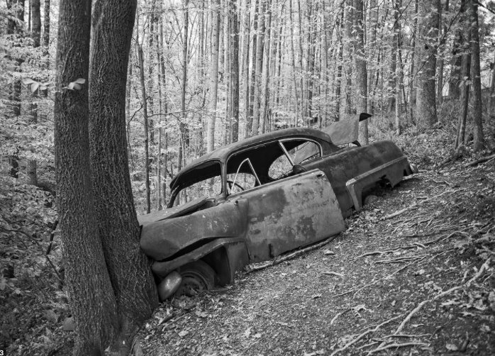

Slide 8
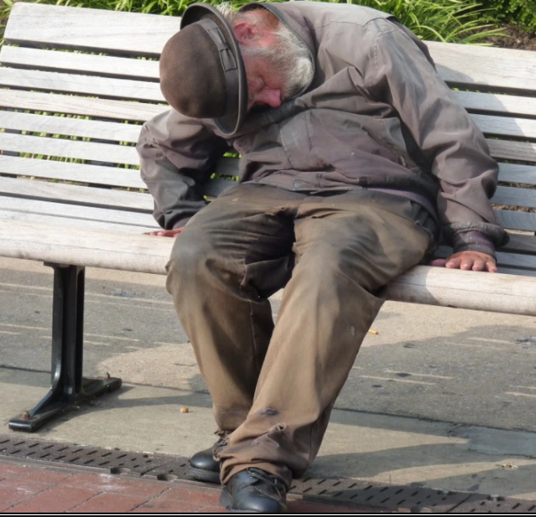
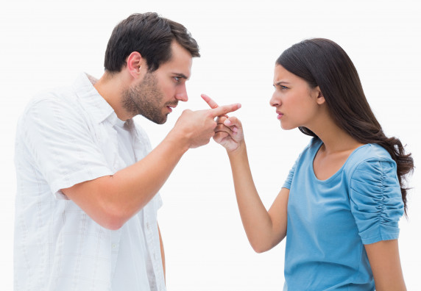

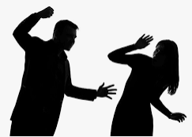
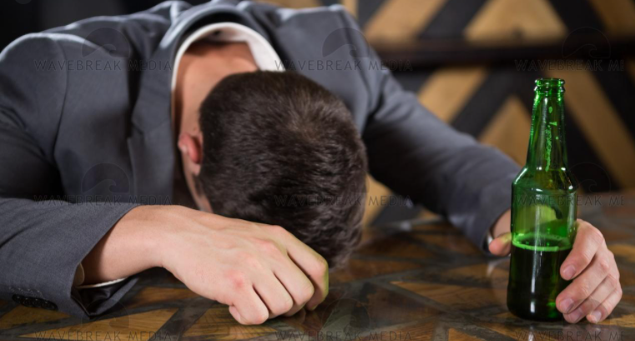
Divorce
Envy
Anger
Alcohol
Bitterness
Abusiveness
Alienation
Lying
Pornography
Depression

Slide 9
Philippians 3:13
Brothers and sisters, I do not regard myself as having taken hold of it yet; but one thing I do: forgetting what lies behind and reaching forward to what lies ahead

Slide 10
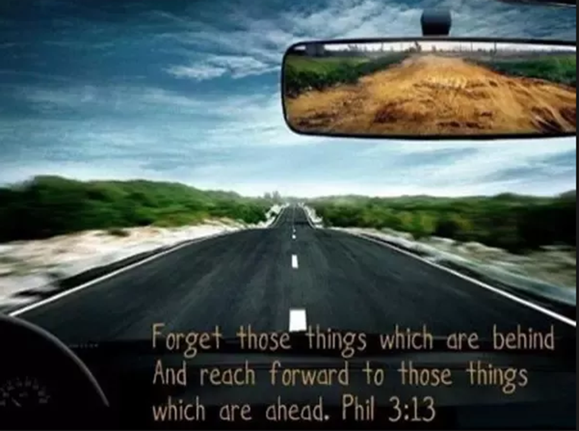

Slide 11
Psalm 119:67
Before I was afflicted I went astray, but now I keep Thy word.

Slide 12
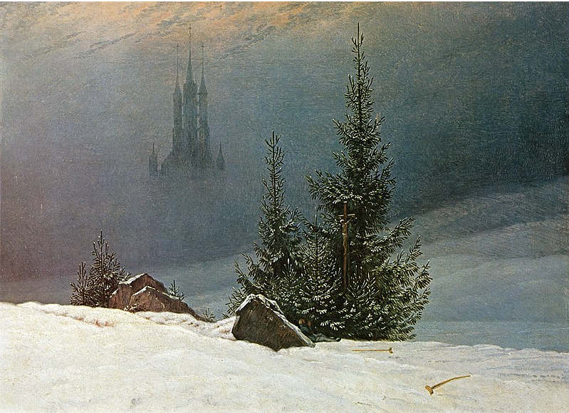

Slide 13
What did you see?

Slide 14
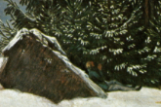

Slide 15
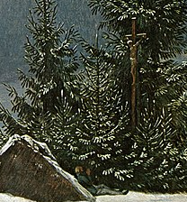

Slide 16
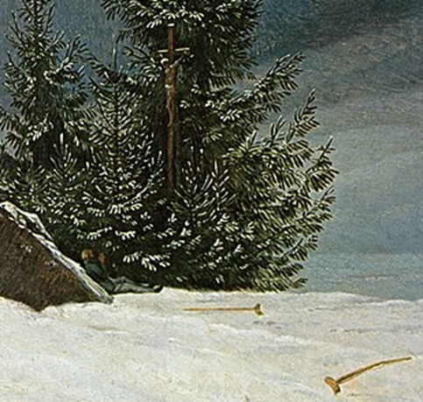

Slide 17


Slide 18
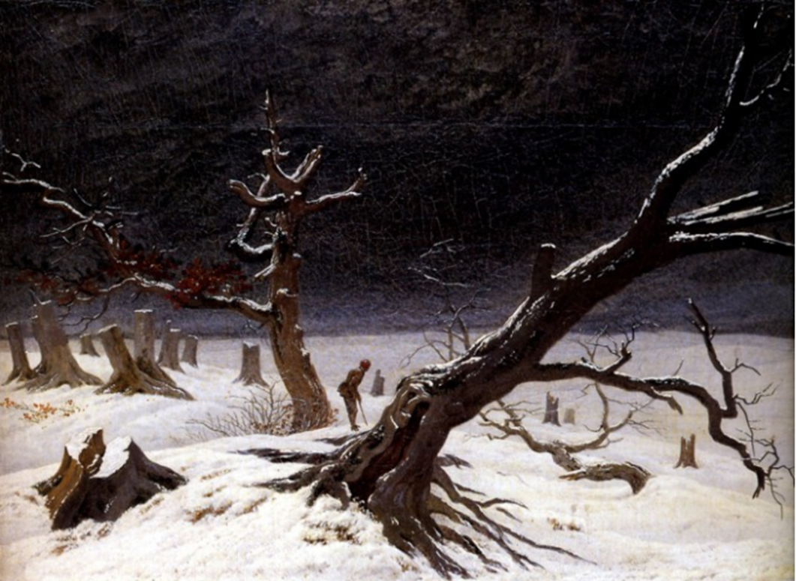

Slide 19



Slide 20
Psalm 46:10
Be still, and know that I am God.

Slide 21


“Turn off that device, and know that I am God.”

Slide 22

“Let some holy ambition invade our souls, so that, dissatisfied with mediocrity, we shall eagerly desire the highest things and shall toil with all our strength to obtain them, since we may if we wish.”
Giovanni Pico della Mirandola

Slide 23
A Person; Not a Project

Slide 24
Mark 5:21-24, 35-43
21 When Jesus had crossed over again in the boat to the other side, a large crowd gathered around Him; and so He stayed by the seashore.
22 One of the synagogue officials named Jairus came up, and on seeing Him, fell at His feet
23 and implored Him earnestly, saying, “My little daughter is at the point of death; please come and lay Your hands on her, so that she will get well and live.”
24 And He went off with him; and a large crowd was following Him and pressing in on Him.

Slide 25
35 While He was still speaking, they came from the house of the synagogue official, saying, “Your daughter has died; why trouble the Teacher anymore?”
36 But Jesus, overhearing what was being spoken, said to the synagogue official, “Do not be afraid any longer, only believe.”
37 And He allowed no one to accompany Him, except Peter and James and John the brother of James.
38 They came to the house of the synagogue official; and He saw a commotion, and people loudly weeping and wailing.
39 And entering in, He said to them, “Why make a commotion and weep? The child has not died, but is asleep.”
40 They began laughing at Him. But putting them all out, He took along the child’s father and mother and His own companions, and entered the room where the child was.
41 Taking the child by the hand, He said to her, “Talitha kum!” (which translated means, “Little girl, I say to you, get up!”).
42 Immediately the girl got up and began to walk, for she was twelve years old. And immediately they were completely astounded.
43 And He gave them strict orders that no one should know about this, and He said that something should be given her to eat.

Slide 26
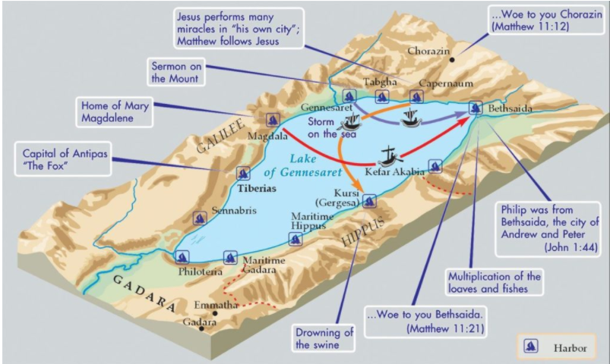

Slide 27
Mark 3:1-6
1 He entered again into a synagogue; and a man was there whose hand was withered.
2 They were watching Him to see if He would heal him on the Sabbath, so that they might accuse Him.
3 He said to the man with the withered hand, “Get up and come forward!”
4 And He said to them, “Is it lawful to do good or to do harm on the Sabbath, to save a life or to kill?” But they kept silent.
5 After looking around at them with anger, grieved at their hardness of heart, He said to the man, “Stretch out your hand.” And he stretched it out, and his hand was restored.
6 The Pharisees went out and immediately began conspiring with the Herodians against Him, as to how they might destroy Him.

Slide 28
Luke 8:41-42
41 And there came a man named Jairus, and he was an official of the synagogue; and he fell at Jesus’ feet, and began to implore Him to come to his house;
42 for he had an only daughter, about twelve years old, and she was dying. But as He went, the crowds were pressing against Him.”

Slide 29
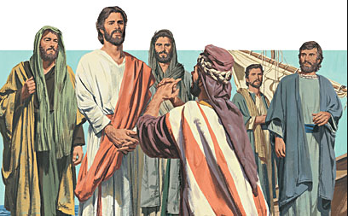

Slide 30
John 6:68-69
Lord, to whom shall we go? You have words of eternal life. We have believed and have come to know that You are the Holy One of God.”
Psalm 73:25-36
“Whom have I in heaven but You? And besides You, I desire nothing on earth. My flesh and my heart may fail, but God is the strength of my heart and my portion forever.

Slide 31
12 - perfection, authority, and government
Jesus spoke in the temple when He was twelve years old.
There were twelve sons and, therefore, twelve tribes of Israel.
Jesus called twelve apostles.
Twelve spies scouted out the Promised Land.
After Jesus fed the 5,000 there were twelve full baskets left over.
In Revelation, the Tree of Life will bear twelve types of fruit.
The high priest’s breastplate had twelve stones in it.
In the book of Revelation:
  The new Jerusalem will have twelve gates of pearl manned by twelve angels.
  Twelve precious stones will be its foundation.
  The church will wear a crown with twelve stars.
  There will be 12,000 from each of the twelve tribes of Israel for a total of 144,000 who will be preserved through the Tribulation and who will preach the Gospel.

Slide 32
Mark 5:29
Immediately the flow of her blood was dried up; and she felt in her body that she was healed of her affliction.

Slide 33
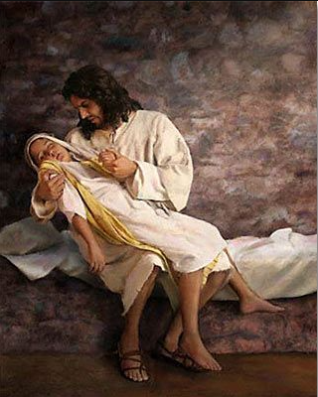

Slide 34
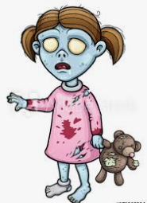

Slide 35
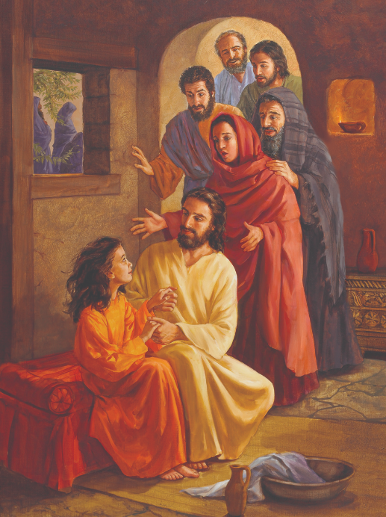

Slide 36
Acts 26:8
Why is it considered incredible among you people if God does raise the dead?

Slide 37
Mark 5:35
While He was still speaking, they came from the house of the synagogue official, saying, “Your daughter has died; why trouble the Teacher anymore?”

Slide 38
First Jesus heals the demon possessed man in the Gerasenes and the now demon filled pigs commit suicide by jumping off of a cliff into the sea of Galilee.
The crowd tells Jesus to leave.
He gets close to the other shore and there is already a crowd gathered.
He barely gets onto the shore and a man rushes through the crowd to get to Him and falls at His feet.
Jesus goes with this man with the crowd pressing in on Him from all sides.
A woman with a hemorrhage is healed by Jesus but, just as that ended, another group of men come to Jesus and tell Him that the little girl is dead.
Then Jesus goes to the house and raises the girl from the dead.

Slide 39
Verse 36
But Jesus, overhearing what was being spoken, said to the synagogue official, “Do not be afraid any longer, only believe.”

Slide 40
ONLY BELIEVE

Slide 41
Hebrews 11:1, “Now faith is the assurance of things hoped for, the conviction of things not seen.”
Matthew 10:31, “So do not fear; you are more valuable than many sparrows.” You have fear because you doubt your value to God.
John 3:20, “For everyone who does evil hates the Light, and does not come to the Light for fear that his deeds will be exposed.” You have fear because you doubt God’s forgiveness.
John 12:42, “Nevertheless many even of the rulers believed in Him, but because of the Pharisees they were not confessing Him, for fear that they would be put out of the synagogue;” You have fear because you doubt that God’s approval is more important than man’s approval.
1 Peter 3:14, “But even if you should suffer for the sake of righteousness, you are blessed. And do not fear their intimidation, and do not be troubled,” You have fear because you doubt that doing what is right is more blessed than doing what is comfortable.

Slide 42
Verse 37
And He allowed no one to accompany Him, except Peter and James and John the brother of James.

Slide 43
Mount of Transformation
Mark 9:2, “Six days later, Jesus took with Him Peter and James and John, and brought them up on a high mountain by themselves.”
Garden of Gethsemane
Mark 14:33, “And He took with Him Peter and James and John, and began to be very distressed and troubled.”)

Slide 44
Verse 38
They came to the house of the synagogue official; and He saw a commotion, and people loudly weeping and wailing.
Verse 39
And entering in, He said to them, “Why make a commotion and weep? The child has not died, but is asleep.”

Slide 45
Jeremiah 9:17-18
17 Thus says the Lord of hosts, ‘Consider and call for the mourning women, that they may come; and send for the wailing women, that they may come! 18 Let them make haste and take up a wailing for us, that our eyes may shed tears and our eyelids flow with water.’”
Amos 5:16
Therefore thus says the Lord God of hosts, the Lord, ‘There is wailing in all the plazas, and in all the streets they say, “Alas! Alas!” They also call the farmer to mourning and professional mourners to lamentation.’”

Slide 46
Verse 40
They began laughing at Him. But putting them all out, He took along the child’s father and mother and His own companions, and entered the room where the child was.

Slide 47
Verses 41-42
41 Taking the child by the hand, He said to her, “Talitha kum!” (which translated means, “Little girl, I say to you, get up!”).
42 Immediately the girl got up and began to walk, for she was twelve years old. And immediately they were completely astounded.

Slide 48
Numbers 19:11-13
11 The one who touches the corpse of any person shall be unclean for seven days. 12 That one shall purify himself from uncleanness with the water on the third day and on the seventh day, and then he will be clean; but if he does not purify himself on the third day and on the seventh day, he will not be clean. 13 Anyone who touches a corpse, the body of a man who has died, and does not purify himself, defiles the tabernacle of the Lord; and that person shall be cut off from Israel. Because the water for impurity was not sprinkled on him, he shall be unclean; his uncleanness is still on him.

Slide 49
Numbers 5:2-3
2 Command the sons of Israel that they send away from the camp every leper and everyone having a discharge and everyone who is unclean because of a dead person.
3 You shall send away both male and female; you shall send them outside the camp so that they will not defile their camp where I dwell in their midst.”

Slide 50
Numbers 19:12
That one shall purify himself from uncleanness with the water on the third day and on the seventh day, and then he will be clean; but if he does not purify himself on the third day and on the seventh day, he will not be clean.

Slide 51
Mark 6:1-2
1 “Jesus went out from there and came into His hometown; and His disciples followed Him.
2 When the Sabbath came, He began to teach in the synagogue; and the many listeners were astonished, saying, ‘Where did this man get these things, and what is this wisdom given to Him, and such miracles as these performed by His hands?’”

Slide 52
Numbers 19:20
But the man who is unclean and does not purify himself from uncleanness, that person shall be cut off from the midst of the assembly, because he has defiled the sanctuary of the Lord; the water for impurity has not been sprinkled on him, he is unclean.

Slide 53
Habakkuk 1:13
… eyes are too pure to approve evil…

Slide 54
Hebrews 12:15
See to it that no one comes short of the grace of God; that no root of bitterness springing up causes trouble, and by it many be defiled…

Slide 55
Haggai 2:11-13
11 “Thus says the Lord of hosts, ‘Ask now the priests for a ruling:
12 If a man carries holy meat in the fold of his garment, and touches bread with this fold, or cooked food, wine, oil, or any other food, will it become holy?’” And the priests answered, “No.”
13 Then Haggai said, “If one who is unclean from a corpse touches any of these, will the latter become unclean?” And the priests answered, “It will become unclean.”

Slide 56
Matthew 12:6
But I say to you that something greater than the temple is here.

Slide 57
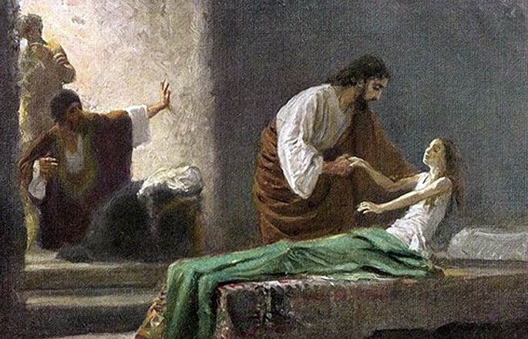

Slide 58
Verse 42
Immediately the girl got up and began to walk, for she was twelve years old. And immediately they were completely astounded.

Slide 59
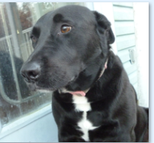

Slide 60
Verse 43
And He gave them strict orders that no one should know about this, and He said that something should be given her to eat.

Slide 61
Matthew 8:4
And Jesus said to him, “See that you tell no one; but go, show yourself to the priest and present the offering that Moses commanded, as a testimony to them.”
Matthew 9:30
And their eyes were opened. And Jesus sternly warned them: “See that no one knows about this!”
Matthew 16:20
Then He warned the disciples that they should tell no one that He was the Christ.
Mark 9:9
As they were coming down from the mountain, He gave them orders not to relate to anyone what they had seen, until the Son of Man rose from the dead.
Mark 3:12
And He earnestly warned them not to tell who He was.
Mark 5:43
And He gave them strict orders that no one should know about this, and He said that something should be given her to eat.
Mark 8:29-30
And He continued by questioning them, “But who do you say that I am?” Peter answered and said to Him, “You are the Christ.” And He warned them to tell no one about Him.

Slide 62
1) It could have caused the focus to be on the miracles and not on the teaching
Mark 1:40-45
40 And a leper came to Jesus, beseeching Him and falling on his knees before Him, and saying, “If You are willing, You can make me clean.”
41 Moved with compassion, Jesus stretched out His hand and touched him, and *said to him, “I am willing; be cleansed.”
42 Immediately the leprosy left him and he was cleansed.
43 And He sternly warned him and immediately sent him away,
44 and He said to him, “See that you say nothing to anyone; but go, show yourself to the priest and offer for your cleansing what Moses commanded, as a testimony to them.”
45 But he went out and began to proclaim it freely and to spread the news around, to such an extent that Jesus could no longer publicly enter a city, but stayed out in unpopulated areas; and they were coming to Him from everywhere.

Slide 63
Luke 23:8
Now Herod was very glad when he saw Jesus; for he had wanted to see Him for a long time, because he had been hearing about Him and was hoping to see some sign performed by Him.

Slide 64
Mark 1:45
But the man went out and openly began to proclaim and spread the news. Consequently, Jesus could no longer enter a town in plain view, but He stayed out in solitary places. Yet people came to Him from every quarter.
John 6:15
So Jesus, aware that they intended to come and take Him by force to make Him king, withdrew again to the mountain by Himself, alone.

Slide 65
2) Jesus had a timetable
John 2:4
And Jesus said to her, “Woman, what does that have to do with us? My hour has not yet come.”
John 7:6
So Jesus said to them, “My time is not yet here, but your time is always opportune.

Slide 66
Matthew 21:1-10
“Hosanna to the Son of David; Blessed is He who comes in the name of the Lord; Hosanna in the highest!”
Zechariah 9:9
Rejoice greatly, O daughter of Zion!
Shout in triumph, O daughter of Jerusalem!
Behold, your king is coming to you;
He is just and endowed with salvation,
Humble, and mounted on a donkey,
Even on a colt, the foal of a donkey.

Slide 67
John 7:3-6
3 So His brothers said to Him, “Move on from here and go into Judea, so that Your disciples also may see Your works which You are doing. 4 For no one does anything in secret when he himself is striving to be known publicly. If You are doing these things, show Yourself to the world.” 5 For not even His brothers believed in Him. 6 So Jesus *said to them, “My time is not yet here, but your time is always ready.
John 7:30
So they were seeking to arrest Him; and yet no one laid a hand on Him, because His hour had not yet come.

Slide 68
Sunday | Jesus enters Jerusalem on a donkey.
Monday | He throws out the moneychangers in the Temple. Teaches His disciples.
Tuesday | He teaches His disciples.
Wednesday | Judas betrays Jesus to the Jewish authorities.
Thursday | Jesus has His last meal, Passover, with the disciples. He is arrested that night after Judas’ kiss.
Friday | First Trial: Nighttime, maybe 2-2:30 A.M., before Annas. Second Trial: Nighttime, somewhere between 2:30 and 5 A.M., before Caiaphas. Third Trial: At dawn around 6 A.M. before Sanhedrin. Fourth Trial: At 6:30 A.M. Jesus is brought before Pilate. Fifth Trial: Before Herod at around 7 A.M. Sixth Trial: Before Pilate at around 7:30 – 8 A.M. At 9 A.M. He is crucified. At 3 P.M. He dies. By sundown He is in the tomb.
Saturday | Jesus lies in the tomb.
Sunday | He is alive!

Slide 69
Verse 43b
and He [Jesus] said that something should be given her to eat.

Slide 70
The girl wasn’t a project.
The girl wasn’t a means to make Himself look better.
The girl wasn’t an event.

Slide 71
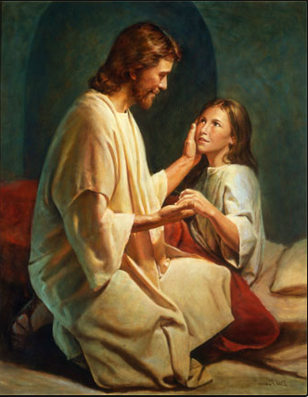

Slide 72

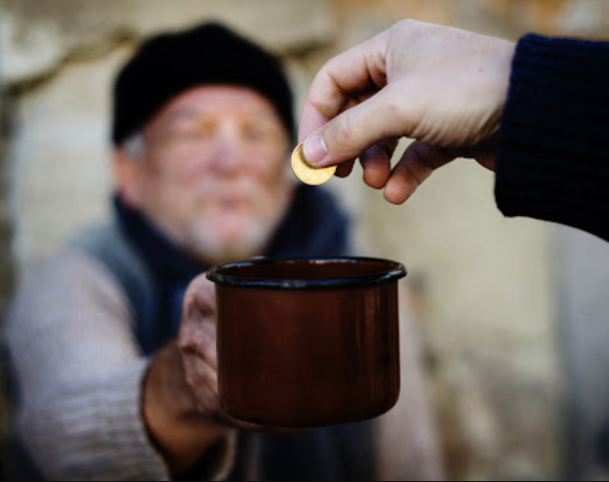
People are not there to validate you.
Rather, you are there to minister to people.
X

Slide 73
Isaiah 58:10
And if you offer yourself to the hungry and satisfy the need of the afflicted, then your light will rise in darkness and your gloom will become like midday.

Slide 74
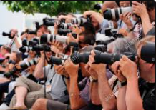
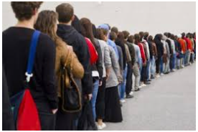
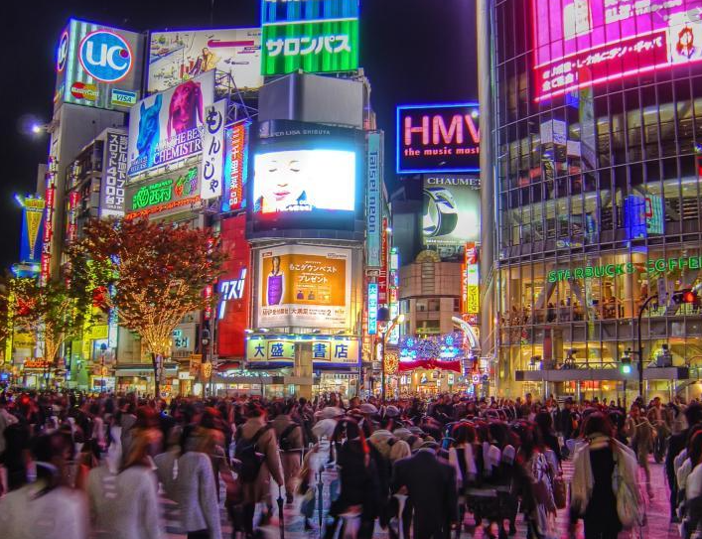
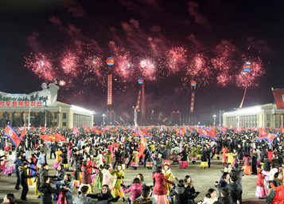



Slide 75
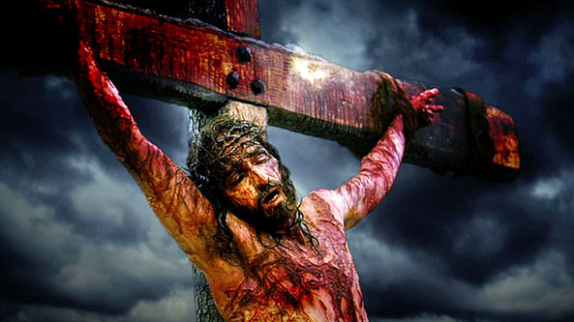
Man of Sorrows

Slide 76
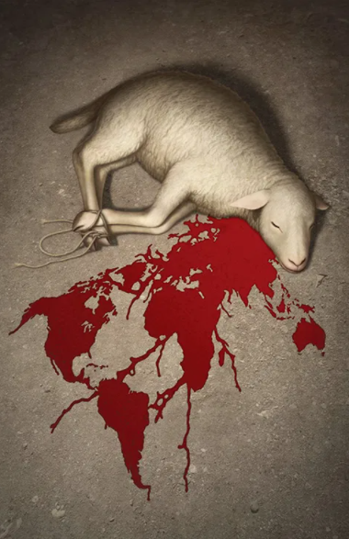

Slide 77
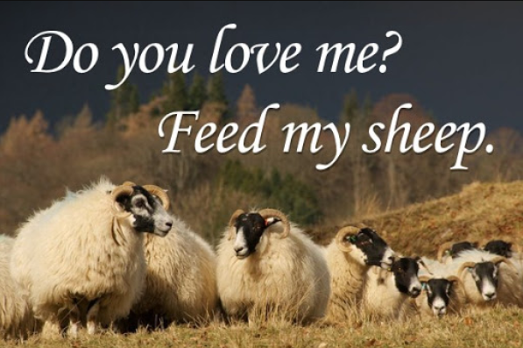

Slide 78
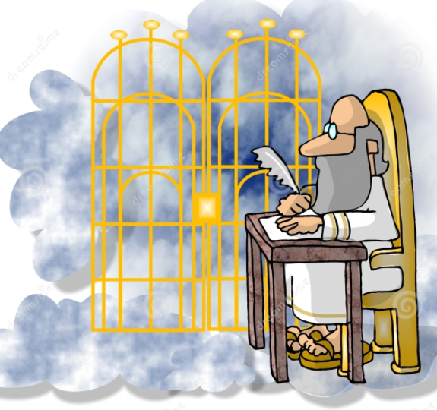
If you died today and stood before St. Peter at the Pearly Gates and he asked you “Why should I let you in?” what would you say?

Slide 79
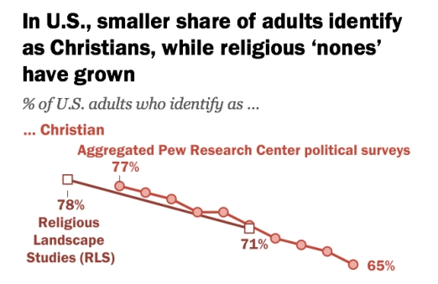
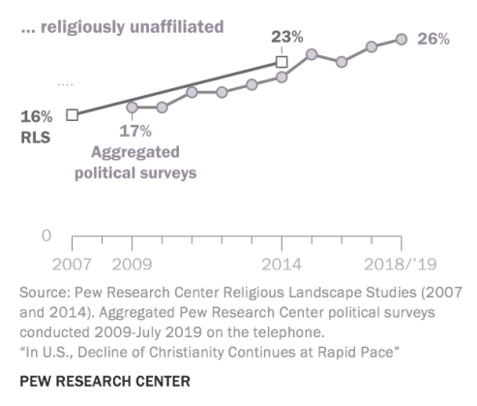

Slide 80
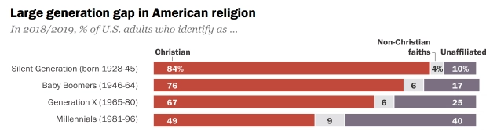

Slide 81
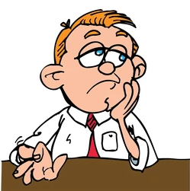
“What should I care?”
“Do I really need this?”

Slide 82
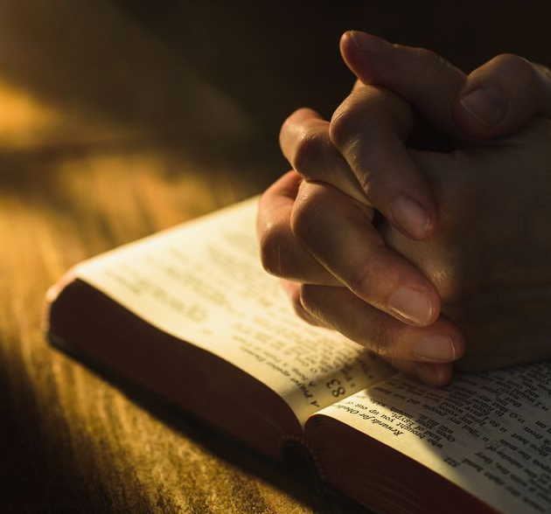
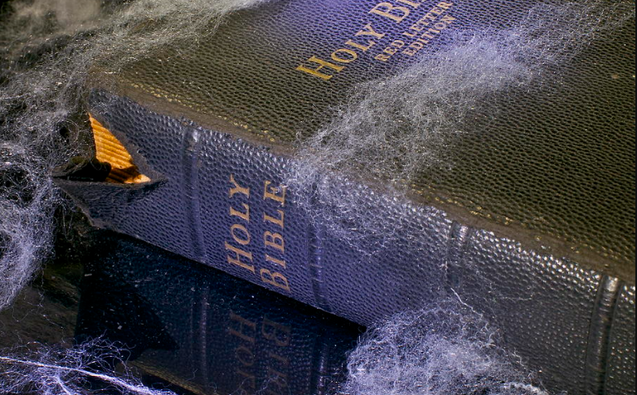

Slide 83
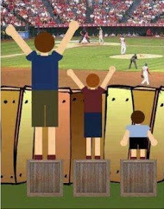
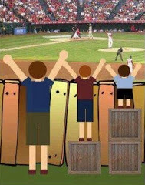

Slide 84
“Why is it that you don’t believe that?”
“When you said [repeat their statement], what influenced you to think that?”
“How did you come to that conclusion?”
“Do you think that it is possible for someone to be forgiven by God?”

Slide 85
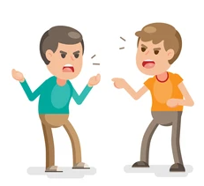

Your goal is not to win the debate;
your goal is to win the person.

Slide 86
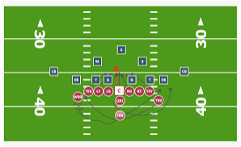

Slide 87
“What do you mean by that?”
“All religions are the same.”
“What do you mean by that?”
“Do all religions have the same solution to the sin/guilt issue?”
“All that matters is that you try your best.”
“What do you mean by that?”
“We all fail. How many failures does it take before we are not trying our best anymore?”

Slide 88
Acts 17:22-23
22 So Paul stood in the midst of the Areopagus and said, “Men of Athens, I see that you are very religious in all respects.
23 For while I was passing through and examining the objects of your worship, I also found an altar with this inscription, ‘TO AN UNKNOWN GOD.’ Therefore, what you worship in ignorance, this I proclaim to you.”

Slide 89
Acts 17:28-29
28 for in Him we live and move and exist, as even some of your own poets have said, ‘For we also are His descendants.’
29 Therefore, since we are the descendants of God, we ought not to think that the Divine Nature is like gold or silver or stone, an image formed by human skill and thought.

Slide 90
2 Timothy 2:24-25
24 The Lord’s bond-servant must not be quarrelsome, but be kind to all, skillful in teaching, patient when wronged,
25 with gentleness correcting those who are in opposition, if perhaps God may grant them repentance leading to the knowledge of the truth
Not quarrelsome
Kind to all
Skillful in teaching
Patient when wronged
With gentleness correcting

Slide 91
Jeremiah 31:3
“The Lord appeared to him long ago, saying, ‘I have loved you with an everlasting love; Therefore I have drawn you out with kindness.’”

Slide 92
1 Peter 3:15
but sanctify Christ as Lord in your hearts, always being ready to make a defense to everyone who asks you to give an account for the hope that is in you, but with gentleness and respect
1) Evangelize with gentleness.
2) We are to show respect.
3) We are to give an account for the “hope” that is in us.
sanctify Christ as Lord in your hearts

Slide 93
Colossians 3:12-13
And so, as those who have been chosen of God, holy and beloved, put on a heart of compassion, kindness, humility, gentleness and patience; bearing with one another, and forgiving each other, whoever has a complaint against anyone; just as the Lord forgave you, so also should you.

Slide 94
He tells us to have | Why?
Compassion | Because Christians can be hurting and suffering and in confusion.
Kindness | Because Christians can be needy.
Humility | Because Christians can be overbearing.
Gentleness | Because Christians can be vulnerable and fragile.
Patience | Because Christians can drive you crazy sometimes with their stupidity, with their self-centeredness, and with their weaknesses.
Bear with one another | Because Christians can be intolerant at times.
Forgive each other | Because Christians can sin against you.

Slide 95
To “one another” we should | Scripture | Why? Because… | How?
Be devoted | Ro 12:10 | Christians can be me-first | Stay loyal even when they are intolerable.
Give preference | Ro 12:10 | Christians can be self-absorbed | Think of others before you think of yourself, let them speak first, show them interest first
Be of the same mind | Ro 12:16 | Christians can be divisive | Do not be deliberately contrary, do not treat some as more contemptible than others
Love | Ro 13:8 | Christians can be unlovable | See people as God sees them and then be to them as Jesus would
Not judge | Ro 14:13 | Christians can be judgmental | Do not expand their one small sin into a mountain of sin and do not recall their previous forgiven sins
Build up | Ro 14:19 | Christians can falter | Praise people for the good that they do, work with them on those areas where they are weak
Persevere | Ro 15:5 | Christians can be uncomfortable | Stick with people even when you aren’t getting anything from the relationship
Accept | Ro 15:7 | Christians can hold others in contempt | Do not categorize people, if they are not as smart or rich or popular or attractive or socially adept as others still treat them as one for whom Christ died and loves

Slide 96
To “one another” we should | Scripture | Why? Because… | How?
Admonish | Ro 15:14 | Christians can sin | “Brothers and sisters, even if a person is caught in any wrongdoing, you who are spiritual are to restore such a person in a spirit of gentleness; each one looking to yourself, so that you are not tempted as well.” Galatians 6:1
Greet | Ro 16:16 | Christians can be snobbish | Be friendly to all, ignore no one, never give anyone the cold shoulder. Go up to new people and introduce yourself.
Do not sue | 1 Cor 6:7 | Christians can be greedy or arrogant | Work things out, talk to each other, get an arbitrator. Be careful about using litigation as your first resort.
Wait for | 1 Cor 11:33 | Christians can be insensitive | Do not grab the best before the others arrive
Show the same care for | 1 Cor 12:25 | Christians can be prejudiced | Give the same to those who can give back as those who cannot, do not exclude or belittle anyone because they are outside of your group
Serve | Gal 5:13 | Christians can only want to get and not to give | Put that other person’s needs above your own

Slide 97
To “one another” we should | Scripture | Why? Because… | How?
Not challenge | Gal 5:26 | Christians can be wrongly competitive | Rejoice with those whom God has blessed more than you, let others get the promotion, the recognition, and the praise without jealousy
Not envy | Gal 5:26 | Christians can want what others have | Rejoice with those whom God has blessed, be content with what God has given to you
Bear the other’s burdens | Gal 6:2 | Christians will struggle | Be with that person in their trials and despair, listen, pray, comfort
Show tolerance | Eph 4:2 | Christians can be irritating | Do not respond in kind to a harsh remark, do not give anyone the cold shoulder, do not scorn someone because they have an annoying habit
Speak the truth | Eph 4:25 | Christians can lie or be deceptive | Always speak what is right even if it diminishes your reputation
Be kind | Eph 4:32 | Christians can cruel and hurtful | Do not belittle, snap at, or injure someone with your words, help others who are needy even to your own sacrifice, do not gossip

Slide 98
To “one another” we should | Scripture | Why? Because… | How?
Be subject to | Eph 5:21 | Christians can act superior | Be the first to serve others, do not just sit around and wait for others to serve you first, defer to other’s opinions or wishes if you do not see any good reason to disagree
Regard others as more important than ourselves | Phil 2:3 | Christians can be egotistical | Put other people’s desire, goals, and needs above your own
Forgive | Col 3:13 | Christians will sin | Just as God forgave you your ocean of sin, forgive that person their one drop of sin
Comfort | 1 Thess 4:18 | Christians can hurt and be confused | Be a good listener, pray with them, offer advice where it can help
Encourage | 1 Thess 5:11 | Christians can be discouraged or depressed | Support them with words and/or actions, be there for them
Live in peace | 1 Thess 5:13 | Christians can be very annoying | Do not harass, be friendly, do them favors, seek their good

Slide 99
To “one another” we should | Scripture | Why? Because… | How?
Seek after that which is good for | 1 Thess 5:15 | Christians can be spiteful | Ask for God’s blessings upon them and you give what would help them the most
Stimulate | Heb 10:24 | Christians can be lazy | Help them make goals and do what you can to enable them to achieve those goals
Do not speak against | Ja 4:11 | Christians can gossip | Do not tell others about someone else’s shortcomings
Do not complain | Ja 5:9 | Christians can be grumblers | If you are not sincerely seeking a solution then do not condemn other people or circumstances
Confess your sins | Ja 5:16 | Christians can be proud and act perfect | If you have sinned against another then humble yourself before them
Pray | Ja 5:16 | Christians can forget about God | Pray with them, pray for them, pray frequently
Be hospitable | 1 Pet 4:9 | Christians can want to take and not receive | Have people over for lunch or dinner, lodge temporary visitors at your house
Be humble | 1 Pet 5:5 | Christians can be competitive | Rejoice with those who rejoice and weep with those who weep, considering them as more important than yourself

Slide 100
Resisting Temptation

Slide 101
Matthew 4:1-11
Then Jesus was led up by the Spirit into the wilderness to be tempted by the devil. 2 And after He had fasted forty days and forty nights, He then became hungry. 3 And the tempter came and said to Him, “If You are the Son of God, command that these stones become bread.” 4 But He answered and said, “It is written, ‘Man shall not live on bread alone, but on every word that proceeds out of the mouth of God.’”
5 Then the devil took Him into the holy city and had Him stand on the pinnacle of the temple, 6 and said to Him, “If You are the Son of God, throw Yourself down; for it is written, ‘He will command His angels concerning You’; and ‘On their hands they will bear You up, So that You will not strike Your foot against a stone.’”

Slide 102
7 Jesus said to him, “On the other hand, it is written, ‘You shall not put the Lord your God to the test.’”
8 Again, the devil took Him to a very high mountain and showed Him all the kingdoms of the world and their glory; 9 and he said to Him, “All these things I will give You, if You fall down and worship me.” 10 Then Jesus said to him, “Go, Satan! For it is written, ‘You shall worship the Lord your God, and serve Him only.’” 11 Then the devil left Him; and behold, angels came and began to minister to Him.

Slide 103
Matthew 3:16-17
After being baptized, Jesus came up immediately from the water; and behold, the heavens were opened, and he saw the Spirit of God descending as a dove and lighting on Him, 17 and behold, a voice out of the heavens said, “This is My beloved Son, in whom I am well-pleased.”

Slide 104
Jesus had just started His priestly ministry. Up until this point, except for an account in Luke 2:41-52 when Jesus was 12 years old and appeared in the Temple, there are no other stories of Jesus in the Bible. This is Jesus’ coming out party so to speak.
We see the Trinity coming together in one visible place for perhaps the first time ever. So we have all of God’s attributes concentrated in one spot.
God the Father affirms that He is well-pleased with His Son, Jesus.

Slide 105
Baptism | Temptation
Jesus is surrounded by admirers | Jesus was in the company of the one who hates Him the most
This had an affirmation of His deity | Satan was trying to deny Him His deity by getting Him to sin
Jesus was in a lush lake | Jesus was in a barren wilderness
The Holy Spirit descended onto Jesus as a gentle dove | The Holy Spirit led Jesus into the wilderness to be tempted
Jesus was anointed | Jesus was tempted
Jesus began His priestly ministry | Satan tried to end His priestly ministry
We saw a glimpse of heaven | We saw a glimpse of hell
His Father spoke to Him | The Devil spoke to Him
There was excitement and joy even if they were short-lived | The torment went on for at least 40 days

Slide 106
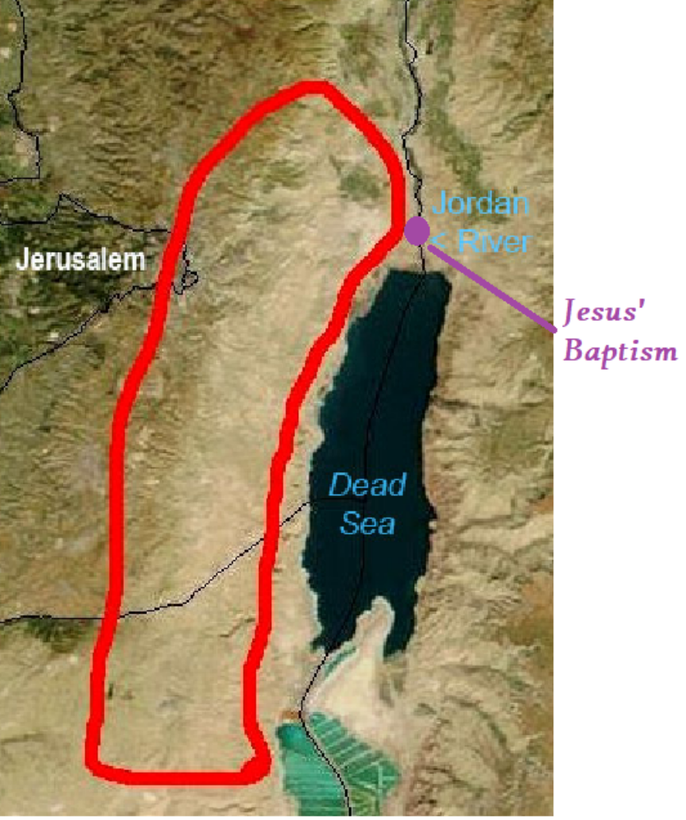

Slide 107
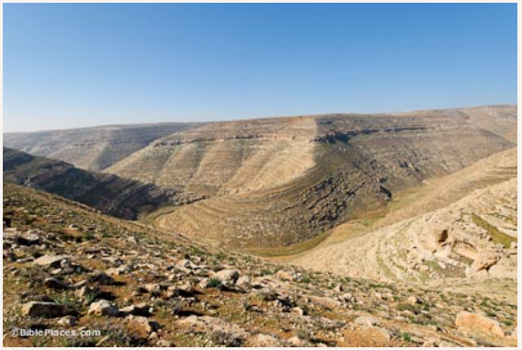
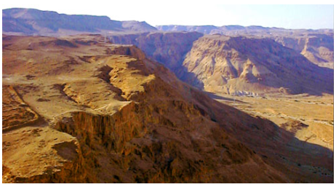

Slide 108
Fasting
1) It shows how serious we are when repenting of sin.

Slide 109
Jonah 3:5-11
5 Then the people of Nineveh believed in God; and they called a fast and put on sackcloth from the greatest to the least of them. 6 When the word reached the king of Nineveh, he arose from his throne, laid aside his robe from him, covered himself with sackcloth and sat on the ashes. 7 He issued a proclamation and it said, “In Nineveh by the decree of the king and his nobles: Do not let man, beast, herd, or flock taste a thing. Do not let them eat or drink water. 8 But both man and beast must be covered with sackcloth; and let men call on God earnestly that each may turn from his wicked way and from the violence which is in his hands. 9 Who knows, God may turn and relent and withdraw His burning anger so that we will not perish.”

Slide 110
Fasting
1) It shows how serious we are when repenting of sin.
2) Fasting moves us to an intense seeking of God when in a rough situation.

Slide 111
Daniel 6:16-18
16 Then the king gave orders, and Daniel was brought in and cast into the lions’ den. The king spoke and said to Daniel, “Your God whom you constantly serve will Himself deliver you.” 17 A stone was brought and laid over the mouth of the den; and the king sealed it with his own signet ring and with the signet rings of his nobles, so that nothing would be changed in regard to Daniel. 18 Then the king went off to his palace and spent the night fasting, and no entertainment was brought before him; and his sleep fled from him.

Slide 112
2 Chronicles 20:1-4
Now it came about after this that the sons of Moab and the sons of Ammon, together with some of the Meunites, came to make war against Jehoshaphat. 2 Then some came and reported to Jehoshaphat, saying, “A great multitude is coming against you from beyond the sea, out of Aram and behold, they are in Hazazon-tamar (that is Engedi).” 3 Jehoshaphat was afraid and turned his attention to seek the Lord, and proclaimed a fast throughout all Judah. 4 So Judah gathered together to seek help from the Lord; they even came from all the cities of Judah to seek the Lord.

Slide 113
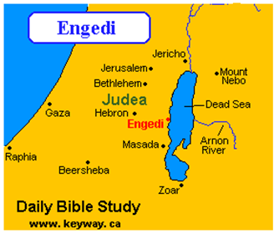

Slide 114
Fasting
1) It shows how serious we are when repenting of sin.
2) Fasting moves us to an intense seeking of God when in a rough situation.
3) Fasting requests God’s anointing and guidance when starting a new ministry, project, or spiritual venture.

Slide 115
Acts 14:23
When they had appointed elders for them in every church, having prayed with fasting, they commended them to the Lord in whom they had believed.

Slide 116
The First Temptation
And the tempter came and said to Him, “If You are the Son of God, command that these stones become bread.”

Slide 117
Genesis 3:1-4
3 Now the serpent was more crafty than any beast of the field which the Lord God had made. And he said to the woman, “Indeed, has God said, ‘You shall not eat from any tree of the garden’?” 2 The woman said to the serpent, “From the fruit of the trees of the garden we may eat; 3 but from the fruit of the tree which is in the middle of the garden, God has said, ‘You shall not eat from it or touch it, or you will die.’” 4 The serpent said to the woman, “You surely will not die! 5 For God knows that in the day you eat from it your eyes will be opened, and you will be like God, knowing good and evil.”

Slide 118
Genesis 2:18
“Then the Lord God said, ‘It is not good for the man to be alone; I will make him a helper suitable for him.’”

Slide 119
Lies of Loneliness
1) I am a bad person. There is something about me that is so wrong that I deserve to be rejected and shunned.

Slide 120
Revolted against God
Spiritual adultery
Lack of reverence for God
Idolatry
Contempt of God
Corruption in government and in ministry
Vain confidence
Lying
Mocking God’s prophets

Slide 121
Jeremiah 31:31-34
31 “Behold, days are coming,” declares the Lord, “when I will make a new covenant with the house of Israel and with the house of Judah, 32 not like the covenant which I made with their fathers in the day I took them by the hand to bring them out of the land of Egypt, My covenant which they broke, although I was a husband to them,” declares the Lord. 33 “But this is the covenant which I will make with the house of Israel after those days,” declares the Lord, “I will put My law within them and on their heart I will write it; and I will be their God, and they shall be My people. 34 They will not teach again, each man his neighbor and each man his brother, saying, ‘Know the Lord,’ for they will all know Me, from the least of them to the greatest of them,” declares the Lord, “for I will forgive their iniquity, and their sin I will remember no more.”

Slide 122
1 John 1:9
If we confess our sins, He is faithful and righteous to forgive us our sins and to cleanse us from all unrighteousness.

Slide 123
Lies of Loneliness
1) I am a bad person. There is something about me that is so wrong that I deserve to be rejected and shunned.
2) Neither God nor anyone else cares about me.

Slide 124
Jesus Christ allowed Himself to be whipped for you.
He allowed Himself to have thorns driven into His forehead for you.
He dragged a harsh, wooden cross down a street lined with people mocking Him for you.
He had large, possibly nine-inch, nails hammered into His wrists and feet for you.
He took your sins upon Himself and suffered the wrath of His Father for you.
Jesus Christ died for you.

Slide 125
1 Peter 5:7, “casting all your anxiety on Him, because He cares for you.”
Isaiah 49:13, “Shout for joy, O heavens! And rejoice, O earth! Break forth into joyful shouting, O mountains! For the Lord has comforted His people and will have compassion on His afflicted.”
Lamentations 3:22-23, “The Lord’s lovingkindnesses indeed never cease, for His compassions never fail. They are new every morning; great is Your faithfulness.”
Luke 12:7, “Indeed, the very hairs of your head are all numbered. Do not fear; you are more valuable than many sparrows.”
Isaiah 41:10, “Do not fear, for I am with you; do not anxiously look about you, for I am your God. I will strengthen you, surely I will help you, surely I will uphold you with My righteous right hand.”

Slide 126
Isaiah 58:10-11
10 And if you give yourself to the hungry and satisfy the desire of the afflicted, then your light will rise in darkness and your gloom will become like midday.
11 “And the Lord will continually guide you, and satisfy your desire in scorched places, and give strength to your bones; and you will be like a watered garden, and like a spring of water whose waters do not fail.”

Slide 127
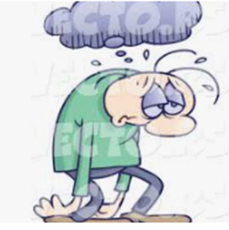
Stage 1
You feel like you are in darkness. Your life is gloomy.

Slide 128


Stage 2
You give yourself to those who are in greater want than yourself (the hungry) and to those who are even more oppressed than you (the afflicted). This is the pivot. This is what flips the card from the back to the front.

Slide 129


Stage 3
Here are the results:
Your light will rise
Your gloom will dissipate like dew in the morning sun
The Lord will continually guide you
Your desire will be satisfied
You will be strengthened
You will flourish and grow like a watered garden
Your life will be like a clear, refreshing spring of water

Slide 130
Lies of Loneliness
1) I am a bad person. There is something about me that is so wrong that I deserve to be rejected and shunned.
2) Neither God nor anyone else cares about me.
3) No one understands me, not even God.

Slide 131
1 Corinthians 10:13
No temptation has overtaken you but such as is common to man

Slide 132
Hebrews 2:17-18
17 Therefore, He had to be made like His brethren in all things, so that He might become a merciful and faithful high priest in things pertaining to God, to make propitiation for the sins of the people. 18 For since He Himself was tempted in that which He has suffered, He is able to come to the aid of those who are tempted.
Hebrews 4:15-16
15 For we do not have a high priest who cannot sympathize with our weaknesses, but One who has been tempted in all things as we are, yet without sin. 16 Therefore let us draw near with confidence to the throne of grace, so that we may receive mercy and find grace to help in time of need.

Slide 133
Homelessness
Matthew 8:20, “Jesus said to him, ‘The foxes have holes and the birds of the air have nests, but the Son of Man has nowhere to lay His head.’”
Temptation
Mark 1:13, “And He was in the wilderness forty days being tempted by Satan.”
Hunger
Matthew 4:2, “He then became hungry”
Loneliness
Matthew 47:26, “About the ninth hour Jesus cried out with a loud voice, saying, ‘Eli, Eli, lama sabachthani?’ that is, ‘My God, My God, why have You forsaken Me?’”

Slide 134
Betrayal
Matthew 26:72, “And again he [Peter] denied it with an oath, “I do not know the man.”
Rejected by family
John 7:5, “For not even His brothers were believing in Him.”
Rejected by an entire community
Matthew 8:34, “And behold, the whole city came out to meet Jesus; and when they saw Him, they implored Him to leave their region.”
Oppressed
Isaiah 53:7, “He was oppressed and He was afflicted…”

Slide 135
Physically weary
John 4:6, “So Jesus, being wearied from His journey.”
Disappointment
Matthew 26:40, “And He came to the disciples and found them sleeping, and said to Peter, ‘So, you men could not keep watch with Me for one hour?’” Jesus was in His hour of distress, and His three closest friends fell asleep. They couldn’t even stand with Him in His hour of need.
Rejection by friends
John 6:66, “As a result of this many of His disciples withdrew and were not walking with Him anymore.”
Sorrow
Isaiah 53:3, “A man of sorrows and acquainted with grief…”

Slide 136
Ridicule
Luke 23:35-37, “And the people stood by, looking on. And even the rulers were sneering at Him, saying, ‘He saved others; let Him save Himself if this is the Christ of God, His Chosen One.’ The soldiers also mocked Him, coming up to Him, offering Him sour wine, and saying, ‘If You are the King of the Jews, save Yourself!’” The man is dying, and they are making fun of Him.
Grieved
Matthew 26:38, “Then He [Jesus] said to them, ‘My soul is deeply grieved, to the point of death;’”
Distressed
Matthew 26:31, “And He took with Him Peter and the two sons of Zebedee, and began to be grieved and distressed.”
Death of a friend/loved one
Matthew 14:13, “Now when Jesus heard about John [the Baptist’s murder], He withdrew from there in a boat to a secluded place by Himself; and when the [i]people heard about this, they followed Him on foot from the cities.”

Slide 137
Lies of Loneliness
1) I am a bad person. There is something about me that is so wrong that I deserve to be rejected and shunned.
2) Neither God nor anyone else cares about me.
3) No one understands me, not even God.
4) Because I don’t have any joy from others it is justifiable for me to find happiness in sin.

Slide 138
Genesis 3:11-13
11 And He said, “Who told you that you were naked? Have you eaten from the tree of which I commanded you not to eat?” 12 The man said, “The woman whom You gave to be with me, she gave me from the tree, and I ate.”
13 Then the Lord God said to the woman, “What is this you have done?” And the woman said, “The serpent deceived me, and I ate.”

Slide 139


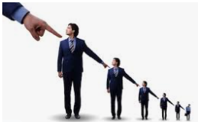
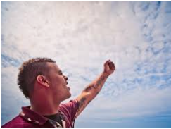

Deny it?
Ignore it?
Blame other people?
Blame God?
Justify it?

Slide 140
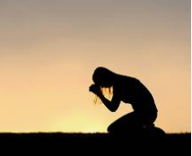
Confess it?

Slide 141
Psalm 38:4-8
4 For my iniquities are gone over my head; as a heavy burden they weigh too much for me.
5 My wounds grow foul and fester because of my folly.

Slide 142
Hebrews 12:15
See to it that no one comes short of the grace of God; that no root of bitterness springing up causes trouble, and by it many be defiled

Slide 143
1 Thessalonians 5:23
Now may the God of peace Himself sanctify you entirely; and may your spirit and soul and body be preserved complete, without blame at the coming of our Lord Jesus Christ.
Hebrews 4:12
For the word of God is living and active and sharper than any two-edged sword, and piercing as far as the division of soul and spirit, of both joints and marrow, and able to judge the thoughts and intentions of the heart.

Slide 144
Psalm 38
4 For my iniquities are gone over my head; as a heavy burden they weigh too much for me.
5 My wounds grow foul and fester because of my folly.
6 I am bent over and greatly bowed down; I go mourning all day long.
7 For my loins are filled with burning, and there is no soundness in my flesh.
8 I am benumbed and badly crushed; I groan because of the agitation of my heart.

Slide 145
Psalm 38
9 Lord, all my desire is before You; and my sighing is not hidden from You.
15 For I hope in You, O Lord; You will answer, O Lord my God.

Slide 146
Lies of Loneliness
1) I am a bad person. There is something about me that is so wrong that I deserve to be rejected and shunned.
2) Neither God nor anyone else cares about me.
3) No one understands me, not even God.
4) Because I don’t have any joy from others it is justifiable for me to find happiness in sin.
5) Any more rejection will break me so I am isolating from others.

Slide 147
Numbers 11:11 – 15
11 So Moses said to the Lord, “Why have You been so hard on Your servant? And why have I not found favor in Your sight, that You have laid the burden of all this people on me?
12 Was it I who conceived all this people? Was it I who brought them forth, that You should say to me, ‘Carry them in your bosom as a nurse carries a nursing infant, to the land which You swore to their fathers’?
13 Where am I to get meat to give to all this people? For they weep before me, saying, ‘Give us meat that we may eat!’
14 I alone am not able to carry all this people, because it is too burdensome for me.
15 So if You are going to deal thus with me, please kill me at once, if I have found favor in Your sight, and do not let me see my wretchedness.”

Slide 148
Moses blamed God for his difficulties: “Why have You been so hard on Your servant?”
Moses tried to offload any responsibility: “Was it I who conceived all this people?”
Moses claimed inability and lack of resources, i.e. he just can’t do it: “Where am I to get meat to give to all this people?”
Moses claimed that no one is helping him, that he is all alone: “I alone am not able to carry all this people.”
Moses’ solution was to die: “Please kill me at once.”
Moses saw himself as wretched: “Do not let me see my wretchedness.”

Slide 149
Numbers 11:16-17
16 The Lord therefore said to Moses, “Gather for Me seventy men from the elders of Israel, whom you know to be the elders of the people and their officers and bring them to the tent of meeting, and let them take their stand there with you.
17 Then I will come down and speak with you there, and I will take of the Spirit who is upon you, and will put Him upon them; and they shall bear the burden of the people with you, so that you will not bear it all alone.

Slide 150
Numbers 11:31
31 Now there went forth a wind from the Lord and it brought quail from the sea, and let them fall beside the camp, about a day’s journey on this side and a day’s journey on the other side, all around the camp and about two cubits deep on the surface of the ground.

Slide 151


X

Slide 152


Slide 153
Job 1:22
Through all this Job did not sin nor did he blame God.

Slide 154
Job 42:5
I have heard of You by the hearing of the ear; but now my eye sees You.

Slide 155
Job 1:8
The Lord said to Satan, ‘Have you considered My servant Job? For there is no one like him on the earth, a blameless and upright man, fearing God and turning away from evil.’

Slide 156
Job 42:6
Therefore I retract, and I repent in dust and ashes.

Slide 157

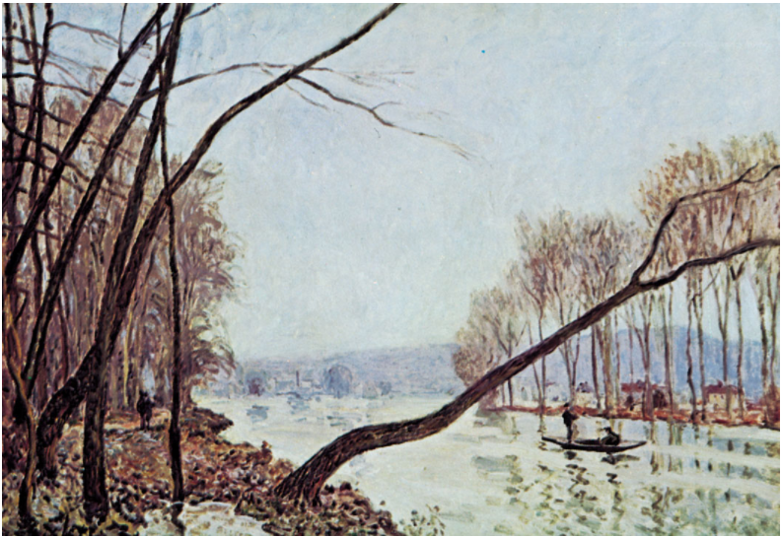
Aerial perspective (atmospheric perspective)
Banks of the Seine in Autumn, by Alfred Sisley

Slide 158
1 Kings 18:38
Then the fire of the Lord fell and consumed the burnt offering.

Slide 159
1 Kings 19:2
Then Jezebel sent a messenger to Elijah, saying, “So may the gods do to me and even more, if I do not make your life as the life of one of them by tomorrow about this time.”

Slide 160
1 Kings 19:3-4
And he was afraid and arose and ran for his life and came to Beersheba, which belongs to Judah, and left his servant there. 4 But he himself went a day’s journey into the wilderness, and came and sat down under a juniper tree; and he requested for himself that he might die, and said, “It is enough; now, O Lord, take my life, for I am not better than my fathers.”

Slide 161
James 5:17
Elijah was a man with a nature like ours.
NLT: Elijah was as human as we are.

Slide 162
Mark 14:72
And he [Peter] began to weep.

Slide 163
Mark 16:1 – 7
1 When the Sabbath was over, Mary Magdalene, and Mary the mother of James, and Salome, bought spices, so that they might come and anoint Him.
2 Very early on the first day of the week, they came to the tomb when the sun had risen.
3 They were saying to one another, “Who will roll away the stone for us from the entrance of the tomb?”
4 Looking up, they saw that the stone had been rolled away, although it was extremely large.
5 Entering the tomb, they saw a young man sitting at the right, wearing a white robe; and they were amazed.
6 And he said to them, “Do not be amazed; you are looking for Jesus the Nazarene, who has been crucified. He has risen; He is not here; behold, here is the place where they laid Him.
7 But go, tell His disciples and Peter, ‘He is going ahead of you to Galilee; there you will see Him, just as He told you.’”

Slide 164
2 Peter 3:17-18
17 You therefore, beloved, knowing this beforehand, be on your guard so that you are not carried away by the error of unprincipled men and fall from your own steadfastness, 18 but grow in the grace and knowledge of our Lord and Savior Jesus Christ. To Him be the glory, both now and to the day of eternity. Amen.

Slide 165
Psalm 31:7, “I will rejoice and be glad in Your lovingkindness, because You have seen my affliction.”
Isaiah 63:9, “In all their affliction He was afflicted, and the angel of His presence saved them; in His love and in His mercy He redeemed them, and He lifted them and carried them all the days of old.”
James 4:8a, “Draw near to God and He will draw near to you.”

Slide 166
Matthew 4:5-7
5 Then the devil took Him into the holy city and had Him stand on the pinnacle of the temple,
6 and said to Him, “If You are the Son of God, throw Yourself down; for it is written, ‘He will command His angels concerning You’; and ‘On their hands they will bear You up, so that You will not strike Your foot against a stone.’”
7 Jesus said to him, “On the other hand, it is written, ‘You shall not put the Lord your God to the test.’”

Slide 167
Malachi 3:1
[The Purifier] “Behold, I am going to send My messenger, and he will clear the way before Me. And the Lord, whom you seek, will suddenly come to His temple; and the messenger of the covenant, in whom you delight, behold, He is coming,” says the Lord of hosts.

Slide 168
Psalm 91:11-12
11 ‘He will command His angels concerning You’;
and
12 ‘On their hands they will bear You up, so that You will not strike Your foot against a stone.’”
Psalm 91:11-12
11 For He will give His angels charge concerning you, to guard you in all your ways.
12 They will bear you up in their hands, that you do not strike your foot against a stone.
John 6:38
For I have come down from heaven, not to do My own will, but the will of Him who sent Me.”

Slide 169
Deuteronomy 6:16
“You shall not put the Lord your God to the test, as you tested Him at Massah.”

Slide 170
Exodus 17:2-3
2 Therefore the people quarreled with Moses and said, “Give us water that we may drink.” And Moses said to them, “Why do you quarrel with me? Why do you test the Lord?” 3 But the people thirsted there for water; and they grumbled against Moses and said, “Why, now, have you brought us up from Egypt, to kill us and our children and our livestock with thirst?”
Exodus 17:7
7 He named the place Massah and Meribah because of the quarrel of the sons of Israel, and because they tested the Lord, saying, “Is the Lord among us, or not?”

Slide 171
Matthew 4:8-10
8 Again, the devil took Him to a very high mountain and showed Him all the kingdoms of the world and their glory;
9 and he said to Him, “All these things I will give You, if You fall down and worship me.”
10 Then Jesus said to him, “Go, Satan! For it is written, ‘You shall worship the Lord your God, and serve Him only.’”

Slide 172
Ephesians 2:2
the prince of the power of the air.

Slide 173
Minister on earth for three more years
Be crucified and pay for everyone’s sins
Resurrect
Ascend into heaven
Return in glory to claim the kingdoms of the world as His own
Bow to Satan
Claim the kingdoms of the world as His own

Slide 174
John 14:30
I will not speak much more with you, for the ruler of the world is coming, and he has nothing in Me…
1 Corinthians 4:4
in whose case the god of this world has blinded the minds of the unbelieving so that they might not see the light of the gospel of the glory of Christ, who is the image of God.

Slide 175
Deuteronomy 6:12-15
12 then watch yourself, that you do not forget the Lord who brought you from the land of Egypt, out of the house of slavery.
13 You shall fear only the Lord your God; and you shall worship Him and swear by His name.
14 You shall not follow other gods, any of the gods of the peoples who surround you,
15 for the Lord your God in the midst of you is a jealous God; otherwise the anger of the Lord your God will be kindled against you, and He will wipe you off the face of the earth.

Slide 176
Isaiah 14:13-14
13 “I will ascend to heaven;
I will raise my throne above the stars of God,
And I will sit on the mount of assembly in the recesses of the north.
14 I will ascend above the heights of the clouds;
I will make myself like the Most High.”
15
“Nevertheless you will be thrust down to Sheol, to the recesses of the pit.”

Slide 177
Ezekiel 28:16b
And you sinned; therefore I have cast you as profane from the mountain of God. And I have destroyed you, O covering cherub, from the midst of the stones of fire.

Slide 178
Matthew 4:11
Then the devil left Him; and behold, angels came and began to minister to Him.

Slide 179
Proverbs 7:6-27
⁶ For at the window of my house
I looked out through my lattice,
⁷ And I saw among the naive,
And discerned among the youths
A young man lacking sense,
⁸ Passing through the street near her corner;
And he takes the way to her house,
⁹ In the twilight, in the evening,
In the middle of the night and in the darkness.
¹⁰ And behold, a woman comes to meet him,
Dressed as a harlot and cunning of heart.
¹¹ She is boisterous and rebellious,
Her feet do not remain at home;
¹² She is now in the streets, now in the squares,
And lurks by every corner.
¹³ So she seizes him and kisses him
And with a brazen face she says to him:
¹⁴ “I was due to offer peace offerings;
Today I have paid my vows.

Slide 180
¹⁵ “Therefore I have come out to meet you,
To seek your presence earnestly, and I have found you.
¹⁶ “I have spread my couch with coverings,
With colored linens of Egypt.
¹⁷ “I have sprinkled my bed
With myrrh, aloes and cinnamon.
¹⁸ “Come, let us drink our fill of love until morning;
Let us delight ourselves with caresses.
¹⁹ “For my husband is not at home,
He has gone on a long journey;
²⁰ He has taken a bag of money with him,
At the full moon he will come home.”
²¹ With her many persuasions she entices him;
With her flattering lips she seduces him.
²² Suddenly he follows her
As an ox goes to the slaughter,
Or as one in fetters to the discipline of a fool,
²³ Until an arrow pierces through his liver;
As a bird hastens to the snare,
So he does not know that it will cost him his life.

Slide 181
²⁴ Now therefore, my sons, listen to me,
And pay attention to the words of my mouth.
²⁵ Do not let your heart turn aside to her ways,
Do not stray into her paths.
²⁶ For many are the victims she has cast down,
And numerous are all her slain.
²⁷ Her house is the way to Sheol,
Descending to the chambers of death.

Slide 182
Verse 7: And I saw among the naive, and discerned among the youths a young man lacking sense
Romans 16:17-18
¹⁷ Now I urge you, brethren, keep your eye on those who cause dissensions and hindrances contrary to the teaching which you learned, and turn away from them. ¹⁸ For such men are slaves, not of our Lord Christ but of their own appetites; and by their smooth and flattering speech they deceive the hearts of the unsuspecting.
Romans 16:19
¹⁹ For the report of your obedience has reached to all; therefore I am rejoicing over you, but I want you to be wise in what is good and innocent in what is evil.

Slide 183
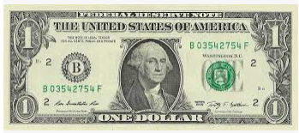

Slide 184


Slide 185
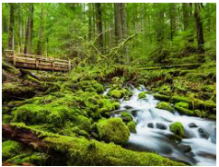

Slide 186
Verse 8: Passing through the street near her corner; and he takes the way to her house
Matthew 5:23-24
23 Therefore if you are presenting your offering at the altar, and there remember that your brother has something against you, 24 leave your offering there before the altar and go; first be reconciled to your brother, and then come and present your offering.
Romans 12:18
If possible, so far as it depends on you, be at peace with all men.

Slide 187
Ephesians 4:32
Be kind to one another, tender-hearted, forgiving each other, just as God in Christ also has forgiven you.
Colossians 2:13-14
13 When you were dead in your transgressions and the uncircumcision of your flesh, He made you alive together with Him, having forgiven us all our transgressions, 14 having canceled out the certificate of debt consisting of decrees against us, which was hostile to us; and He has taken it out of the way, having nailed it to the cross.

Slide 188
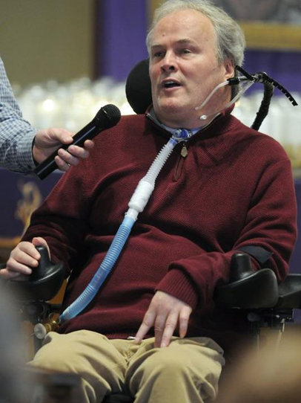

Slide 189

"When I try, I fail. When I trust, He succeeds."
"Forgiveness is an act of the will, and the will can function regardless of the temperature of the heart."
"Jesus Christ had died for this man; was I going to ask for more? Lord Jesus, I prayed, forgive me and help me to forgive him... Jesus, I cannot forgive him. Give me your forgiveness."
"You may never know that Jesus is all you need, until Jesus is all you have."
"To forgive is to set a prisoner free and discover the prisoner was you."

Slide 190
Romans 8:28
And we know that God causes all things to work together for good to those who love God, to those who are called according to His purpose.

Slide 191
Verse 9 In the twilight, in the evening, in the middle of the night and in the darkness.
Verses 10-12
10 And behold, a woman comes to meet him, dressed as a harlot and cunning of heart.
11 She is boisterous and rebellious, her feet do not remain at home;
Verse 12 She is now in the streets, now in the squares, and lurks by every corner.
Foolish men think to hide themselves from God, by hiding God from themselves.

Slide 192
Verses 13 - 21
¹³ So she seizes him and kisses him
And with a brazen face she says to him:
¹⁴ “I was due to offer peace offerings;
Today I have paid my vows.
¹⁵ “Therefore I have come out to meet you,
To seek your presence earnestly, and I have found you.
¹⁶ “I have spread my couch with coverings,
With colored linens of Egypt.
¹⁷ “I have sprinkled my bed
With myrrh, aloes and cinnamon.
¹⁸ “Come, let us drink our fill of love until morning;
Let us delight ourselves with caresses.
¹⁹ “For my husband is not at home,
He has gone on a long journey;
²⁰ He has taken a bag of money with him,
At the full moon he will come home.”

Slide 193

Proverbs 5:22
His own iniquities will capture the wicked, and he will be held with the cords of his sin.

Slide 194
1) Quick pleasure. “and kisses him.” Sin is not usually patient. It wants to strike quickly at the first opportunity so as to pull you in.
2) Makes the occasion seem special. “I was due to offer peace offerings; today I have paid my vows.” Sin says that this is a special time. You have to act now or it will be lost forever. Sin’s tagline could be “For a limited time only” or at least sin wants you to think that.
3) Notice also in this same phrase she talks about peace offerings and vows. Sin sometimes puts on an air of righteousness and religion if it knows that is necessary to catch its prey.
4) Flattery, making you seem special. “Therefore I have come out to meet you, to seek your presence earnestly, and I have found you.” Sin wants you to feel like you and only you deserve what she has to offer. “Today is your lucky day” sin says to the gambler. “I’ve had my eye on you” sin says to the co-worker. “You deserve better than that” sin says to everyone.

Slide 195
5) Appeal to your desires. “I have spread my couch with coverings, with colored linens of Egypt. I have sprinkled my bed with myrrh, aloes and cinnamon.” What do you want that you don’t have? Sin will figure out a way seduce you with that desire. “I have something special for you; something that you really want.”
6) Promises guaranteed satisfaction. “Come, let us drink our fill of love until morning; let us delight ourselves with caresses.” Sin makes you think that it will satisfy you, but it will always leave you wanting more. More alcohol, more unearned money, more fooling around, more bitterness, more, more, more.
7) Promise of safety. “For my husband is not at home, he has gone on a long journey; he has taken a bag of money with him, at the full moon he will come home.” Sin always lets you think that there will be no repercussions. “It’s OK. No one will see you.” “You have plenty of time.”

Slide 196
Verses 21 - 23
²¹With her many persuasions she entices him; with her flattering lips she seduces him.
²² Suddenly he follows her as an ox goes to the slaughter, or as one in fetters to the discipline of a fool,
²³ Until an arrow pierces through his liver; as a bird hastens to the snare, so he does not know that it will cost him his life.
Verses 24 – 27
²⁴ Now therefore, my sons, listen to me, and pay attention to the words of my mouth.
²⁵ Do not let your heart turn aside to her ways, do not stray into her paths.
²⁶ For many are the victims she has cast down, and numerous are all her slain.
²⁷ Her house is the way to Sheol, descending to the chambers of death.

Slide 197



Slide 198
1 Corinthians 10:12
Therefore let him who thinks he stands take heed that he does not fall.
Verse 24
Now therefore, my sons, listen to me, and pay attention to the words of my mouth.”

Slide 199
Imitating Jesus
1) Scripture
2) Faith
3) Grace
4) God’s Faithfulness
Jeremiah 23:23
“Am I a God who is near,’” declares the Lord, ‘And not a God far off?”

Slide 200
1 Corinthians 10:13
No temptation has overtaken you but such as is common to man; and God is faithful, who will not allow you to be tempted beyond what you are able, but with the temptation will provide the way of escape also, so that you will be able to endure it.

Slide 201
Verse 6—the sin
6 We have sinned like our fathers,
We have committed iniquity, we have behaved wickedly.
Verse 7—the reason
7 Our fathers in Egypt did not understand Your wonders;
They did not remember Your abundant kindnesses,
But rebelled by the sea, at the Red Sea.
Verse 14—the sin
14 But craved intensely in the wilderness,
And tempted God in the desert.
Verse 13—the reason
13 They quickly forgot His works;
They did not wait for His counsel,
Verses 19 and 20—the sin
19 They made a calf in Horeb
And worshiped a molten image.
20 Thus they exchanged their glory
For the image of an ox that eats grass.
Verse 21—the reason
21 They forgot God their Savior,
Who had done great things in Egypt,

Slide 202
Determining God’s Will

Slide 203
Luke 6:12-16
12 It was at this time that He went off to the mountain to pray, and He spent the whole night in prayer to God.
13 And when day came, He called His disciples to Him and chose twelve of them, whom He also named as apostles:
14 Simon, whom He also named Peter, and Andrew his brother; and James and John; and Philip and Bartholomew;
15 and Matthew and Thomas; James the son of Alphaeus, and Simon who was called the Zealot;
16 Judas the son of James, and Judas Iscariot, who became a traitor.

Slide 204
Mountains
Noah’s ark rests on Mount Ararat.
On Mount Sinai Moses was given the Ten Commandments.
Abraham’s near sacrifice of Isaac on Mount Moriah.
The Temple was built on Mount Zion.
Elijah challenges the prophets of Baal on Mount Carmel.
The glory of the Lord appears like a devouring fire on the top of the mountain (Exodus 24:17)
When the Israelites entered into the promised they passed between two mountains. Mount Gerazim represented the blessing for serving God and Mount Ebal represented the curse for rejecting God.
Moses died on Mount Pisgah. Aaron died on Mount Hor.
When Jesus returns at the Second Coming His feet will touch down on the Mount of Olives.

Slide 205
Jesus’ key events on mountains
Temptation by the Devil (Matt 4:8)
Before calling Apostles (Luke 6:12-16)
Sermon on the Mount (Matt 5:1-12)
Many healings (Matt 15:29-31)
Transfiguration on Mount Tabor (Matt 17:1)
Final discourse (Matt 24:3)
Prays on the Mount of Olives before His arrest and crucifixion (Luke 222:39-49)
Commissioning of the Apostles (Matt 28:16-20)

Slide 206
Mountains symbolize:
Power
(Psalm 30:7, “O Lord, by Your favor You have made my mountain to stand strong…”)
Authority
(Isaiah 2:2, “Now it will come about that In the last days the mountain of the house of the Lord will be established as the chief of the mountains, and will be raised above the hills; and all the nations will stream to it.”)
Blessings and plenty
(Isaiah 25:6, “The Lord of hosts will prepare a lavish banquet for all peoples on this mountain; a banquet of aged wine, choice pieces with marrow, and refined, aged wine.”)
Understanding God and His ways
(Micah 4:2, “Come and let us go up to the mountain of the Lord and to the house of the God of Jacob, that He may teach us about His ways and that we may walk in His paths.”)
Meeting God
(Exodus 19:3, “Moses went up to God, and the Lord called to him from the mountain, saying, ‘Thus you shall say to the house of Jacob and tell the sons of Israel…’”)
The presence of God
(Psalm 24:3, “Who may ascend into the hill of the Lord? And who may stand in His holy place?”)

Slide 207
The number twelve in the Bible represents God’s authority and government.
Twelve tribes of Israel
Twelve Apostles
Ishmael had 12 princes
Twelve unleavened cakes of bread be placed every week in the temple
In Revelation, 12,000 are called from each of the 12 tribes to be 144,000 witnesses
The New Jerusalem will have 12 gates and its walls will be 144 (12 x 12) cubits high and will be 12,000 furlongs square
Jesus’ first recorded words were when He was 12 years old
The Tree of Life in the new creation will bear twelve kinds of fruit (Revelation 22:2)

Slide 208
Name | A.K.A. (Also Known As) | Trade | Significance in the NT (not complete)
Simon | Peter. Cephas (meaning “Rock”). | Fisherman | Walked on water (Matt 14:28-33). At Transfiguration (Matt 17:1-13). Denied Jesus (Luke 22:54-62). Early church leader (Acts 2, 10).
Andrew (Peter’s brother) | Protokletos (by the Orthodox church with means “first-called.”) | Fisherman | Finds the boy with the bread and fish in the feeding of the 5,000 (John 6:1-15).
James son of Zebedee | James the Greater. Boanerges, Son of Thunder (with John) (Mark 3:17). | Fisherman | Wanted to call down fire on an inhospitable village (Luke 9:54). Asked Jesus if he and John could sit on either side of Jesus’ throne in heaven (Mark 10:35-40).
John son of Zebedee | Boanerges, Son of Thunder (with James) (Mark 3:17). Beloved disciple. The elder (2 John 1:1) | Fisherman | Wanted to call down fire on an inhospitable village (Luke 9:54). Asked Jesus if he and John could sit on either side of Jesus’ throne in heaven (Mark 10:35-40). Asked by Jesus to take care of His mother, Mary (John 19:26-27). Sits next to Jesus at the Passover meal (John 21:20).

Slide 209
Philip | Philip the Apostle to distinguish from Philip the Evangelist (Acts 6:2-6). |  | Brought Nathanael (Bartholomew) to Jesus (“come and see”) (John 1:45-46).
Bartholomew | Nathanael. |  | Jesus called him by seeing him under the fig tree (John 1:45-51).
Matthew | Levi son of Alphaeus. | Tax collector | Jesus and sinners ate at his house (Matt 9:10-13).
Thomas | Doubting Thomas Didymus (which means twin). The Twin. |  | Doubted Jesus’ resurrection (John 20:25-29).
James son of Alphaeus | James the Lesser
Simon the Zealot |  | Maybe fisherman
Judas of James | Jude. Jude of James. Thaddeus. Judas Thaddeus. Lebbaeus. | Maybe fisherman
Judas Iscariot |  |  | Complained about Mary wasting perfume by anointing Jesus (John 12:1-8). Agrees to betray Jesus (Matt 26:14-16). Kisses Jesus to indicate who He was (Matt 26:47-49). Returns the betrayal money (Matt 27:3-4). Committed suicide (Acts 1:18-19).

Slide 210
Name | Death | Wrote | Noted | Symbol
Simon | Crucified by Nero around 64. The “Acts of Peter” claim that he was crucified upside down because he was not worthy to die as Jesus did. | 1 Peter 2 Peter | Andrew’s brother. | Upside down cross with keys
Andrew (Peter’s brother) | Crucified on an “X” shaped cross (known as St. Andrew’s Cross) in Patras in Greece at around 60 AD. |  | Simon Peter’s brother. First disciple called. First disciple to recognize Jesus as Messiah (John 1:41-42). Was a disciple of John the Baptist (John 1:35-40). | Two crossed fish
James son of Zebedee | Killed by the sword (beheaded?) by Herod (Acts 12:2). Only martyrdom recorded in the Bible. |  | Brother of John. | Three shells
John son of Zebedee | Old age (only one not martyred) possibly lived until 100 AD. | Gospel of John 1 John 2 John 3 John Revelation | Brother of James. Disciples include: Polycarp of Smyrna, Ignatius of Antioch | Chalice with a snake in it

Slide 211
Philip | Probably martyred around 80 A.D. in Hierapolis, Phrygia but texts vary as to the means (stoning, beheaded, crucified). |  |  | Basket
Bartholomew | Martyred but year and how is debated. Most common is that his skin was stripped off while alive (flayed) and then beheaded. Ouch. |  |  | Three parallel knives
Matthew | Probably martyred although the year and means are debated. Some say that Hircanus the king had him killed with a spear. | Gospel of Matthew | A tax collector was among the most reviled jobs and so considered to be a traitor. | Three money bags
Thomas | On July 3, 72 AD he was pierced with a lance in India. |  |  | Group of spears, stones, & arrows
James son of Alphaeus | Probably martyred. He may have been crucified in Egypt or stoned in Jerusalem or sawed in pieces. |  | Some think he may have been Matthew’s brother. | Saw
Simon the Zealot | Probably martyred but year and how is debated. Some say he was crucified in England in 74 AD. |  |  | Fish on a Bible
Judas of James | May have been clubbed to death or killed with arrows at Ararat. |  |  | Ship
Judas Iscariot | Suicide by hanging. |  |  | Hangman noose

Slide 212
Apostles
They spent more time with Jesus being taught and trained by Him.
“And He called the twelve together, and gave them power and authority over all the demons and to heal diseases.” – Luke 9:1
Whereas the disciples followed Jesus, the Apostles were sent out by Jesus.
  16 But the eleven disciples proceeded to Galilee, to the mountain which Jesus had designated. 17 When they saw Him, they worshiped Him; but some were doubtful. 18 And Jesus came up and spoke to them, saying, “All authority has been given to Me in heaven and on earth. 19 Go therefore and make disciples of all the nations, baptizing them in the name of the Father and the Son and the Holy Spirit, 20 teaching them to observe all that I commanded you; and lo, I am with you always, even to the end of the age.” – Matthew 28:16-20

Slide 213
After Jesus’ ascension the Apostles were given power from the Holy Spirit to be witness to the ends of the earth.
  The first account I composed, Theophilus, about all that Jesus began to do and teach, 2 until the day when He was taken up to heaven, after He had by the Holy Spirit given orders to the apostles whom He had chosen. 3 To these He also presented Himself alive after His suffering, by many convincing proofs, appearing to them over a period of forty days and speaking of the things concerning the kingdom of God. 4 Gathering them together, He commanded them not to leave Jerusalem, but to wait for what the Father had promised, “Which,” He said, “you heard of from Me; 5 for John baptized with water, but you will be baptized with the Holy Spirit not many days from now.” – Acts 1:1-5

Slide 214
They received new revelation from Jesus such as the church, the Second Coming, salvation, and many other doctrines. | Much of the Gospels; 1 Peter 1:12
They were the validation and core from which the church was built. | Matthew 16:18; Acts 2
They set the precedence of evangelism by taking the Gospel to all nations. | Matthew 28:18-20
They were with Jesus and so witnessed His life, sinlessness, teachings, miracles, death, resurrection, and ascension. Therefore, they could record this for future generations. | The Gospels and 21 of the 27 New Testament books, if you count Paul as an Apostle.

Slide 215




Slide 216

Methods for Discerning God’s Will
Bible

Slide 217
Romans 15:4
For whatever was written in earlier times was written for our instruction, so that through perseverance and the encouragement of the Scriptures we might have hope.

Slide 218
Know God’s commandments and examples
2 Corinthians 6:14 – 16
Do not be bound [unequally yoked] together with unbelievers; for what partnership have righteousness and lawlessness, or what fellowship has light with darkness? 15 Or what harmony has Christ with Belial, or what has a believer in common with an unbeliever? 16 Or what agreement has the temple of God with idols? For we are the temple of the living God; just as God said, “I will dwell in them and walk among them; And I will be their God, and they shall be My people.”

Slide 219
Hebrews 10:24-25
24 and let us consider how to stimulate one another to love and good deeds,
25 not forsaking our own assembling together, as is the habit of some, but encouraging one another; and all the more as you see the day drawing near.
Matthew 5:28
but I say to you that everyone who looks at a woman with lust for her has already committed adultery with her in his heart.

Slide 220
Ephesians 5:18
And do not get drunk with wine, for that is dissipation, but be filled with the Spirit…
1 Corinthians 6:18
Flee immorality…
1 Thessalonians 5:18
in everything give thanks

Slide 221
Romans 13:9
You shall not steal
Ephesians 4:32
Be kind to one another, tender-hearted, forgiving each other, just as God in Christ also has forgiven you.
Hebrews 10:25
not forsaking our own assembling together, as is the habit of some, but encouraging one another; and all the more as you see the day drawing near.

Slide 222
Colossians 3:5
Therefore consider the members of your earthly body as dead to immorality, impurity, passion, evil desire, and greed, which amounts to idolatry.
Ephesians 4:29
Let no unwholesome word proceed from your mouth, but only such a word as is good for edification according to the need of the moment, so that it will give grace to those who hear.
2 Corinthians 6:14
Do not be bound together with unbelievers; for what partnership have righteousness and lawlessness, or what fellowship has light with darkness?

Slide 223
Noah Obedience
David Victory
Ruth Loyalty
Joshua Courage and Trust in God
Esther Standing for what is right and actively opposing evil
Peter God’s Second Chances
Herod Evil of Vanity
Jezebel Evil of Power

Slide 224
2) Reading the Bible carefully and slowly and letting God speak to you personally
Matthew 14
22 Immediately He made the disciples get into the boat and go ahead of Him to the other side, while He sent the crowds away. 23 After He had sent the crowds away, He went up on the mountain by Himself to pray; and when it was evening, He was there alone. 24 But the boat was already a long distance from the land, battered by the waves; for the wind was contrary. 25 And in the fourth watch of the night He came to them, walking on the sea. 26 When the disciples saw Him walking on the sea, they were terrified, and said, “It is a ghost!” And they cried out in fear. 27 But immediately Jesus spoke to them, saying, “Take courage, it is I; do not be afraid.”
28 Peter said to Him, “Lord, if it is You, command me to come to You on the water.” 29 And He said, “Come!” And Peter got out of the boat, and walked on the water and came toward Jesus. 30 But seeing the wind, he became frightened, and beginning to sink, he cried out, “Lord, save me!” 31 Immediately Jesus stretched out His hand and took hold of him, and said to him, “You of little faith, why did you doubt?” 32 When they got into the boat, the wind stopped. 33 And those who were in the boat worshiped Him, saying, “You are certainly God’s Son!”

Slide 225
Finding God’s will for your life is not as difficult as we make it out to be. In fact, 90 percent of God's will for my life is the same as 90 percent of God's will for your life. (Actual results may vary.)
I believe it's because most of us tend to overplay the importance of God's specific will for our life, while underestimating the value of knowing and doing God's universal will for all our lives. We often want to skip past the 90 percent (the Essentials) and jump straight to the 10 percent (the Specifics).
Jesus never asked us to be unique. He told us to be faithful.

Slide 226

2) Prayer

Slide 227
Psalms
  Confidence/Trust
  Kingship/Royal of both God and of a human king
  Lamentation, sometimes further divided into personal and communal
  Praise hymns
  Remembrance
  Thanksgiving
  Wisdom

Slide 228
Abuse by enemies – Psalm 3
God feeling distant – Psalm 13
Sorrow – Psalm 137
Feeling overwhelmed and helpless – Psalm 69
Suffering – Psalm 22
Isolation – Psalm 102
Feeling vulnerable – Psalm 31
Guilt – Psalm 32
Feeling crushed and oppressed – Psalm 38
Betrayal – Psalm 55
A sense of injustice – Psalm 58
Envy of the wicked and rich – Psalm 73
Feeling needy – Psalm 86
Disappointment – Psalm 74
Depression/Discouragement – Psalm 88

Slide 229
James 1:5-8
5 But if any of you lacks wisdom, let him ask of God, who gives to all generously and without reproach, and it will be given to him.
6 But he must ask in faith without any doubting, for the one who doubts is like the surf of the sea, driven and tossed by the wind.
7 For that man ought not to expect that he will receive anything from the Lord,
8 being a double-minded man, unstable in all his ways.

Slide 230
Hebrews 4:14-16
14 Therefore, since we have a great high priest who has passed through the heavens, Jesus the Son of God, let’s hold firmly to our confession.
15 For we do not have a high priest who cannot sympathize with our weaknesses, but One who has been tempted in all things just as we are, yet without sin.
16 Therefore let’s approach the throne of grace with confidence, so that we may receive mercy and find grace for help at the time of our need.

Slide 231
Mark 9:23
All things are possible for the one who believes.
Mark 9:24
Immediately the boy’s father cried out and said, “I do believe; help my unbelief.”

Slide 232
The father’s desire. He hoped to believe. He wanted to believe. He felt that, in some small way, he did believe.
2) The father’s understanding of his shortcomings. He knew that he didn’t believe as much as he should. He knew that he had doubts. He knew that he was weak.
3) The father’s heart to grow. He wanted to replace his weakness with strength, to replace his doubts with faith.
4) The father’s dependence on Jesus. He knew that he couldn’t grow his faith by himself. He knew that he needed God to help him. And so he placed his son’s life at the feet of Jesus.

Slide 233

3) Counsel

Slide 234
1 Kings 12:13-14
13 The king answered the people harshly, for he forsook the advice of the elders which they had given him,
14 and he spoke to them according to the advice of the young men, saying, “My father made your yoke heavy, but I will add to your yoke; my father disciplined you with whips, but I will discipline you with scorpions.”

Slide 235
How to choose a wise counselor
1) Someone who relies on the Bible
2) Someone who cares
3) Someone who has experience and maturity

Slide 236
2 Corinthians 1:3-4
3 Blessed be the God and Father of our Lord Jesus Christ, the Father of mercies and God of all comfort,
4 who comforts us in all our affliction so that we will be able to comfort those who are in any affliction with the comfort with which we ourselves are comforted by God.
who comforts us
so that we will be able to comfort

Slide 237



Slide 238
1 Timothy 4:12
Let no one look down on your youthfulness, but rather in speech, conduct, love, faith and purity, show yourself an example of those who believe.
Job 32:6-9
6 So Elihu the son of Barachel the Buzite spoke out and said, “I am young in years and you are old; therefore I was shy and afraid to tell you what I think. 7 “I thought age should speak, and increased years should teach wisdom. 8 But it is a spirit in man, And the breath of the Almighty gives them understanding. 9 The abundant in years may not be wise, Nor may elders understand justice.

Slide 239
How to choose a wise counselor
1) Someone who relies on the Bible
2) Someone who cares
3) Someone who has experience and maturity
4) Abundance of counselors

Slide 240


Proverbs 11:14
Where there is no guidance the people fall, but in abundance of counselors there is victory.
OR

Slide 241


Slide 242
Matthew 7:24-27
24 “Therefore everyone who hears these words of Mine and acts on them, may be compared to a wise man who built his house on the rock.
25 And the rain fell, and the floods came, and the winds blew and slammed against that house; and yet it did not fall, for it had been founded on the rock.
26 Everyone who hears these words of Mine and does not act on them, will be like a foolish man who built his house on the sand.
27 The rain fell, and the floods came, and the winds blew and slammed against that house; and it fell—and great was its fall.”

Slide 243


Versus

Slide 244
How to choose a wise counselor
1) Someone who relies on the Bible
2) Someone who cares
3) Someone who has experience and maturity
4) Abundance of counselors
5) Calls sin, sin and righteousness, righteousness

Slide 245
Isaiah 5:20
Woe to those who call evil good, and good evil; Who substitute darkness for light and light for darkness; Who substitute bitter for sweet and sweet for bitter!

Slide 246
How to choose a wise counselor
1) Someone who relies on the Bible
2) Someone who cares
3) Someone who has experience and maturity
4) Abundance of counselors
5) Calls sin, sin and righteousness, righteousness
6) Understands forgiveness

Slide 247
Ephesians 4:32
Be kind to one another, tender-hearted, forgiving each other, just as God in Christ also has forgiven you.
Proverbs 28:13
He who conceals his transgressions will not prosper, but he who confesses and forsakes them will find compassion.

Slide 248
How to choose a wise counselor
1) Someone who relies on the Bible
2) Someone who cares
3) Someone who has experience and maturity
4) Abundance of counselors
5) Calls sin, sin and righteousness, righteousness
6) Understands forgiveness
7) Emphasizes personal accountability

Slide 249

Proverbs 27:17
Iron sharpens iron, so one man sharpens another.

Slide 250
James 5:16
Therefore, confess your sins to one another, and pray for one another so that you may be healed. The effective prayer of a righteous man can accomplish much.

Slide 251
4) Reason and Wisdom
Proverbs 14:8, 15
8 The wisdom of the sensible is to understand his way, but the foolishness of fools is deceit.
15 The naive believes everything, but the sensible person considers his steps.

Slide 252
Luke 1:1-3
1 Inasmuch as many have undertaken to compile an account of the things accomplished among us,
2 just as they were handed down to us by those who from the beginning were eyewitnesses and servants of the word,
3 it seemed fitting for me as well, having investigated everything carefully from the beginning, to write it out for you in consecutive order, most excellent Theophilus…

Slide 253
Who do I trust?

Slide 254
Matthew 7:6
Do not throw your pearls before swine, or they will trample them under their feet, and turn and tear you to pieces.”

Slide 255
Isaiah 1:18
“Come now, and let us reason together,” says the Lord, “Though your sins are as scarlet, they will be as white as snow; though they are red like crimson, they will be like wool.”

Slide 256

5) Peace

Slide 257
John 16:33
These things I have spoken to you, so that in Me you may have peace. In the world you have tribulation, but take courage; I have overcome the world.
John 14:27
Peace I leave with you; My peace I give to you; not as the world gives do I give to you. Do not let your heart be troubled, nor let it be fearful.

Slide 258

Horatio Spafford

Slide 259
When peace like a river, attendeth my way,
When sorrows like sea billows roll;
Whatever my lot, Thou hast taught me to say
It is well, it is well, with my soul.
Refrain
It is well, (it is well),
With my soul, (with my soul)
It is well, it is well, with my soul.
Though Satan should buffet, though trials should come,
Let this blest assurance control,
That Christ has regarded my helpless estate,
And hath shed His own blood for my soul.
My sin, oh, the bliss of this glorious thought!
My sin, not in part but the whole,
Is nailed to the cross, and I bear it no more,
Praise the Lord, praise the Lord, O my soul!
For me, be it Christ, be it Christ hence to live:
If Jordan above me shall roll,
No pang shall be mine, for in death as in life,
Thou wilt whisper Thy peace to my soul.
But Lord, 'tis for Thee, for Thy coming we wait,
The sky, not the grave, is our goal;
Oh, trump of the angel! Oh, voice of the Lord!
Blessed hope, blessed rest of my soul.
And Lord, haste the day when the faith shall be sight,
The clouds be rolled back as a scroll;
The trump shall resound, and the Lord shall descend,
Even so, it is well with my soul.

Slide 260
2 Thessalonians 3:16
Now may the Lord of peace Himself continually grant you peace in every circumstance. The Lord be with you all!
And let the peace (soul harmony which comes) from Christ rule (act as umpire continually) in your hearts [deciding and settling with finality all questions that arise in your minds, in that peaceful state] to which as [members of Christ's] one body you were also called [to live]. And be thankful (appreciative), [giving praise to God always].
-- Colossians 3:15 Amplified Bible

Slide 261
6) Fasting
Ezra 8:21-23
21 Then I proclaimed a fast there at the river of Ahava, that we might humble ourselves before our God to seek from Him a safe journey for us, our little ones, and all our possessions.
22 For I was ashamed to request from the king troops and horsemen to protect us from the enemy on the way, because we had said to the king, “The hand of our God is favorably disposed to all those who seek Him, but His power and His anger are against all those who forsake Him.”
23 So we fasted and sought our God concerning this matter, and He listened to our entreaty.

Slide 262
Types of Fasts
A Partial Fast is one where you give up a certain item or category of items. For example, in Daniel 10:3, Daniel said that for three weeks “I did not eat any tasty food, nor did meat or wine enter my mouth.”
A Complete Fast is where you give up all food and drink except for water and, maybe, juice.
An Absolute Fast is where you give up all food and drink, even water.
A Timed Fast is where you only eat for a portion of the day and then fast the rest of the time. For example, you may allow yourself to eat only from 7:00 AM to 2:00 PM and then abstain from food the rest of the day. You might do this for a week or for a month.

Slide 263
Hebrews 7:26-27
26 For it was fitting for us to have such a high priest, holy, innocent, undefiled, separated from sinners, and exalted above the heavens;
27 who has no daily need, like those high priests, to offer up sacrifices, first for His own sins and then for the sins of the people, because He did this once for all time when He offered up Himself.

Slide 264
“For the flesh sets its desire against the Spirit, and the Spirit against the flesh; for these are in opposition to one another, so that you may not do the things that you please.” – Galatians 5:17
“It is the Spirit who gives life; the flesh profits nothing; the words that I have spoken to you are spirit and are life.” -- John 6:63
“For the mind set on the flesh is death, but the mind set on the Spirit is life and peace…” Romans 8:6

Slide 265
Galatians 5:19-21
19 Now the deeds of the flesh are evident, which are: immorality, impurity, sensuality,
20 idolatry, sorcery, enmities, strife, jealousy, outbursts of anger, disputes, dissensions, factions,
21 envying, drunkenness, carousing, and things like these, of which I forewarn you, just as I have forewarned you, that those who practice such things will not inherit the kingdom of God.

Slide 266
Ephesians 2:1-5
1 And you were dead in your trespasses and sins,
2 in which you formerly walked according to the course of this world, according to the prince of the power of the air, of the spirit that is now working in the sons of disobedience.
3 Among them we too all formerly lived in the lusts of our flesh, indulging the desires of the flesh and of the mind, and were by nature children of wrath, even as the rest.
4 But God, being rich in mercy, because of His great love with which He loved us,
5 even when we were dead in our transgressions, made us alive together with Christ (by grace you have been saved),

Slide 267
Galatians 5:22-23
22 But the fruit of the Spirit is love, joy, peace, patience, kindness, goodness, faithfulness,
23 gentleness, self-control; against such things there is no law.
24 Now those who belong to Christ Jesus have crucified the flesh with its passions and desires.

Slide 268
James 4:1-3
What is the source of quarrels and conflicts among you? Is not the source your pleasures that wage war in your members?
2 You lust and do not have; so you commit murder. You are envious and cannot obtain; so you fight and quarrel. You do not have because you do not ask.
3 You ask and do not receive, because you ask with wrong motives, so that you may spend it on your pleasures.

Slide 269
Galatians 5:17
For the flesh sets its desire against the Spirit, and the Spirit against the flesh; for these are in opposition to one another, so that you may not do the things that you please.

Slide 270


Slide 271



Slide 272
Psalm 81:10
I, the Lord, am your God, Who brought you up from the land of Egypt; Open your mouth wide and I will fill it.

Slide 273
7) Circumstances
Romans 1:10-13
10 always in my prayers making request, if perhaps now at last by the will of God I may succeed in coming to you.
11 For I long to see you so that I may impart some spiritual gift to you, that you may be established;
12 that is, that I may be encouraged together with you while among you, each of us by the other’s faith, both yours and mine.
13 I do not want you to be unaware, brethren, that often I have planned to come to you (and have been prevented so far) so that I may obtain some fruit among you also, even as among the rest of the Gentiles.
Acts 16:6
They passed through the Phrygian and Galatian region, having been forbidden by the Holy Spirit to speak the word in Asia;

Slide 274
Romans 12:2
And do not be conformed to this world, but be transformed by the renewing of your mind, so that you may prove what the will of God is, that which is good and acceptable and perfect.

Slide 275
Seven ways to discern God’s will
The Bible
Prayer
Counsel
Reason and wisdom
Peace
Fasting
Circumstances

Slide 276
Pitfalls in Discerning God’s Will
1) How is fear, insecurities, and biases affecting my decision?
2) Am I choosing and forcing my methods so as to ultimately agree with what I want in the end?
3) Am I using “God’s will” to justify something that I know is wrong or sin?

Slide 277

F.B. Meyer

Slide 278
Imitate
Jesus

Slide 279
www.disciplescorner.com

