Slide 1
Welcome to
Who is God
And
Why Does it Matter to Us
The Attributes of God
Bob LaForge

Slide 2
Q. What is the chief end of man?
A. Man's chief end is to glorify God, and to enjoy him forever.

Slide 3
Across time, God has moved closer to us
Old Testament: God dwelt before His people
Gospels: God dwelt among His people
Now: God dwells in His people
Heaven: God dwells everywhere

Slide 4
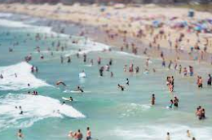
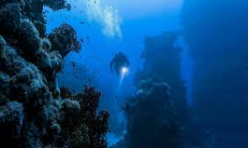

Slide 5
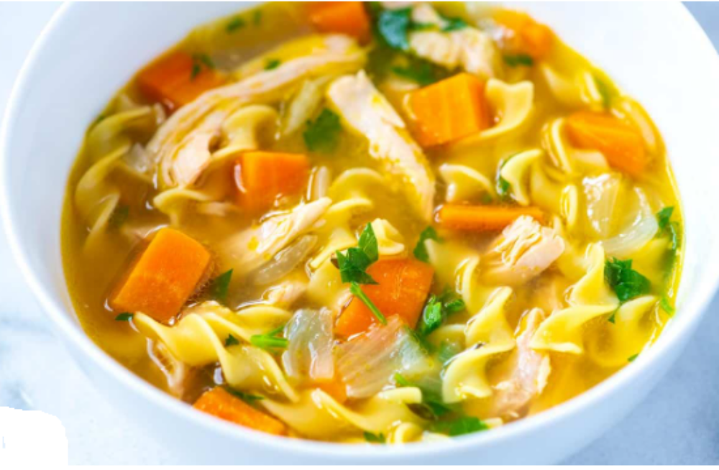

Slide 6
1 Corinthians 2:9-10
“but just as it is written,
‘THINGS WHICH EYE HAS NOT SEEN AND EAR HAS NOT HEARD,
AND which HAVE NOT ENTERED THE HEART OF MAN,
ALL THAT GOD HAS PREPARED FOR THOSE WHO LOVE HIM.’
For to us God revealed them through the Spirit; for the Spirit searches all things, even the depths of God.”

Slide 7
How do we get to know God better?
Bible

Slide 8

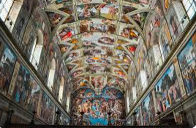

Slide 9
How do we get to know God better?
Bible
Other Christian’s Teachings
Your Own and Other People’s Experiences Including Biographies
Nature

Slide 10
Romans 1:20
For since the creation of the world His invisible attributes, that is, His eternal power and divine nature, have been clearly perceived, being understood by what has been made, so that they are without excuse.

Slide 11
Job 12:7
But now ask the beasts, and let them teach you; and the birds of the heavens, and let them tell you.

Slide 12
How do we get to know God better?
Bible
Other Christian’s Teachings
Your Own and Other People’s Experiences Including Biographies
Nature
Reason

Slide 13
Why is it important to know God better?
The better we know God the bigger He will be

Slide 14
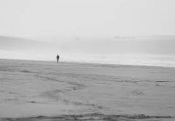
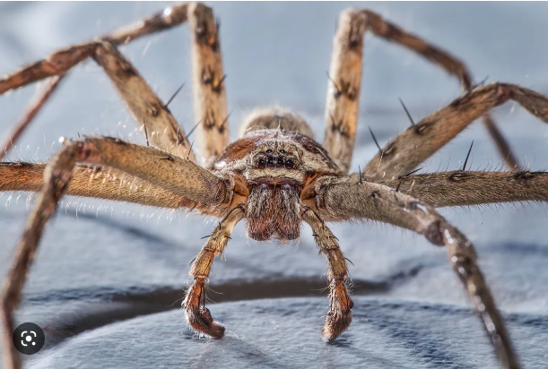

Slide 15
Why is it important to know God better?
The better we know God the bigger He will be
We were designed for a relationship with God

Slide 16

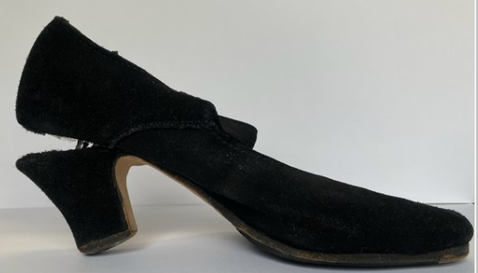

Slide 17
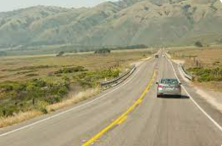
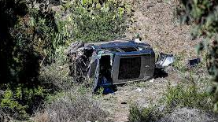

Slide 18
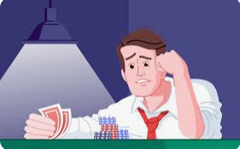


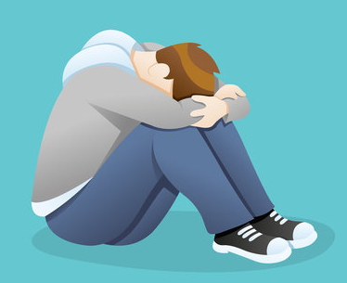
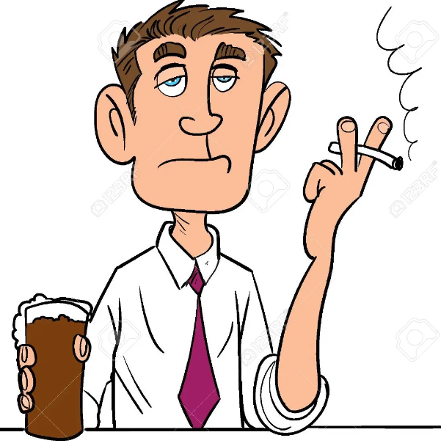
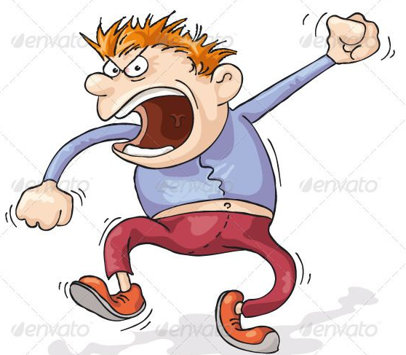

Slide 19
Why is it important to know God better?
The better we know God the bigger He will be
We were designed for a relationship with God
Intimacy is God’s desire

Slide 20
“… He created them.”
“God blessed them”
“and God said to them...”
Creation
Blessing
Personal interaction
Revelation 22:20
“Yes, I am coming soon.”

Slide 21
Job 1:1
that man was blameless and upright; he feared God and shunned evil.
Job 42:5
My ears had heard of you but now my eyes have seen you.

Slide 22
Why is it important to know God better?
The better we know God the bigger He will be
We were designed for a relationship with God
Intimacy is God’s desire
We can become more like God because we see it in God first

Slide 23
Proverbs 29:19
A slave will not be instructed by words alone; for though he understands, there will be no response.

Slide 24
We will trust God more

Slide 25

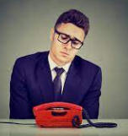

Slide 26
We will trust God more
As we deepen our understanding of God it will deepen our relationship with Him and so strengthen our prayer life and our desire to read the Bible
As we understand more who God is it will deepen our worship

Slide 27
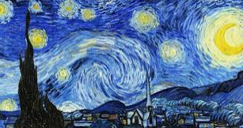


Slide 28
We will trust God more
As we deepen our understanding of God it will deepen our relationship with Him and so strengthen our prayer life and our desire to read the Bible
As we understand more who God is it will deepen our worship
As we know God better it will motivate us to evangelize more

Slide 29
You will be more motivated to go to church

Slide 30
Psalm 42:1
As the deer pants for the water brooks, so my soul pants for You, O God.

Slide 31
You will be more motivated to go to church
It creates a correct and proper self-image

Slide 32
Our lowered self-image
Dull and worthless
God’s image of us
Dignity and tremendous value & worth
Our inflated self-image
Arrogant and independent
God’s image of us
Sinners who need grace and mercy
A wrong self-image is self’s view of self; a right self-image is God’s view of self.

Slide 33
You will be more motivated to go to church
It creates a correct and proper self-image
It creates right relationships

Slide 34
1 John 4:19
We love because He first loved us.
Colossians 3:13
Bearing with one another, and forgiving each other, whoever has a complaint against anyone; just as the Lord forgave, so also should you.

Slide 35
Division of Attributes
Metaphysical, Incommunicable (does not exist in people), Absolute
The Eternal God
The Immutable God
The Omnipotent God
The Omniscient God
The Omnipresent God
The Holy God
The Sovereign God

Slide 36
Moral, Communicable (does exist in people), Comparative
The Divine Love
The Divine Faithfulness
The Divine Comfort

Slide 37
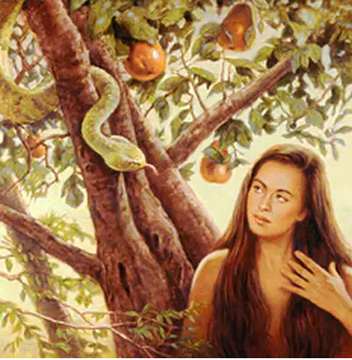

Slide 38
The first lie: God is not what He says He is.
God is infinite in His immensity and also infinite in the perfection of every detail.
God functions as one.

Slide 39
The wicked try to conform God to what they want Him to be and when they cannot twist God any further then they deny Him.
Ps 10:1, “The fool has said in his heart, ‘There is no God.’”
As Christians we no longer have to twist God to justify our sin, but, rather, we know that we are forgiven and so can strive to become more like God.

Slide 40
Hosea 6:3
So let us know, let us press on to know the LORD
His going forth is as certain as the dawn;
And He will come to us like the rain,
Like the spring rain watering the earth.

Slide 41
Welcome to
Who is God and
Why does it Matter to Us
The Eternity of God

Slide 42
Four sections to the study of each attribute:
Contemplation
What does it mean to us
Discussion questions (Possibly)
Situation (Possibly)

Slide 43
God has no beginning or end.
Nothing came before God and nothing will outlast Him; He is the alpha and omega—the first and the last.
God is not limited by time but exists outside of time’s constraints.
He simultaneously exists in all of time.

Slide 44
Genesis 1:1, “In the beginning God created…”
Isaiah 57:15,
“For thus says the high and exalted One
Who dwells in eternity, whose name is Holy,
‘I dwell on a high and holy place,
And also with the contrite and lowly of spirit
In order to revive the spirit of the lowly
And to revive the heart of the contrite.’”

Slide 45
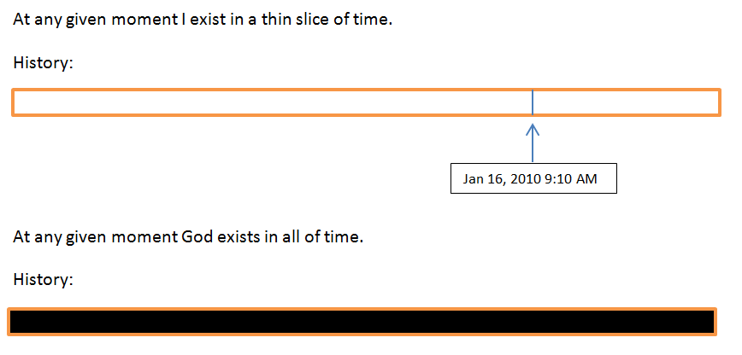
1) Existence in time

Slide 46
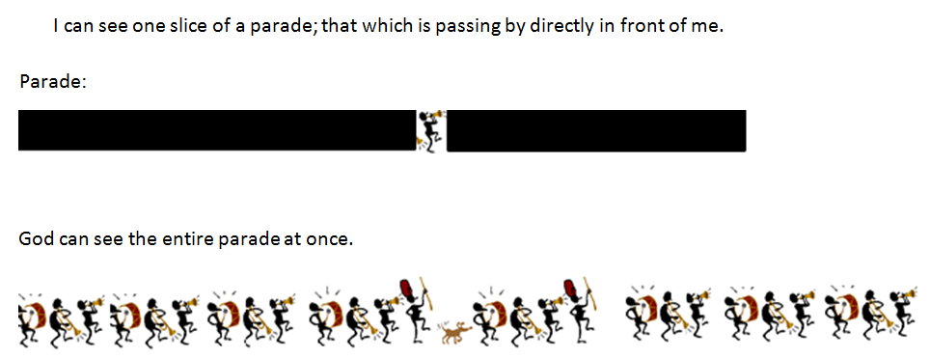
2) Two views of a parade.

Slide 47
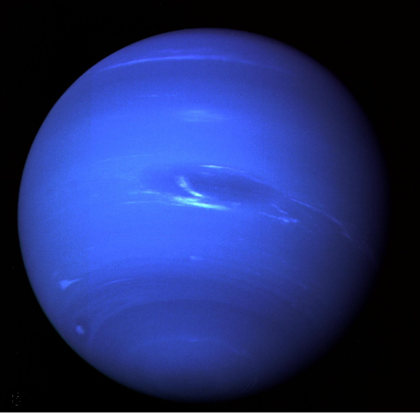
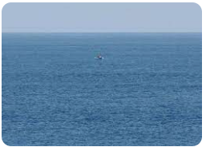
3) Size

Slide 48
Time does not affect God
Isaiah 40:28,
“Do you not know? Have you not heard?
The Everlasting God, the LORD, the Creator of the ends of the earth
Does not become weary or tired
His understanding is inscrutable.”

Slide 49
When God determines something it is forever
Psalm 119:89,
“Forever, O Lord, Thy word is settled in heaven.”

Slide 50
1 John 1:9
If we confess our sins, He is faithful and righteous to forgive us our sins and to cleanse us from all unrighteousness.

Slide 51
Romans 7:12
So then, the Law is holy, and the commandment is holy and righteous and good.

Slide 52
Matthew 24:35
Heaven and earth will pass away, but My words will not pass away.

Slide 53
Salvation requires an eternal God
Hebrews 10:11-12
Every priest stands daily ministering and offering time after time the same sacrifices, which can never take away sins; but He, having offered one sacrifice for sins for all time, SAT DOWN AT THE RIGHT HAND OF GOD

Slide 54



Colossians 2:13-14
When you were dead in your transgressions and the uncircumcision of your flesh, He made you alive together with Him, having forgiven us all our transgressions, having canceled out the certificate of debt consisting of decrees against us, which was hostile to us; and He has taken it out of the way, having nailed it to the cross.

Slide 55
Isaiah 53:4-5
“Surely our griefs He Himself bore,
And our sorrows He carried;
Yet we ourselves esteemed Him stricken,
Smitten of God, and afflicted.
But He was pierced through for our transgressions,
He was crushed for our iniquities;
The chastening for our well-being fell upon Him,
And by His scourging we are healed.”

Slide 56

The dots represent each and every person who has and who ever will live.

Slide 57
Revelation 5:13
To Him who sits on the throne, and to the Lamb, be blessing and honor and glory and dominion forever and ever.

Slide 58
What does God’s eternity mean to us?
We can trust God for the future
Romans 8:28
“And we know that God causes all things to work together for good to those who love God, to those who are called according to His purpose.”

Slide 59
We can know that God is always listening
We can be confident in His guidance

Slide 60
Discussion Questions
In addition to the ones discussed above, what are some other assurances that God’s eternity means to us?
If God has always existed then who created God?
By contemplating God’s eternity how can that help us through a trial?
The concept that God exists outside of time is hard to grasp. Is there any kind of visualization or analogy that can help someone understand this?
It has been said that God created time. If that is the case then what existed before time was created?
How can a God who exists outside of time be involved in each moment of my life when I am confined by time?
God is eternal. When we are born we will live forever. What is the difference?
What are some things that we can do to get to know God better?
How can someone always exist without ever being born?

Slide 61
Situation
Peggy is always nervous about the future. If you mention some situation to her, she will always think of the worst possible outcome and get uptight about it. This not only fills her with anxiety but also puts a damper on any plans or ideas that someone else suggests. One time someone suggested a church picnic at the nearby park and she responded, “That park has a playground and children can get hurt on those and then the church will get sued. And then there’s the bugs and what if it rains?” Is there anything about God’s character and perhaps particularly His eternity that you can use to help alleviate Peggy’s chronic fears?

Slide 62
Welcome to
Who is God and
Why Does it Matter to Me
The Immutable God

Slide 63
Introduction
The Eternal God
The Immutable God
The Omnipotent God
The Omniscient God
The Omnipresent God
The Holy God
The Sovereign God
The Divine Love
The Divine Faithfulness
The Divine Comfort

Slide 64
James 1:17
“Every good thing given and every perfect gift is from above, coming down from the Father of lights, with whom there is no variation or shifting shadow.”

Slide 65
He cannot vary
Cannot change
Cannot decrease
Cannot increase
He is all that He will ever be, all that He ever was

Slide 66
Job 34:14-16
¹⁴"If He should determine to do so,
If He should gather to Himself His spirit and His breath,
¹⁵All flesh would perish together,
And man would return to dust.
¹⁶"But if you have understanding, hear this;
Listen to the sound of my words.

Slide 67
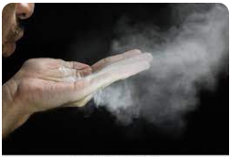
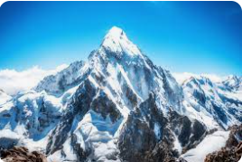

Slide 68
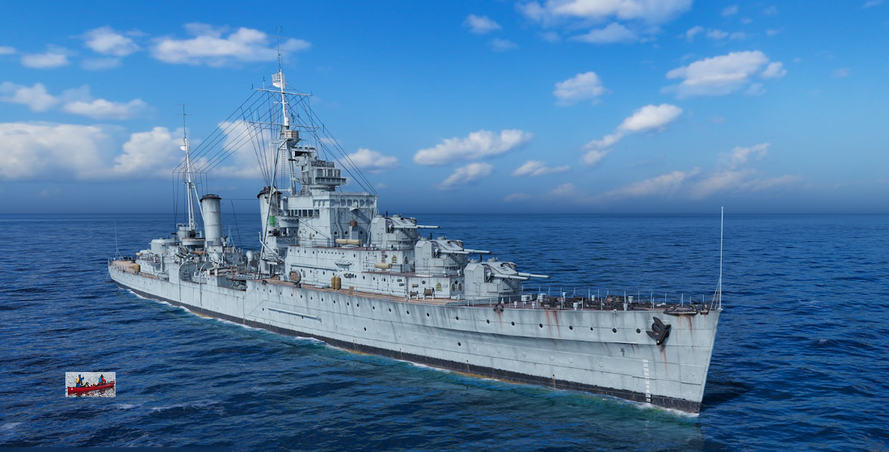

Slide 69
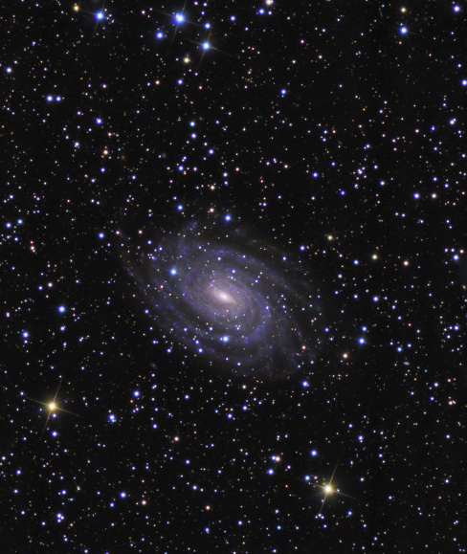
300,000,000,000,000,000,000,000 (300 sextillion) stars in the universe
Psalm 102:25-27
²⁵"Of old You founded the earth, And the heavens are the work of Your hands.
²⁶"Even they will perish, but You endure; And all of them will wear out like a garment; Like clothing You will change them and they will be changed.
²⁷"But You are the same, And Your years will not come to an end.

Slide 70
Nothing can change God
He cannot be changed by outside forces
He cannot change from within
Philippians 1:6
“For I am confident of this very thing, that He who began a good work in you will perfect it until the day of Christ Jesus.”
Because God does not need to hold back any resources for Himself He is able to apply all of them to us and knowing that the purpose which He has for our lives is one of perfection should give us an enormous sense of honor.

Slide 71
God’s immutability is our survival
Malachi 3:6
“For I, the LORD, do not change; therefore you, O sons of Jacob, are not consumed.”
It is true that:
God is self-sufficient and so does not need us.
God can immediately take anyone’s life and still be righteous.
We are sinners and God is perfectly holy.
However, it is also immutably true that:
God is rich in mercy.
God loves us with a great love.
Although God does not need us, nonetheless, He greatly delights in us. We are not without a friend in Heaven.

Slide 72
Because God does not change then neither do His eternal purposes
Hebrews 6:17-18
“In the same way God, desiring even more to show to the heirs of the promise the unchangeableness of His purpose, interposed with an oath,
¹⁸so that by two unchangeable things in which it is impossible for God to lie, we who have taken refuge would have strong encouragement to take hold of the hope set before us.”

Slide 73
2 Corinthians 1:20
For as many as the promises of God are, in Him they are yes; therefore through Him also is our Amen to the glory of God through us.

Slide 74
2 Corinthians 1:18-20
¹⁸ But as God is faithful, our word to you is not yes and no.
¹⁹ For the Son of God, Christ Jesus, who was preached among you by us—by me and Silvanus and Timothy—was not yes and no, but has been yes in Him.
²⁰ For as many as the promises of God are, in Him they are yes; therefore through Him also is our Amen to the glory of God through us.

Slide 75
Truth is forever
Matthew 24:35
“Heaven and earth will pass away, but My words will not pass away.”
Truth is never dependent on our understanding or acceptance of it. It is as true if we believe it and just as true if we doubt it.

Slide 76
Jesus Christ is immutable
Luke 2:52
“kept increasing in wisdom and stature, and in favor with God and men”
Philippians 2:6-7
“Who, although He existed in the form of God, did not regard equality with God a thing to be grasped, but emptied Himself, taking the form of a bond-servant, and being made in the likeness of men.”
Hebrews 13:8
“Jesus Christ is the same yesterday and today and forever.”

Slide 77
John 17:5
And now You, Father, glorify Me together with Yourself, with the glory which I had with You before the world existed.

Slide 78
God raises us up
Isaiah 59:2
But your iniquities have made a separation between you and your God, And your sins have hidden His face from you so that He does not hear.
Ephesians 2:6
and raised us up with Him, and seated us with Him in the heavenly places in Christ Jesus

Slide 79
2 Corinthians 5:21
He made Him who knew no sin to be sin on our behalf, so that we might become the righteousness of God in Him.

Slide 80
What does God’s immutability mean to us?
We can trust God
James 1:17 says
Every good thing bestowed and every perfect gift is from above, coming down from the Father of lights, with whom there is no variation, or shifting shadow.

Slide 81
We can resist temptation
1 Corinthians 10:13
No temptation has overtaken you but such as is common to man; and God is faithful, who will not allow you to be tempted beyond what you are able, but with the temptation will provide the way of escape also, that you may be able to endure it.

Slide 82
We can have confidence in His desire for our life
John 10:10
The thief comes only to steal and kill and destroy; I came that they may have life, and have it abundantly.
Psalm 16:11
You will make known to me the path of life; in Your presence is fullness of joy; in Your right hand there are pleasures forever.

Slide 83
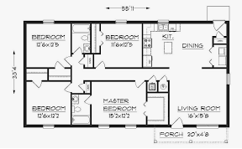
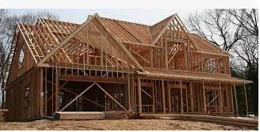
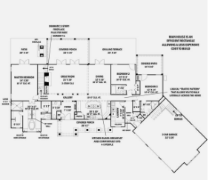
We can become more godly

Slide 84
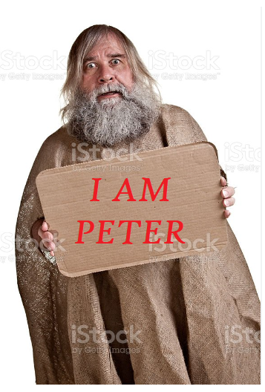
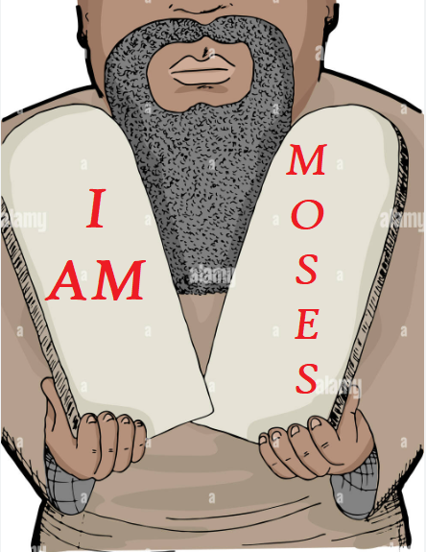

Slide 85
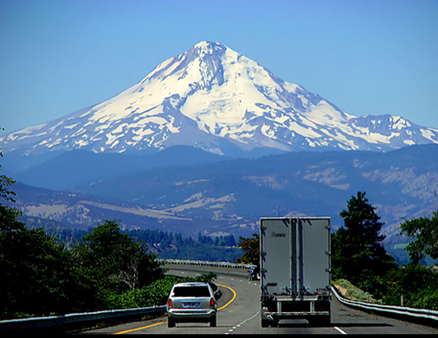

Slide 86
Discussion Questions
1) In addition to the ones discussed about, what are some other assurances that God’s immutability gives to us?
2) Why would an unchanging God do things differently because of prayer?
3) If God does not change then why does He appear to be different in the Old Testament than in the New Testament?

Slide 87
4) How does God’s immutability make us feel more secure as a Christian?
5) If God does not change then how come sometimes I feel more like He loves me and other times I feel more like He is mad at me?
6) If God is always the same then why do so many religions have such different views of God?
7) If God loves us so much then why does He not change? In a marriage, the husband and wife will change to better themselves for the sake of the other person?

Slide 88
Situation
Max has been a fairly steady Christian for a number of years. He has had his ups and downs but has always managed to work through them. For the last several months he has been overwhelmed with a very difficult trial and his faith has wavered. He often says, “God doesn’t love me” even though many of those times he says it in a mildly joking manner. He skips church every once in a while and when he does go he seems uninterested in the singing and sermon. You have been one of his close friends over the years. How can you encourage Max and is there anything regarding God’s immutability that might be especially helpful?

Slide 89
Welcome to
Who is God and
Why Does it Matter to Us?
The Omnipotent God

Slide 90
Introduction
The Eternal God
The Immutable God
The Omnipotent God
The Omniscient God
The Omnipresent God
The Holy God
The Sovereign God
The Divine Love
The Divine Faithfulness
The Divine Comfort

Slide 91
Think of the greatest demonstration of God’s power.
Creation of the universe?
The Resurrection of Jesus Christ and the crushing of Satan?
The final destruction and recreation of the universe?
Job 26:14, “Behold, these are the fringes of His ways.”

Slide 92
Omnipotence
Having all power
Having infinite power
Having all authority
God is not as powerful as He needs to be; He is as powerful as anyone can ever be

Slide 93
Names of God related to His omnipotence
Elohim
Almighty
Lord of Hosts
Lord God Almighty
Consuming Fire
Arm of the Lord
Creator

Slide 94
Holy Spirit
Isaiah 31:3
Now the Egyptians are men and not God,
And their horses are flesh and not spirit

Slide 95
Job 36:5
Behold, God is mighty but does not despise any.

Slide 96
Revelation 20:7-9
^{“7}When the thousand years are completed, Satan will be released from his prison,
⁸and will come out to deceive the nations which are in the four corners of the earth, Gog and Magog, to gather them together for the war; the number of them is like the sand of the seashore.
⁹And they came up on the broad plain of the earth and surrounded the camp of the saints and the beloved city, and…”
“…fire came down from heaven and devoured them.”

Slide 97
Psalm 106:8
“Nevertheless He saved them for the sake of His name, that He might make His power known.”
Why did God want to make His power known?
So that we might worship and glorify Him.
So that we might know the power that is available to us.
So that we might look to Him in trust and obedience.

Slide 98
Psalm 106:13
They quickly forgot His works; they did not wait for His counsel.

Slide 99
Great Evacuations
480 BC when 100,000 people left Athens because of the approaching Persian army
3.75 million people in British cities starting in September 1939 due to World War II
14 million Chinese in July 1998 because of flooding
2.5 million residents fleeing the Houston area from Hurricane Rita

Slide 100
Darkness
Judgment
Oppression
Danger
Light
Forgiveness
Freedom
Safety

Slide 101
Colossians 1:13
“For He delivered us from the domain of darkness, and transferred us to the kingdom of His beloved Son”

Slide 102
Sin is conquered
Romans 5:20
“where sin increased, grace abounded all the more.”
2 Timothy 1:7
“For God has not given us a spirit of timidity, but of power and love and discipline.”

Slide 103
How do we obtain this power?
Prayer
Transforming our minds (Romans 12:2) from defeatism and justification to victory and righteousness
Stepping out of the boat to do what is right

Slide 104
Jeremiah 32:17
“Ah Lord GOD! Behold, You have made the heavens and the earth by Your great power and by Your outstretched arm! Nothing is too difficult for You”
Ephesians 3:20-21
“Now to Him who is able to do far more abundantly beyond all that we ask or think, according to the power that works within us,
²¹to Him be the glory in the church and in Christ Jesus to all generations forever and ever. Amen.”

Slide 105
Our salvation is protected by the power of God
1 Peter 1:3-5
Blessed be the God and Father of our Lord Jesus Christ, who according to His great mercy has caused us to be born again to a living hope through the resurrection of Jesus Christ from the dead,
⁴to obtain an inheritance which is imperishable and undefiled and will not fade away, reserved in heaven for you,
⁵who are protected by the power of God through faith for a salvation ready to be revealed in the last time.

Slide 106
Romans 8:38-39
For I am convinced that neither death, nor life, nor angels, nor principalities, nor things present, nor things to come, nor powers,
³⁹nor height, nor depth, nor any other created thing, will be able to separate us from the love of God, which is in Christ Jesus our Lord.

Slide 107
Our ultimate response to God’s power
Psalm 21:13
“Be exalted, O LORD, in Your strength;
We will sing and praise Your power.”

Slide 108
What does God’s omnipotence mean to us?
We can trust God in tough circumstances

Slide 109
Proverbs 10:12, “Hatred stirs up strife, But love covers all transgressions.”
Proverbs 11:17, “The merciful man does himself good, But the cruel man does himself harm.”
Proverbs 12:28, “He who trusts in his riches will fall, But the righteous will flourish like the green leaf.”

Slide 110
God can accomplish great things in our lives
God’s omnipotence means that numerous people who are enslaved to sins such as alcohol or drugs are able to quit and never return.
God’s omnipotence means that people who were terribly hurt by someone are able to forgive and move on with their lives.
God’s omnipotence means that people who are depressed or have terrible self-worth are able to walk in confidence and victory.
Because God is omnipotent we can echo Paul from Philippians 4:13, “I can do all things through Him who strengthens me.”

Slide 111
“The basic difference between physical and spiritual power
is that men use physical power
but spiritual power uses men.”

Slide 112
We can trust in His promises
Isaiah 41:10, “Do not fear, for I am with you; Do not anxiously look about you, for I am your God. I will strengthen you, surely I will help you, Surely I will uphold you with My righteous right hand”
2 Corinthians 12:9, “My grace is sufficient for you, for power is perfected in weakness”
Psalm 18:2, “The LORD is my rock and my fortress and my deliverer, My God, my rock, in whom I take refuge; My shield and the horn of my salvation, my stronghold”

Slide 113
The future will be exactly as He says in the Bible

Slide 114
Discussion Questions
1) In addition to the ones discussed above, what are some other assurances that God’s omnipotence means to us?
2) If God is so powerful then why does He appear so helpless during some of history’s greatest tragedies such as the Holocaust, World Wars, and a number of genocides?

Slide 115
3) What does it mean to make God our foundation? That sounds good, but how do we do that? How do we in a practical way build upon God’s foundation and not on sand?
4) Why is it important to learn more about God’s attributes? Isn’t it enough just to know that God loves us?

Slide 116
5) If God can do anything that He wants to then why can we read in the Bible about people doing the opposite of what God wants them to do? Why does not He just force them to do what He wants?
6) If God can do anything then why did He have to become a man and die for our sins? Why could He not just decide to forgive anyone that He wants to without having to have gone through all of that in the Gospels?

Slide 117
7) Does not God and Satan do constant battle with God winning sometimes and Satan winning other times?
8) Why do we not see more of God’s miraculous power today?

Slide 118
Situation
Kathy had a rough childhood. She was raised solely by her mother who was verbally abusive. There was always just barely enough food available and oftentimes in the winter the heat was turned off because of non-payment. At an early age Kathy would get drunk a lot to help her cope with this misery. When she was 20 years old Kathy got saved and threw herself wholeheartedly into knowing and serving God. But overcoming her dependence on alcohol has proven to be difficult and she often relapses. What counsel might you give to Kathy to help her out particularly regarding God’s omnipotence?

Slide 119
Welcome to
Who is God and Why Does that Matter to Us?
The Omniscient God

Slide 120
Introduction
The Eternal God
The Immutable God
The Omnipotent God
The Omniscient God
The Omnipresent God
The Holy God
The Sovereign God
The Divine Love
The Divine Faithfulness
The Divine Comfort

Slide 121
What does it mean to be omniscient?
God knows everything
He knows all of the actual
He knows all of the possible
He does not learn
He does not forget
He commits no errors
He makes no mistakes
He knows all thoughts, intentions, and desires
He knows all mysteries and secrets

Slide 122
Of all of God’s infinite knowledge He has chosen to reveal only a tiny sliver of it. So if God revealed something then it is of such vast importance that we should study and learn as much as we can.
Proverbs 25:2
“It is the glory of God to conceal a matter, But the glory of kings is to search out a matter.”

Slide 123
The Crucifixion and Resurrection of Jesus Christ is the only way to salvation
Acts 4:12
"And there is salvation in no one else; for there is no other name under heaven that has been given among men by which we must be saved."

Slide 124
Confidence in how we were created
Psalm 139:13-15
For You formed my inward parts;
You wove me in my mother's womb.
I will give thanks to You, for I am fearfully and wonderfully made;
Wonderful are Your works,
And my soul knows it very well.
My frame was not hidden from You,
When I was made in secret,
And skillfully wrought in the depths of the earth;

Slide 125
Psalm 19:1
The heavens are telling of the glory of God; and their expanse is declaring the work of His hands.

Slide 126
Psalm 139:14
I will give thanks to You, because I am awesomely and wonderfully made; wonderful are Your works, and my soul knows it very well.
We are God’s works.
We are, to the minutest detail, the marvelous handiwork of a loving God. God created each one of us specially and in such a way that we can give Him the most glory.

Slide 127
Fear of sinning
Psalm 139:1-6
¹O LORD, You have searched me and known me.
²You know when I sit down and when I rise up; You understand my thought from afar.
³You scrutinize my path and my lying down, and are intimately acquainted with all my ways.
⁴Even before there is a word on my tongue, behold, O LORD, You know it all.
⁵You have enclosed me behind and before, and laid Your hand upon me.
⁶Such knowledge is too wonderful for me; it is too high, I cannot attain to it.

Slide 128
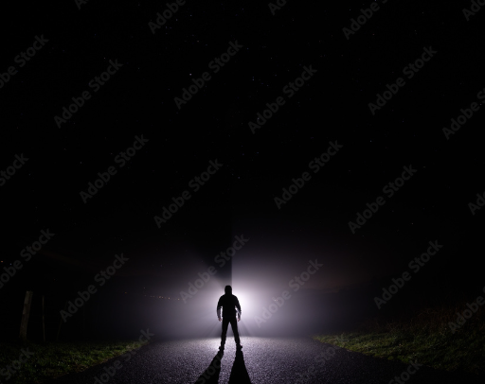

Slide 129
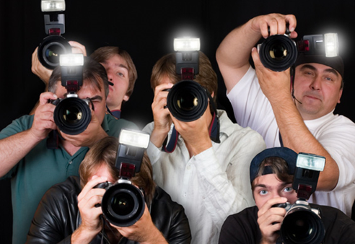

Slide 130
Proverbs 5:21
For the ways of a man are before the eyes of the LORD, And He watches all his paths.
Job 34:21-22
²¹For His eyes are upon the ways of a man, and He sees all his steps.
²²There is no darkness or deep shadow where the workers of iniquity may hide themselves.

Slide 131
God understands and can heal
Psalm 103:14
For He Himself knows our frame; He is mindful that we are but dust.
Because God knows all things
Whatever hurts can be healed
Whoever is grieving can be encouraged
Whoever is weak can be strengthened

Slide 132
Matthew 10:30
But the very hairs of your head are all numbered.

Slide 133
Exodus 3:7
The LORD said, "I have surely seen the affliction of My people who are in Egypt, and have given heed to their cry because of their taskmasters, for I am aware of their sufferings.
8a
So I have come down to deliver them from the power of the Egyptians, and to bring them up from that land to a good and spacious land, to a land flowing with milk and honey

Slide 134
What is sin as defined by God’s omniscience?
When we sin we are saying that we know better than God, that our understanding of what makes us happy is superior to God’s understanding.
Sin is temporary spiritual insanity because we are not, at that moment, correctly perceiving spiritual reality; we are denying God’s revealed truth.

Slide 135

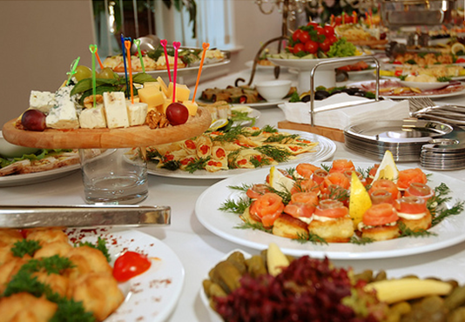


Slide 136
God’s omniscience affects the quality of our eternity
For the saved our good works will be rewarded in Heaven.
Hebrews 6:10
For God is not unjust so as to forget your work and the love which you have shown toward His name, in having ministered and in still ministering to the saints.

Slide 137
For the unsaved it will determine their torment.
Revelation 20:11-13
¹¹Then I saw a great white throne and Him who sat upon it, from whose presence earth and heaven fled away, and no place was found for them.
¹²And I saw the dead, the great and the small, standing before the throne, and books were opened; and another book was opened, which is the book of life; and the dead were judged from the things which were written in the books, according to their deeds.
¹³And the sea gave up the dead which were in it, and death and Hades gave up the dead which were in them; and they were judged, every one of them according to their deeds.

Slide 138
What does God’s omniscience mean to us?
He has wonderful plans for our lives even before we are born
2 Corinthians 2:14
But thanks be to God, who always leads us in His triumph in Christ.

Slide 139
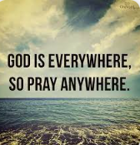
We can pray anytime and anywhere

Slide 140
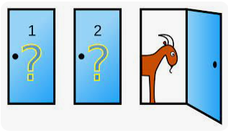
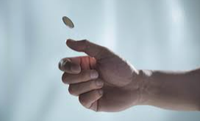
God’s way is always the best possible way

Slide 141
He can heal us deeply and completely.
Jeremiah 8:11
And they heal the brokenness of the daughter of My people superficially, Saying, ‘Peace, peace,’ But there is no peace.
Psalm 147:3
He heals the brokenhearted, and binds up their wounds.

Slide 142
Discussion Questions
1) In addition to the ones discussed above, what are some other assurances that God’s omniscience means to us?
2) If God knows everything then why does He ask people questions in the Bible? Examples are God asking Adam, “Where are you?” (Genesis 3:9), God asking Cain, “Where is Abel your brother?” (Genesis 4:9), and Jesus asking the blind man, “What do you want me to do for you?” (Mark 10:51).

Slide 143
3) If God knows everything then why does He test people? Examples are Abraham and Isaac (Genesis 22), Israel in the wilderness (Deuteronomy 8:2, 16), and Hezekiah (2 Chronicles 32:31).
4) If God truly knows the future then why does not He tell us more about it such as when we will marry or what disaster or victory is imminent.

Slide 144
5) God is omniscient. Jesus is God. Then how could Jesus increase in wisdom (Luke 2:40, “And the Child [Jesus] continued to grow and become strong, increasing in wisdom; and the grace of God was upon Him.”)?
6) If God knows everything then He must have seen ahead of time that sin was going to come into the world. So then why did not He do something to stop it?

Slide 145
7) Does the Devil know our thoughts? Why or why not?
8) How can God know the future when it has not occurred yet?

Slide 146
Situation
Sam had an older brother that he greatly looked up to and who took Sam under his wing. When his brother was 12 years old and Sam was 8 his brother was hit by a car and killed. When Sam was in college he became a born-again Christian but he has always been filled with caution and mistrust towards God. One day you and Sam are sitting together and he looks at you and asks, “If God knows everything and is all powerful then why didn't He stop that car from hitting my brother?” How would you answer Sam and how could you use God’s omniscience in your answer?

Slide 147
Welcome to
Who is God and Why Does that Matter to Us?
The Omnipresent God

Slide 148
Introduction
The Eternal God
The Immutable God
The Omnipotent God
The Omniscient God
The Omnipresent God
The Holy God
The Sovereign God
The Divine Love
The Divine Faithfulness
The Divine Comfort

Slide 149
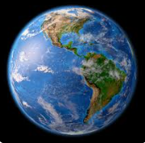

The Earth is about 196,940,400 square miles
Each one of us takes up 10 square feet.

Slide 150
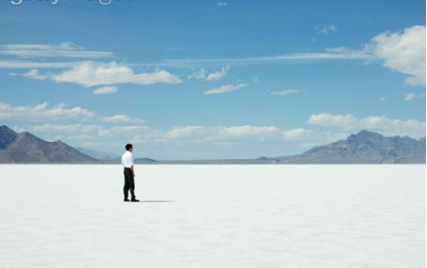
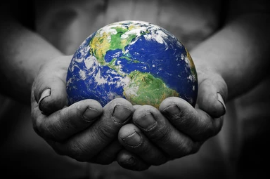
Each person is on 0.00000000000018% of the earth
God is on 100% of the Earth

Slide 151

If we walked 3 mph it would take us 3747 years to walk on every square foot of the Earth
God is on all of it at once

Slide 152
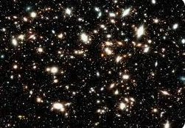
He counts the number of the stars;
He gives names to all of them.
Psalm 147:4
10,000,000,000,000,000,000 stars

Slide 153
1 Kings 8:27
But will God indeed dwell on the earth? Behold, heaven and the highest heaven cannot contain You, how much less this house which I have built!

Slide 154
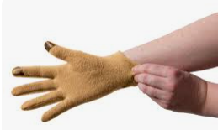
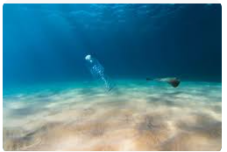
God does not fill the universe like a hand would fill a glove; rather, God fills the universe like the ocean fills a bottle on its bottom.

Slide 155
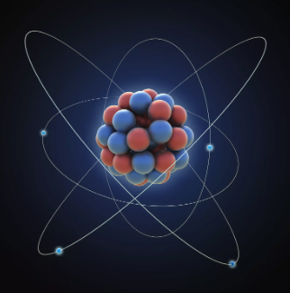
Colossians 1:17
He is before all things, and in Him all things hold together.”

Slide 156

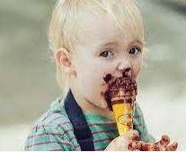
God’s omnipresence vs. the presence of God
Psalm 16:11
You will make known to me the path of life; In Your presence is fullness of joy; In Your right hand there are pleasures forever.

Slide 157

You can be surrounded by people and everyone is ignoring everyone else. Presence does not necessitate intimacy.

Slide 158


Slide 159
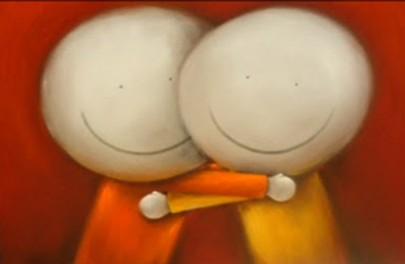
Or there can only be two people but be in a relationship.

Slide 160
We can never escape God’s presence
Jonah 1:3-4
³But Jonah rose up to flee to Tarshish from the presence of the LORD So he went down to Joppa, found a ship which was going to Tarshish, paid the fare and went down into it to go with them to Tarshish from the presence of the LORD.
⁴The LORD hurled a great wind on the sea and there was a great storm on the sea so that the ship was about to break up.

Slide 161
Jeremiah 23:24
Can a man hide himself in hiding places
So I do not see him?" declares the LORD
"Do I not fill the heavens and the earth?" declares the LORD.
Hebrews 4:13
And there is no creature hidden from His sight, but all things are open and laid bare to the eyes of Him with whom we have to do.

Slide 162
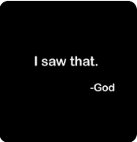

Slide 163
God all around us
God is behind us. He protects us from our past. Isaiah 58:8, “The glory of the LORD will be your rear guard.”
God is above us. He covers us from those who arrogantly stand above us and make accusations. Psalm 91:4, “He will cover you with His pinions, And under His wings you may seek refuge.”
God is in front of us. He goes before us so that we might make right decisions. Isaiah 45:2, “"I will go before you and make the rough places smooth.”
God is under us. He cushions and comforts us when we fall. Deuteronomy 33:7, “The eternal God is a dwelling place, and underneath are the everlasting arms.”
God is to our left and to our right. He guards us from unexpected attacks. Psalm 125:2, “As the mountains surround Jerusalem, so the LORD surrounds His people from this time forth and forever.”

Slide 164
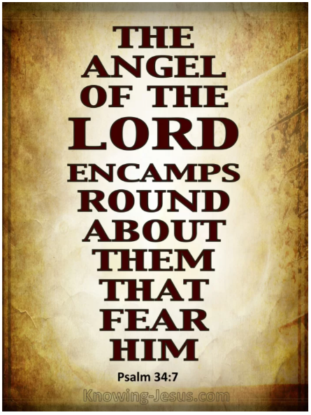

Slide 165
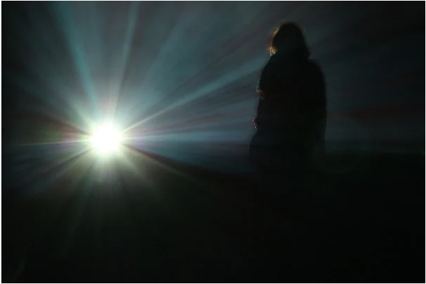
What Does God’s Omnipresence Mean to Us?
Nothing can block out God

Slide 166
He is always with us to the end of the age
Matthew 28:20, “teaching them to observe all that I commanded you; and lo, I am with you always, even to the end of the age.”
He will never leave nor forsake us
Hebrews 13:5, “Make sure that your character is free from the love of money, being content with what you have; for He Himself has said, " I WILL NEVER DESERT YOU, NOR WILL I EVER FORSAKE YOU,"

Slide 167
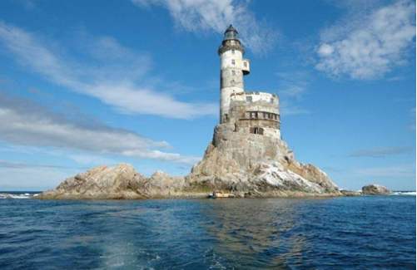
God is not so much a lighthouse that we have to move towards to get out of trouble

Slide 168
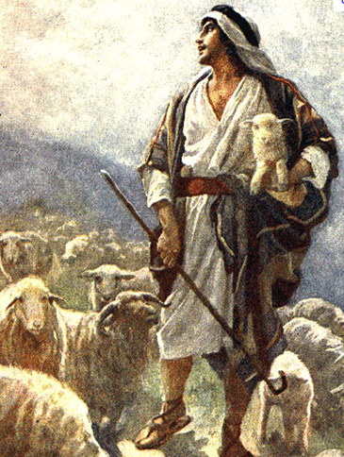
Rather, He is like a shepherd who picks us up and carries us away from danger

Slide 169
Living God’s Presence

Slide 170
Let us occupy ourselves entirely in knowing God. The more we know Him, the more we will desire to know Him. As love increases with knowledge, the more we know God, the more we will truly love Him. We will learn to love Him equally in times of distress or in times of great joy.”
“I cannot imagine how religious persons can live satisfied without the practice of the presence of GOD. For my part I keep myself retired with Him in the depth of centre of my soul as much as I can; and while I am so with Him I fear nothing; but the least turning from Him is insupportable.”
“The King, full of mercy and goodness, very far from chastising me, embraces me with love, makes me eat at His table, serves me with His own hands, gives me the key of His treasures; He converses and delights Himself with me incessantly, in a thousand and a thousand ways, and treats me in all respects as His favorite. It is thus I consider myself from time to time in His holy presence.”
― Brother Lawrence, The Practice of the Presence of God

Slide 171
Zephaniah 3:17
The LORD your God is in your midst, A victorious warrior He will exult over you with joy, He will be quiet in His love, He will rejoice over you with shouts of joy.

Slide 172
Psalm 73:23-24
²³Nevertheless I am continually with You;
You have taken hold of my right hand.
²⁴With Your counsel You will guide me,
And afterward receive me to glory.

Slide 173
Discussion Questions
1) In addition to the ones discussed above, what are some other assurances that God’s omnipresence means to us?
2) If God is everywhere, then why do so many people, including many Christians, feel so abandoned and alone?
3) How does knowing that God is omnipresent help us as we go through life?

Slide 174
4) How will our understanding of God’s relationship to us help us in our relationships with others?
5) If God is all around me and with me then why do not I feel His presence in some special obvious way?
6) Romans 8:9 reads, “However, you are not in the flesh but in the Spirit, if indeed the Spirit of God dwells in you but if anyone does not have the Spirit of Christ, he does not belong to Him.” If God is everywhere then how can someone not have the Spirit of Christ?

Slide 175
7) Matthew 18:20 says, “For where two or three have gathered together in My name, I am there in their midst.” If God is omnipresent then is not He already in our midst all of the time anyway? So what does this verse mean?

Slide 176
Situation
Floyd got saved around a year ago and when he started coming to your church you became friends. Though you know that no one completely cleans up every aspect of their life soon after becoming a Christian you have a suspicion that Floyd still regularly indulges in pornography. You have asked him about it and his reply is always that he used to be heavy into it but that stopped immediately after he got saved. Then one day you are at his house and you notice a pornography magazine that was carelessly left on a table. You notice that it is a recent issue. Just then Floyd walks into the room and sees what you have found. He stammers but cannot explain it away. You ask him to sit down. What will you say to him and how might God’s omnipresence prove to be a deterrent?

Slide 177
Welcome to
Who is God and
Why Does it Matter to Us?
The Holy God

Slide 178
Introduction
The Eternal God
The Immutable God
The Omnipotent God
The Omniscient God
The Omnipresent God
The Holy God
The Sovereign God
The Divine Love
The Divine Faithfulness
The Divine Comfort

Slide 179
To define holiness as an abstinence from sin and a hatred of sin is be half right.
Habbakuk 1:13a
Your eyes are too pure to approve evil, And You can not look on wickedness with favor
Holiness also means to be separate, to be above. It has a sense of supreme excellence.
Exodus 15:11
Who is like Thee among the gods, O LORD? Who is like Thee, majestic in holiness, Awesome in praises, working wonders?
1 Samuel 2:2
There is no one holy like the LORD, Indeed, there is no one besides Thee, Nor is there any rock like our God.

Slide 180
“Holy” is the only attribute of God that is repeated three times in any one place.
Isaiah 6:3
And one called out to another and said," Holy, Holy, Holy, is the LORD of hosts, The whole earth is full of His glory."
Revelation 4:8
And the four living creatures, each one of them having six wings, are full of eyes around and within; and day and night they do not cease to say, "HOLY, HOLY, HOLY is THE LORD GOD, THE ALMIGHTY, WHO WAS AND WHO IS AND WHO IS TO COME."

Slide 181
The Holy One (Acts 2:27)
The Holy One of Israel (Isaiah 49:7)
Blessed and Holy Ruler (1 Timothy 6:15)
Holy Spirit

Slide 182
Psalm 5:3-7
⁴For You are not a God who takes pleasure in wickedness; no evil dwells with You.
⁵The boastful shall not stand before Your eyes; You hate all who do iniquity.
⁶You destroy those who speak falsehood; the LORD abhors the man of bloodshed and deceit.
⁷But as for me, by Your abundant lovingkindness I will enter Your house, At Your holy temple I will bow in reverence for You.

Slide 183




Abortion
about human trafficking
about discrimination
about bullying
about gossip

Slide 184
⁷But as for me,
by Your abundant lovingkindness I will enter Your house,
At Your holy temple I will bow in reverence for You.

Slide 185

To understand holiness we need to understand what sin is
1. "Hamartia" = "To miss the mark", as in archery competition, and therefore fail to receive the prize, or blessing. This is the general Greek word for sin, and is used 221 times. "Hamartia" encompasses the other 6 words for specific sins, in the sense that in all types of sin, we are "missing the mark". Example: Heb. 12:1, "the sin (hamartia) which doeth so easily beset us". We are aiming at God's best, but miss it.

Slide 186

2. "Hettema" = "Diminishing what should have been given full measure". Example: 1 Cor. 6:7, "there is a fault (hettema) among you". Not giving God and all that is related to Him their proper place.

Slide 187

3. "Paraptoma" = "Falling when one should have stood". This is actually an unintentional slip. Example: Eph. 1:7, We have "the forgiveness of sins (paraptoma), according to the riches of His grace".

Slide 188

4. "Agnoeema" = "Ignorance when one should have known". Example: Heb. 9:7, "the errors (agnoeema) of the people". This passage speaks of how the Old Testament was a shadow of the New Testament. Ignorance is no excuse.

Slide 189

5. "Parakoe" = "To refuse to hear and heed God's word". Example: 2 Cor. 10:6, "disobedience". In this passage, Paul urges us to hear God's Word and to bring every thought into captivity for Christ.

Slide 190

6. "Parabasis" = "To intentionally cross a line". Example: Heb. 2:2, "every transgression (parabasis) & disobedience (parakoe) received a just recompense of reward". When God "draws a line in the sand", we can suffer great loss of rewards and blessings by intentionally "stepping over".

Slide 191
7. "Anomia" and "Paranomia" = "Lawlessness, or willfully breaking God's written rules". Example: Titus 2:14 Jesus gave himself for us in order to "redeem us from all iniquity (anomia)". God gives us "rules" so as to bless us, not to curse us.

Slide 192


Slide 193


Slide 194
Sin is an outrage to the holiness of God. It slanders all that God is and all that God says.
2 Peter 3:10
But the day of the Lord will come like a thief, in which the heavens will pass away with a roar and the elements will be destroyed with intense heat, and the earth and its works will be burned up.

Slide 195



The punishment of sin is not so much based on the sin itself but by the quality of what was sinned against.

Slide 196
James 2:10
For whoever keeps the whole law and yet stumbles in one point, he has become guilty of all.

Slide 197


Slide 198
Isaiah 59:2
But your iniquities have made a separation between you and your God, And your sins have hidden His face from you so that He does not hear.

Slide 199



Slide 200


Slide 201
The Wicked Mock God’s Holiness
Psalm 10:11
He says to himself, "God has forgotten; He has hidden His face; He will never see it.”
Galatians 6:7
Do not be deceived, God is no mocked; for whatever a man sows, this he will also reap.

Slide 202
God’s Holiness gives us Security
Numbers 23:19
God is not a man, that He should lie, Nor a son of man, that He should repent; Has He said, and will He not do it? Or has He spoken, and will He not make it good?
2 Corinthians 1:20
For as many as are the promises of God, in Him they are yes; therefore also through Him is our Amen to the glory of God through us.

Slide 203
God wants us to be Holy
1 Peter 1:15-16
but like the Holy One who called you, be holy yourselves also in all your behavior;
because it is written, "YOU SHALL BE HOLY, FOR I AM HOLY."

Slide 204
God’s Holiness is Praised Throughout the Heavens
“Holy, Holy, Holy, is the Lord of Hosts, the whole earth is full of His glory.” (Isaiah 6:3)
Likewise, in the book of the Revelation, the victors proclaim, “who will not fear, O Lord, and glorify They name? For Thou only art holy.” (Revelation 15:4)

Slide 205
What does God’s holy mean to us?
When we are saved we can be assured that our sins are not merely overlooked but are fully paid for.

Slide 206


Slide 207
He expects us to be holy also.
God wants us:
1) To recognize sin
2) To not sin
3) To hate sin
4) When possible, to act against sin
We recognize sin primarily through the Bible, through our conscience, and from other people.
We not sin by controlling what we think, guarding what we take in, and watching our actions. We resist temptation.
We learn to hate sin we understand the consequences of any particular sin and not just focus on its pleasures.
We can act against sin in numerous ways from standing with the oppressed, feeding the hungry, saving the lost, and the list goes on.

Slide 208





We will never need to stop becoming better.

Slide 209
Praise God for His Magnificent Holiness
Psalm 30:4
Sing praise to the LORD, you His godly ones,
And give thanks to His holy name.
Psalm 99:5
Exalt the LORD our God and worship at His footstool;
Holy is He.

Slide 210
Discussion Questions
1) In addition to the ones discussed above, what are some other assurances that God’s holiness means to us?
2) Why is it important to us that God is holy?
3) How can we learn how to hate sin?
4) What are some practical things that we can do to become more holy ourselves?

Slide 211
5) What are some obstacles to a person desiring to be holy?
6) Why, when we first get saved, does God not just make us completely free from sin for the rest of our lives?
7) If we have been doing well overcoming a sin in our lives but then slip up once does that mean that we have to start all over again as though we had not made any previous progress?
8) In my quest to become holy why should I not compare myself to others?

Slide 212
Situation
Jill has been a Christian for quite a while but every once in while when she is confronted by temptation she readily gives in to it and sins. Her explanation is that God promises to always forgive and so once she confesses her sin and repents it is completely wiped out. Therefore, there is no problem and if anyone points out that sin then that person is being judgmental since God no longer remembers it. Keeping in mind God’s holiness, how would you explain to Jill that her reasoning is flawed and that her behavior is destructive?

Slide 213
Welcome to
Who is God and
Why Does it Matter to Us?
The Sovereign God

Slide 214
Introduction
The Eternal God
The Immutable God
The Omnipotent God
The Omniscient God
The Omnipresent God
The Holy God
The Sovereign God
The Divine Love
The Divine Faithfulness
The Divine Comfort

Slide 215
God’s Sovereignty
God is the most important
God has all authority
God sustains all things
God has the right to command, establish laws and standards, exact obedience, and be final judge
God can freely delegate authority as He so pleases
Romans 13:1b, “For there is no authority except from God, and those which exist are established by God.”

Slide 216
Psalm 115:3
But our God is in the heavens; He does whatever He pleases.

Slide 217
Isaiah 46:9-11
⁹"Remember the former things long past,
For I am God, and there is no other;
I am God, and there is no one like Me,
¹⁰Declaring the end from the beginning,
And from ancient times things which have not been done,
Saying, My purpose will be established,
And I will accomplish all My good pleasure';
¹¹Calling a bird of prey from the east,
The man of My purpose from a far country
Truly I have spoken; truly I will bring it to pass.
I have planned it, surely I will do it.

Slide 218
Names of God related to His sovereignty
Adonai (Master or Lord)
The Lord of Hosts
King
King Eternal
King of Kings
King of the Ages
Lord
Lord God Almighty
Lord Jesus Christ
Lord of All
Lord of Glory
Lord of Lords
Lord of our Righteousness

Slide 219
Highest
The Most High God
Shepherd
Chief Shepherd
Great Shepherd
Shepherd of our Souls
Commander
God over All
Head of the Body
Head of the Church
Leader
Lion of the Tribe of Judah
Ruler of God’s Creation
Ruler over Kings of the Earth
Ruler over Israel

Slide 220
Satan is called:
“the ruler of this world” (John 16:11)
“the god of this world” (2 Corinthians 4:4)
“the prince of the power of the air” (Eph. 2:2)
But is it God who is the “great King over all the earth” (Psalm 47:2)

Slide 221
Isaiah 40:15
Behold, the nations are like a drop from a bucket, And are regarded as a speck of dust on the scales; Behold, He lifts up the islands like fine dust.

Slide 222
God’s sovereignty should not be equated with that of earthly kings
An Earthly King | God
From an isolated castle | Is among and in His people
Decrees are best guesses | Decrees are based on omniscience
Enforced by his soldiers and minions | Enforced directly by Himself to each person
May decree laws that benefit only himself | All of His decrees will benefit us
May be corrupt | Is never corrupt
May be overthrown by enemies, by revolutions, or by his own inner circle | Can never be overthrown
Authority is probably shared | Authority is absolute
Spends much of his time maintaining his power | Spends much of His time guiding and perfecting us
Average reign of a medieval king was just over 20 years | Average reign of God is just over an eternity
Daniel 2:21
It is He who changes the times and the epochs; He removes kings and establishes kings; He gives wisdom to wise men and knowledge to men of understanding.

Slide 223
The wicked scorn God’s sovereignty
“How could a loving God let that person suffer and die like that?”
“That guy killed some many people and now he is going to spend the rest of his life in jail with free medical care, a warm bed, and three meals a day. Then he’ll probably die in his sleep. If there is a God then He is certainly unjust.”
“Look at all of the wars, famine, and disasters. Where is God and why doesn’t He do something?”

Slide 224
Lamentations 3:39
Why should any living mortal, or any man, Offer complaint in view of his sins?

Slide 225
Romans 14:11
For it is written,
AS I LIVE, SAYS THE LORD, EVERY KNEE SHALL BOW TO ME,
AND EVERY TONGUE SHALL GIVE PRAISE TO GOD.
Philippians 2:10-11
¹⁰so that at the name of Jesus EVERY KNEE WILL BOW, of those who are in heaven and on earth and under the earth,
¹¹and that every tongue will confess that Jesus Christ is Lord, to the glory of God the Father.

Slide 226
God’s perfect will vs. God’s permissive will
Genesis 19
¹⁷When they had brought them outside, one said, "Escape for your life! Do not look behind you, and do not stay anywhere in the valley; escape to the mountains, or you will be swept away."
¹⁸But Lot said to them, "Oh no, my lords!
¹⁹"Now behold, your servant has found favor in your sight, and you have magnified your lovingkindness, which you have shown me by saving my life; but I cannot escape to the mountains, for the disaster will overtake me and I will die;
²⁰now behold, this town is near enough to flee to, and it is small. Please, let me escape there (is it not small?) that my life may be saved."
²¹He said to him, "Behold, I grant you this request also, not to overthrow the town of which you have spoken.
²²"Hurry, escape there, for I cannot do anything until you arrive there." Therefore the name of the town was called Zoar.

Slide 227
End-time prophecy is assured
Daniel 4:34-35
For His dominion is an everlasting dominion,
And His kingdom endures from generation to generation.
All the inhabitants of the earth are accounted as nothing, But He does according to His will in the host of heaven And among the inhabitants of earth; And no one can ward off His hand
Or say to Him, 'What have You done?'

Slide 228
All Messianic OT prophecies were completely fulfilled in Jesus Christ
His place of birth (Micah 5:2)
The time of birth (Daniel 9:25)
The manner of birth (Isaiah 7:14)
How He was betrayed (Zechariah 11:11-13)
The manner of His Death (Psalm 22:16)
The piercing of His hands, feet and side (Psalm 22, Zechariah 12:10)
The fact that people mocked Him (Isaiah 53, Psalm 22)
How He was buried (Isaiah 53:9)

Slide 229




He found the odds to be 1 in 10¹⁷. To put this in perspective, this many silver dollars would cover the state of Texas two feet deep. Mark only one of these silver dollars. Now blindfold someone and let him parachute and pick only one coin. That this would be the one and only marked coin is the same odds as 1 in 10¹⁷.

Slide 230


George Heron, a French mathematician, calculated that the odds of one man fulfilling only 40 of those prophecies to be 1 in 10¹⁵⁷. The estimated number of electrons in the entire universe is only around 10⁷⁹.

Slide 231
God’s sovereignty means that He can use anyone
2 Corinthians 12:9-10
⁹And He has said to me, "My grace is sufficient for you, for power is perfected in weakness " Most gladly, therefore, I will rather boast about my weaknesses, so that the power of Christ may dwell in me.
¹⁰Therefore I am well content with weaknesses, with insults, with distresses, with persecutions, with difficulties, for Christ's sake; for when I am weak, then I am strong.”

Slide 232
Satan rejected God’s supremacy
Isaiah 14:13-14
¹³"But you said in your heart,
'I will ascend to heaven;
I will raise my throne above the stars of God,
And I will sit on the mount of assembly
In the recesses of the north.
¹⁴'I will ascend above the heights of the clouds;
I will make myself like the Most High.'

Slide 233
Genesis 3:5
For God knows that in the day you eat from it your eyes will be opened, and you will be like God, knowing good and evil.
Romans 1:25
For they exchanged the truth of God for a lie, and worshiped and served the creature rather than the Creator, who is blessed forever. Amen.

Slide 234
We cannot serve two masters
Matthew 6:24
No one can serve two masters; for either he will hate the one and love the other, or he will be devoted to one and despise the other you cannot serve God and wealth.

Slide 235
2 Timothy 2:20-21
²⁰ Now in a large house there are not only gold and silver implements, but also implements of wood and of earthenware, and some are for honor while others are for dishonor. ²¹ Therefore, if anyone cleanses himself from these things, he will be an implement for honor, sanctified, useful to the Master, prepared for every good work.

Slide 236
What are implements of honor? Those who:
Put others above themselves
Are kind and generous to others
Stand with and support the oppressed
Glorify God in their thoughts, motives, and actions
What are implements of dishonor? Those who:
Consider their own wants as more important than other people’s wants
Consider how to get from others
Bully and oppress those who are weaker and more vulnerable
Glorify themselves in their thoughts, motives, and actions

Slide 237
What does God’s sovereignty mean to us?
He is not merely a distant observer.
Jeremiah 23:23 declares
’Am I a God who is near,’ declares the LORD, ‘And not a God far off?’

Slide 238
Joshua 1:9
Have I not commanded you? Be strong and courageous! Do not be terrified nor dismayed, for the Lord your God is with you wherever you go.”

Slide 239
God can direct and control whatever He wants
Romans 8:28 states
And we know that God causes all things to work together for good to those who love God, to those who are called according to His purpose.

Slide 240
We never have to be overcome by Satan or by any other evil or sin.
1 Corinthians 10:13
No temptation has overtaken you except something common to mankind; and God is faithful, so He will not allow you to be tempted beyond what you are able, but with the temptation will provide the way of escape also, so that you will be able to endure it.

Slide 241


Slide 242
Discussion Questions
1) In addition to the ones discussed above, what are some other assurances that God’s sovereignty means to us?
2) If God is sovereign then why do bad things still happen? Does not this mean that He has relinquished at least a little of His power or authority?
3) How does knowing that God is in control help us in our struggles?

Slide 243
4) If God is sovereign then why did He allow sin into the world?
5) If God is in control then why does not He just come back now and set everything straight?
6) What are some ways that we can give God greater control of our lives?
7) Can you think of any examples of God’s sovereignty being demonstrated in any of the people in the Bible?

Slide 244
Situation
George is not a Christian and every time that you try to bring up the Gospel his response is that he would never want to serve a God that allows such horrors as genocide, torture, and war. So if God really is in control, he will say, then He must not care what happens to people and so is not worthy of our worship. The only other option, he will continue, is that God really is not in control and so then how could He guarantee our eternal future? After giving it careful thought, how would you answer George’s contention?

Slide 245
Welcome to
Who is God and
Why Does it Matter to Us?
The Love of God

Slide 246
Introduction
The Eternal God
The Immutable God
The Omnipotent God
The Omniscient God
The Omnipresent God
The Holy God
The Sovereign God
The Love of God
The Faithfulness of God
The Comfort of God

Slide 247
Three types of love
“I love you if…”
This love is conditional on what the other person does.
I love you if you love me back.
I love you if you cook me meals, do my laundry, and clean the house.
I love you if you make a lot of money and make my life comfortable.
“I love you because…”
This love is conditional on what the other person is or has.
I love you because you are attractive.
I love you because you are smart.
I love you because you are funny.

Slide 248
“I love you no matter what”
This love is unconditional. It does not depend on anything regarding the object but only on the source. God is the source and so as long as God is love we will be loved.
God loves us now,
Regardless of what we will become
Regardless of what we are
Regardless of what we were

Slide 249
The Gospel in John 3:16
For God | the greatest lover
so loved | the greatest degree
the world | the greatest number
that He gave | the greatest act
His only begotten | the greatest sacrifice
Son | the greatest gift
that whosoever | the greatest invitation
believes | the greatest simplicity
in Him | the greatest person
shall not perish | the greatest deliverance
but | the greatest difference
have | the greatest certainty
everlasting | the greatest time
life | the greatest possession

Slide 250
Four Greek words for love
Storge (στοργή storgē) Affection
It is natural affection, like that felt by parents for offspring. It is mostly used in the context of relationships within the family. It is considered the most natural because it is the result of familiarity rather than coercion.
Philia (φιλία philía) Friendship
This is a dispassionate virtuous love. It includes loyalty to friends, family, and community, and requires virtue, equality and familiarity. It usually develops between people who share common interests or activities.

Slide 251
Éros (ἔρως érōs) Romance
This is a passionate love, with sensual desire and longing; however, eros does not have to be sexual in nature. Eros can be interpreted as a love for someone whom you love more than the philia, love of friendship. It can also apply to dating relationships as well as marriage. It has a sense of emotional intimacy.
Agápe (ἀγάπη agápē) True, Unconditional Love
Agape is the highest form of love there is. This is an unconditional love for others in spite of their character flaws and weaknesses. It is a difficult love to obtain simply because we are usually concerned more with ourselves and how the world and people around us affect us. Agape is used in 1 Corinthians 13 and is described there and throughout the New Testament as sacrificial love. In the New Testament it describes, amongst other things, the relationship between Jesus and the beloved disciple. Its meaning and usage is illustrated by self-sacrificing, giving love to all--both friend and enemy. It is used in Matthew 22:39, "Love your neighbor as yourself," and in John 15:12, "This is my commandment, that you love one another as I have loved you," and in 1 John 4:8, "God is love."

Slide 252
All of God’s attributes affirm His love
Because God is eternal and so simultaneously exists in all of time, He loves us now as much as He loved us when Jesus was dying on the cross for our sins. He loves us now as much as He loved us in eternally past and will love us in eternity future. There has never been a point in time when God first began to love us.
Because God is omniscient and has always known everything about us, there is nothing that we can say or do that will surprise Him and cause Him to pull away from us.
Because God is immutable He will never change and become bitter or resentful towards us because we are so sinful and foolish.
Because God is holy His love is pure.
Because God is just His love disciplines.
Because God is omnipresent His love is always with us.
Because God is omnipotent His love is inseparable from us.
Because God is infinite His love is limitless.

Slide 253
The cause of salvation
God saves people simply because He wants to. The gratification that God gets from saving someone is deeper and more complex than the benefits that even we receive. What we sometimes see merely as a fact, “I’m saved,” God cherishes.
Song of Solomon 4:9
You have made my heart beat faster, my sister, my bride; You have made my heart beat faster with a single glance of your eyes.

Slide 254

To be without sin is to be pure.
To be pure while having a deep hatred towards sin is to be holy.
To be holy and yet to die in order to pay for another’s sins towards you is to love.
John 15:13
Greater love has no one than this, that one lay down his life for his friends.

Slide 255
Ephesians 2:4-7
⁴But God, being rich in mercy, because of His great love with which He loved us,
⁵even when we were dead in our transgressions, made us alive together with Christ (by grace you have been saved),
⁶and raised us up with Him, and seated us with Him in the heavenly places in Christ Jesus,
⁷so that in the ages to come He might show the surpassing riches of His grace in kindness toward us in Christ Jesus.
We were dead in our sins -> His love made us alive
We were alone -> His love brought us to Christ
We were low -> His love raised us up
We were struggling on the Earth -> His love seated us in Heaven
Our destiny was eternal torment in Hell -> His love will show us the surpassing riches of His grace

Slide 256
God’s unwavering love
Romans 8:32
He who did not spare His own Son, but delivered Him over for us all, how will He not also with Him freely give us all things?

Slide 257
God’s giving
Ephesians 1:3
Blessed be the God and Father of our Lord Jesus Christ, who has blessed us with every spiritual blessing in the heavenly places in Christ.

Slide 258
Galatians 5:22-23
But the fruit of the Spirit is love, joy, peace, patience, kindness, goodness, faithfulness, gentleness, self-control

Slide 259
Psalm 81:9-11
⁹"Let there be no strange god among you;
Nor shall you worship any foreign god.
¹⁰"I, the LORD, am your God,
Who brought you up from the land of Egypt;
Open your mouth wide and I will fill it.
¹¹"But My people did not listen to My voice,
And Israel did not obey Me.

Slide 260
James 4:2b
You do not have because you do not ask.

Slide 261

The cause of our obedience
We do not obey to get God to love and accept us. That is like putting the cart before the horse.

Slide 262

Because God already loves and accepts us, we should obey.
Psalm 116:12
What shall I render to the LORD for all His benefits toward me?

Slide 263
Colossians 2:6
Therefore as you have received Christ Jesus the Lord, so walk in Him.

Slide 264
2 Corinthians 5:14-15
¹⁴For the love of Christ controls us, having concluded this, that one died for all, therefore all died;
¹⁵and He died for all, so that they who live might no longer live for themselves, but for Him who died and rose again on their behalf.

Slide 265
What does God’s love mean to us?
Personalize God’s love
“For God so loved me that He gave His only begotten Son” (John 3:16)
“Because the love of God has been poured out within my heart through the Holy Spirit who was given to me” (Romans 5:5)
“But God demonstrates His own love toward me, in that while I was yet a sinner, Christ died for me” (Romans 5:8)

Slide 266
Discussion Questions
1) In addition to the ones discussed above, what are some other assurances that God’s love mean to us?
2) If God is so loving then why do so many people live in poverty or terrible suffering?
3) If God’s love is unconditional then why do we have to confess our sins?
4) What does the fact that God unconditionally loves you mean to you?

Slide 267
5) Give some practical examples of God’s love in action in your own life.
6) Give some practical examples of how you can love others with God’s love.
7) Why do not trials and miserable circumstances prove that maybe God does not love us right at this moment?
8) Why is it important to personalize God’s love for us? I.e., why is not it good enough to only claim that God’s loves everyone?

Slide 268
9) Why do we sometimes doubt God’s love for us?
10) Are there times when God does not love us? Why or why not?

Slide 269
Situation
Amy has a terrible problem with feeling like she has no value or worth. She hates her appearance and thinks that everyone looks down on her. She was picked on while growing up both in school and by her parents. As a result, she struggles in her Christian walk since she does not think that she can do anything that anyone or even God will find useful. What are some things that you can say to encourage her and give her a new and victorious outlook on herself all the while emphasizing God’s love?

Slide 270
Welcome to
Who is God and
Why Does it Matter to Us?
The Faithfulness of God

Slide 271
Introduction
The Eternal God
The Immutable God
The Omnipotent God
The Omniscient God
The Omnipresent God
The Holy God
The Sovereign God
The Love of God
The Faithfulness of God
The Comfort of God

Slide 272
The faithfulness of God means that God will never desert us nor forsake us.
It means that He will stick by us whether we are doing well or doing poorly, whether we are on the top of the spiritual mountain or down in the valley.
God is always available.
Walter Winchell said, “A real friend is one who walks in when the rest of the world walks out.”

Slide 273
God’s Faithfulness is a necessity
Romans 3
We are unrighteous
We do not seek for God
We are useless
We do not do good
We are deceitful
We do not fear God
We are sinners
Ephesians 2
We are dead in our sins
We live in the lusts of our flesh
We are by nature children of wrath

Slide 274



Slide 275
God will always receive us back
Psalm 73
²¹When my heart was embittered
And I was pierced within,
²²Then I was senseless and ignorant;
I was like a beast before You.
²³Nevertheless I am continually with You;
You have taken hold of my right hand.

Slide 276
If God accepted us as unforgiven sinners then what would induce Him to leave us as forgiven saints?
God is infinitely invested in us; He bought us with His Son.

Slide 277
1 John 1:9
If we confess our sins, He is faithful and righteous to forgive us our sins and to cleanse us from all unrighteousness.

Slide 278


Slide 279
Do you sometimes think that God has abandoned you?
Do you wonder if you might have lost your salvation?
Do you sometimes think that you’ve been so bad that God no longer loves you?
Then study and mediate on God’s faithfulness. It will change your life.

Slide 280
We will be brought to Heaven
1 Corinthians 3:11-15
¹¹For no man can lay a foundation other than the one which is laid, which is Jesus Christ.
¹²Now if any man builds on the foundation with gold, silver, precious stones, wood, hay, straw,
¹³each man's work will become evident; for the day will show it because it is to be revealed with fire, and the fire itself will test the quality of each man's work.
¹⁴If any man's work which he has built on it remains, he will receive a reward.
¹⁵If any man's work is burned up, he will suffer loss; but he himself will be saved, yet so as through fire.

Slide 281
Security of our relationship
2 Timothy 2:13
If we are faithless, He remains faithful, for He cannot deny Himself.
Our Security of Salvation = (My character x 0%) + (God’s character x 100%)
Our Security of Salvation = God’s character

Slide 282
Hebrews 13:5
“I WILL NEVER DESERT YOU, NOR WILL I EVER FORSAKE YOU.”
1 John 5:13
These things I have written to you who believe in the name of the Son of God, so that you may know that you have eternal life.

Slide 283
Philippians 1:6
For I am confident of this very thing, that He who began a good work in you will perfect it until the day of Christ Jesus.

Slide 284
Hebrews 6:4-6
⁴For in the case of those who have once been enlightened and have tasted of the heavenly gift and have been made partakers of the Holy Spirit,
⁵and have tasted the good word of God and the powers of the age to come,
⁶and then have fallen away, it is impossible to renew them again to repentance, since they again crucify to themselves the Son of God and put Him to open shame.

Slide 285
Matthew 7:21-23
21 “Not everyone who says to Me, ‘Lord, Lord,’ will enter the kingdom of heaven, but the one who does the will of My Father who is in heaven will enter.
22 Many will say to Me on that day, ‘Lord, Lord, did we not prophesy in Your name, and in Your name cast out demons, and in Your name perform many miracles?’
23 And then I will declare to them, ‘I never knew you; leave Me, you who practice lawlessness.’

Slide 286
We can always have joy
John 15:11
These things I have spoken to you so that My joy may be in you, and that your joy may be made full.

Slide 287

Psalm 91:2
I will say to the LORD, "My refuge and my fortress, My God, in whom I trust!”

Slide 288

God is faithful in providing us with opportunities for persecution and affliction
Psalm 119:67, 75
Before I was afflicted I went astray, But now I keep Your word.
I know, O LORD, that Your judgments are righteous, And that in faithfulness You have afflicted me.

Slide 289
Escape from temptation
1 Corinthians 10:13
No temptation has overtaken you but such as is common to man; and God is faithful, who will not allow you to be tempted beyond what you are able, but with the temptation will provide the way of escape also, so that you will be able to endure it.

Slide 290
Proverbs 7:22
Suddenly he follows her As an ox goes to the slaughter, Or as one in fetters to the discipline of a fool.

Slide 291




Slide 292
2 Timothy 4:18
The Lord will rescue me from every evil deed, and will bring me safely to His heavenly kingdom; to Him be the glory forever and ever. Amen.

Slide 293
What does God’s faithfulness mean to us?
He is in the details of our lives.
John 15:15
No longer do I call you slaves, for the slave does not know what his master is doing; but I have called you friends, for all things that I have heard from My Father I have made known to you.

Slide 294
God is always ready and available to comfort and protect
Psalm 91:4
He will cover you with His pinions, And under His wings you may seek refuge; His faithfulness is a shield and bulwark.

Slide 295
Lamentations 3:20-23
²⁰Surely my soul remembers
And is bowed down within me.
²¹This I recall to my mind,
Therefore I have hope.
²²The LORD'S lovingkindnesses indeed never cease, For His compassions never fail.
²³They are new every morning;
Great is Your faithfulness.

Slide 296
Discussion Questions
1) In addition to the ones discussed above, what are some other assurances that God’s faithfulness means to us?
2) How does knowing that God is faithful help us through difficult times?
3) Is God still faithful to us when we are in sin or does He leave us only to return when we repent?
4) What are some ways that God has proven His faithfulness to you personally?

Slide 297
5) Who are some people in the Bible that God proved His faithfulness to?
6) If God is so faithful then how come some people claim that in their darkest hour they felt as though God were not there at all?
7) If God has promised to be faithful no matter what then why cannot we use that as an excuse to do whatever we want?
8) What is the difference between God’s faithfulness (God will never leave nor forsake us) and God’s omnipresence (God is everywhere)?
9) What are some practical ways that we can be faithful to other people the way that God is faithful to us?

Slide 298
Situation
Elizabeth’s father abandoned her family when she was eight years old. As a result she has had a hard time keeping friends. When she feels that someone is getting too close to her she will say harsh things to that person and become distant. She is often lonely and many times it is obvious that she longs for a close friendship. You have been getting close to her and you are starting to see her doing the same thing to you. The other day she insulted your clothes and you have left several friendly but unanswered messages in the last two weeks. When you started to get to know her you knew that she is like this and you promised yourself that you would stick it out and show her that you are a loyal friend. You know that she is hurting and that her behavior is a defense mechanism to avoid being hurt, but it is difficult to endure the growing insults and cold shoulder. You decide that rather then pull away from her like everyone else you will talk to her. What will you say to her and can you incorporate God’s faithfulness into your discussion?

Slide 299
Welcome to
Who is God and
Why Does it Matter to Us?
The Comfort of God

Slide 300
Introduction
The Eternal God
The Immutable God
The Omnipotent God
The Omniscient God
The Omnipresent God
The Holy God
The Sovereign God
The Love of God
The Faithfulness of God
The Comfort of God

Slide 301
Jesus can relate to our pain because He has experienced it Himself
Hebrews 4:15-16
¹⁵For we do not have a high priest who cannot sympathize with our weaknesses, but One who has been tempted in all things as we are, yet without sin.
¹⁶Therefore let us draw near with confidence to the throne of grace, so that we may receive mercy and find grace to help in time of need.

Slide 302
Loneliness: Matthew 26:46, “About the ninth hour Jesus cried out with a loud voice, saying," ELI, ELI, LAMA SABACHTHANI?" that is, "MY GOD, MY GOD, WHY HAVE YOU FORSAKEN ME?”
Temptation: Matthew 4:1, “Then Jesus was led up by the Spirit into the wilderness to be tempted by the devil.”
Death of close relative/friend: Matthew 14:11-13, “And his head was brought on a platter and given to the girl, and she brought it to her mother. His disciples came and took away the body and buried it; and they went and reported to Jesus. Now when Jesus heard about John, He withdrew from there in a boat to a secluded place by Himself…”
Physical pain: Matthew 27:35, “And when they had crucified Him…”

Slide 303
Betrayal by a close friend: Matthew 26:47-48a, “While He was still speaking, behold, Judas, one of the twelve, came up accompanied by a large crowd with swords and clubs, who came from the chief priests and elders of the people. Now he who was betraying Him gave them a sign…”
Falsely accused: Matthew 26:59, “Now the chief priests and the whole Council kept trying to obtain false testimony against Jesus, so that they might put Him to death.”
Abandonment by friends: Matthew 26:71-72, “When he had gone out to the gateway, another servant-girl saw him and said to those who were there, ‘This man was with Jesus of Nazareth.’ And again he denied it with an oath, "I do not know the man."
Financial loss/homelessness: Matthew 8:20, “Jesus said to him, ‘The foxes have holes and the birds of the air have nests, but the Son of Man has nowhere to lay His head.’”

Slide 304
Isaiah 53:3-5
³He was despised and forsaken of men,
A man of sorrows and acquainted with grief;
And like one from whom men hide their face
He was despised, and we did not esteem Him.
⁴Surely our griefs He Himself bore,
And our sorrows He carried;
Yet we ourselves esteemed Him stricken,
Smitten of God, and afflicted.
⁵But He was pierced through for our transgressions,
He was crushed for our iniquities;
The chastening for our well-being fell upon Him,
And by His scourging we are healed.
The Man of Sorrows has become the God all comfort.

Slide 305
All of God’s attributes intensify the magnificence of His comfort
Because God is omniscient He knows the deepest and most intimate details of our lives. This includes our thoughts, hopes, desires, and feelings. Therefore, He is able to fully understand what we are going through. But not only does He understand the pain, but He also knows the perfect solution.
Because God is omnipotent there is no pain too deep or too complex that He cannot heal. His arm is not too short to save; therefore, it is not too short to heal.
Because God is eternal He knew our sorrows from time past and has a solution for all time in the future.
Because God is immutable His desire for our well-being will never change.
Because God is love He will always have deep concern for us. He will never toy with us or be glad to see us suffer because we deserve it.

Slide 306
Our source of comfort is God
In Psalm 143, David speaks of a number of anguishes.
He was persecuted.
His life was crushed.
He was dwelling in dark places.
He was like one long dead.
His spirit was overwhelmed.
His heart was appalled.
His spirit was failing.
His enemies were after him.

Slide 307
Verse 6, “I stretch out my hands to You; My soul longs for You, as a parched land.”
The thirsty soul will find no greater satisfaction than in that of its God.
The best that the world has to offer is escape; God offers Himself.
The world scorns weakness; God uses it.
The world encourages us to complain about our misery; God tells us to focus on His greatness.
We love self-pity; God wants self-denial.

Slide 308
Psalm 34:18, “The Lord is near to the brokenhearted.”
Psalm 40:17, “Since I am afflicted and needy, the Lord is mindful of me; Thou art my help and my deliverer; do not delay, O my God.”
Psalm 147:3, “He heals the brokenhearted, and binds up their wounds.”
Isaiah 57:15, “’I dwell on a high and holy place and also with the contrite and lowly of spirit in order to revive the heart of the contrite.’”
Jeremiah 17:14, “Heal me, O Lord, and I will be healed; save me and I will be saved, for Thou art my praise.”

Slide 309


Slide 310
How to receive God’s comfort
Jeremiah 16:14
They have healed the brokenness of My people superficially, Saying, “Peace, peace,” But there is no peace.

Slide 311



Slide 312
How to receive God’s comfort
Humility
1 Peter 5:6-7
⁶Therefore humble yourselves under the mighty hand of God, that He may exalt you at the proper time,
⁷casting all your anxiety on Him, because He cares for you.

Slide 313
Humility means what?
Not demanding that God do something right now
Not telling God how He must remedy the situation
Not focusing on “Why me?” and playing the victim card
Telling people about the pain so that they might prayer, support, encourage, and help but not telling them so that you might be the center of attention
Not despising yourself because you are weak and vulnerable or because you make mistakes or because you let your emotions get the best of you

Slide 314
Psalm 103:14
For He Himself knows our form; He is mindful that we are nothing but dust.
2 Corinthians 12:9
For power is perfected in weakness

Slide 315
If we do not understand the “why” of a situation then it becomes more necessary to understand the “Who.” Understanding the “why” of a trial is limited to that one situation. But understanding God applies to all situations.
Isaiah 51:12, “I, even I, am He who comforts you…”

Slide 316
Prayer
Philippians 4:6-7
⁶Be anxious for nothing, but in everything by prayer and supplication with thanksgiving let your requests be made known to God.
⁷And the peace of God, which surpasses all comprehension, will guard your hearts and your minds in Christ Jesus.

Slide 317
Recovery comes mainly through growth and not rescue
Our faith may not be big enough to move a mountain, but it is always big enough to move God.
Hosea 5:15
In their affliction they will earnestly seek me.”

Slide 318
John 5:1-9
¹After these things there was a feast of the Jews, and Jesus went up to Jerusalem.
²Now there is in Jerusalem by the sheep gate a pool, which is called in Hebrew Bethesda, having five porticoes.
³In these lay a multitude of those who were sick, blind, lame, and withered, [waiting for the moving of the waters;
⁴for an angel of the Lord went down at certain seasons into the pool and stirred up the water; whoever then first, after the stirring up of the water, stepped in was made well from whatever disease with which he was afflicted.]
⁵A man was there who had been ill for thirty-eight years.
⁶When Jesus saw him lying there, and knew that he had already been a long time in that condition, He said to him, "Do you wish to get well?"
⁷The sick man answered Him, "Sir, I have no man to put me into the pool when the water is stirred up, but while I am coming, another steps down before me."
⁸Jesus said to him, "Get up, pick up your pallet and walk."
⁹Immediately the man became well, and picked up his pallet and began to walk. Now it was the Sabbath on that day.

Slide 319


Slide 320
The intimacy of healing

Slide 321
In Mark 5 a 12-year old girl had died. When Jesus arrived at the official’s house there was a commotion. There were relatives and friends and, as in the tradition of the times, mourners hired to weep and wail.
Mark 5:40, “He took the child's father and mother and the disciples who were with him, and went in where the child was.”
But Jesus put them all out and only took with Himself the child’s father and mother and His three companions. And in the silence of the room He took the child’s hand and spoke and the child rose up alive.

Slide 322


Slide 323
Healing and then giving
2 Chronicles 32:25
But Hezekiah's heart was proud and he did not respond to the kindness shown him.

Slide 324
James 4:3
When you ask, you do not receive, because you ask with wrong motives…
that you may spend what you get on your pleasures.

Slide 325
2 Corinthians 1:3-5
³Blessed be the God and Father of our Lord Jesus Christ, the Father of mercies and God of all comfort,
⁴who comforts us in all our affliction so that we will be able to comfort those who are in any affliction with the comfort with which we ourselves are comforted by God.
⁵For just as the sufferings of Christ are ours in abundance, so also our comfort is abundant through Christ.

Slide 326
God can use many means to heal
Counseling: Professional, Pastoral, and from other Christians
A Christian book
Deliverance through our own efforts: God did deliver the Israelites from Egypt but they played a big part in making that happen
The Bible
By us changing our attitude
Through our own efforts to change the situation: ex. Making our work environment more righteous
We forgive

Slide 327
Exodus 4:31
“So the people believed; and when they heard that the LORD was concerned about the sons of Israel and that He had seen their affliction, then they bowed low and worshiped.”

Slide 328
Discussion Questions
1) In addition to the ones discussed above, what are some other assurances that God’s comfort means to us?
2) Why do we find it easy to blame God for difficult circumstances?
3) God does not physically hug us or whisper audible words of encourage in our ears. So what are some ways that we can actually experience the comfort of God?
4) What are some ways that we can comfort others?

Slide 329
5) Why is it that sometimes when we are in the lowest point of a trial that we do not seem to feel the comfort of God at all?
6) How do our own afflictions enable us to better comfort other people?
7) In the Bible, what are ways in which God comforted some people?
8) Why is God so able to perfectly comfort us?

Slide 330
9) If someone is in a tough situation that is entirely their own doing then when should we offer them comfort and when should we admonish them? Feel free to compose your own example of such a situation and how you would respond to it.
10) What are some ways of how we might willfully or unconsciously refuse God’s comfort?

Slide 331
Situation
You oversee the “Mercy Ministry” which responsibilities include hospital visits, encouraging the discouraged and fainthearted, going to the homes of the incapacitated and helping out, and listening to those who need support. Todd is someone who views emotions as a weakness and whose response to everything is to either repent or to “just do something about it.” Inexplicably, he just joined your ministry. You are concerned that he will be overbearing and overwhelm those who are tottering, but you do not want to discourage his desire to serve. So you take him aside to give him some examples of situations where people might need comfort, encouragement, and support and what you would do for them and say to them. What might you say?

Slide 332
www.disciplescorner.com

